Slide 1

People and Qualifications
Skills Supply
Edinburgh and South East Scotland LMI Toolkit
Skills Development Scotland 2020-2021
Notes:
These slides highlight SDS Labour Market Information (LMI) and Other Trusted Sources of LMI.
They can be used and adapted to help you turn LMI into CMI – Career Management information
Please use the NOTES throughout.

Slide 2


The Edinburgh and South East Scotland LMI Toolkit
The purpose of the three slide decks included within the LMI Toolkit is to aid your understanding of Labour Market Information.
These slide decks operate as an information pack to assist your interpretation and understanding of labour market indicators and to allow you to explore labour market data independently as it emerges.
Please note that the slide decks do not provide up to date, real time information.
The slide decks have been populated with sample data and only reflect a specific moment in time. You are encouraged to use the sources provided within the notes to access the most up to date data from SDS publications, such as the RSA Data Matrix, Regional Skills Assessments and the Sector Skills Assessments.
You can also use the interactive ESES LMI Map to identify any relevant labour market publications that may support your understanding of wider changes in the labour market.
Please use the notes provided as you work your way through the slide decks to assist your learning and identify the relevant sources.

Slide 3
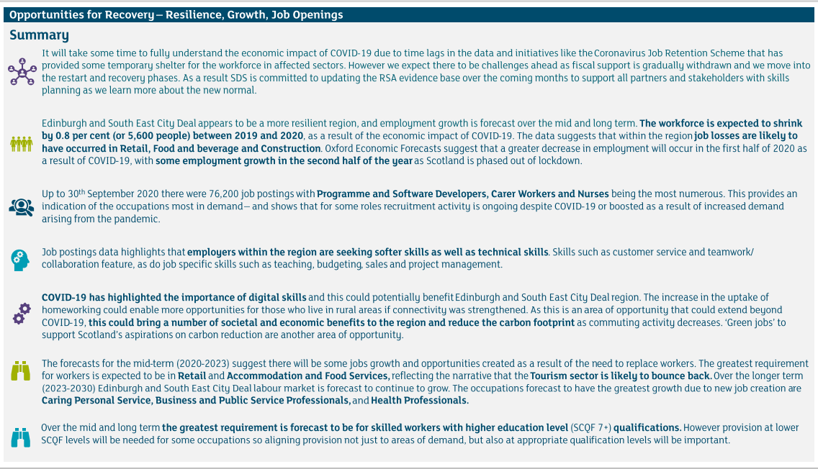
Edinburgh and South East Scotland Summary

Slide 4







Contents
Skills Supply
The Annual Participation Measure (APM)
School Leaver Attainment/ School Leaver Destinations
Vocational Qualifications
College and University Leaver Destinations
SCQF Framework
‘Pathways’ search tool
Please use the notes contained under each slide to assist the reading of this slide pack and use the ‘SOURCE’ in the notes to find additional data.
Notes:
These Labour Market Information (LMI) to Career Management Information (CMI) slides operate as an LMI Toolkit for the Edinburgh and South East Scotland City Region to help you find and interpret evidence that can enhance Careers Information, Advice and Guidance (CIAG) delivery.
The slide pack will introduce LMI use within the skills planning landscape. The purpose of this slide deck is to provide you with an introduction to the use of LMI and evidence in skills planning and provision, and to support you in your own use of the data and how it informs your everyday practice.
This Toolkit will use data from the Edinburgh and South East of Scotland City Region in the examples. It is important to note that data is update and renewed frequently and so the insight contained within this Toolkit may not be up to date. It is for this reason that you should use Toolkit to develop your understanding so that you can interpret the most up to date LMI available at the linked and recommended sources.

Slide 5





Skills Supply
Example 1 - Skills Supply Edinburgh and South East of Scotland
What is Skills Supply?
Skills supply refers to the supply of people within the labour market. To analyse skills supply we can look at the demographics of a population such as the number of people of working age.
In some cases, we may wish to look at forecasts such as population projections to give us an indication of future labour supply across a region.
We can also look at participation rates to see where people aged 16-19 are in the learner journey.
It is also important to consider unemployment rates, when looking at skills supply, as this can give not only give an indication of the pool of potential labour in a region, but also an overview of the health of the labour market.
Total Population 2018:
Edinburgh and South East Scotland
1,385,000
Forecast change 2018 to 2043:
Edinburgh and South East Scotland:
126,000
9.1%
Working Age Population 2018:
Edinburgh and South East Scotland
898,700
Forecast change 2018 to 2043:
Edinburgh and South East Scotland:
64,300
7.2%
Notes:
We can look at the age of individuals within a region (demographics) to understand the skills supply. For example, if we have a high number of young people (0-15) and a higher number of older people (65+), we have a lot of individuals in the population that might not be working. This means that we do not have huge pool of labour to draw from to fill opportunities in the labour market. This would cause labour market challenges.
Rural regions, such as the Scottish Borders have historically had issues of talent retention, whereby adolescents and young adults migrate out of the region to other densely populated areas in search of training, education or employment opportunities. This means that there is a high number of people in the region who no longer work, and a low number of people of working age.
Sources:
National Records of Scotland (2020) Mid-2019 Population Estimates Scotland, available online: https://www.nrscotland.gov.uk/statistics-and-data/statistics/statistics-by-theme/population/population-estimates/mid-year-population-estimates/mid-2019
Skills Development Scotland (2021) Regional Skills Assessments: Edinburgh and South East City Deal, available online: https://www.skillsdevelopmentscotland.co.uk/what-we-do/skills-planning-alignment/regional-skills-assessments/

Slide 6


Demographics
Dependency Ratio: The dependency ratio considers the non working age population in comparison to the working age population. A ratio of 54% would mean that for every 1,000 people of working age, there were 540 of non working age. A high dependency ratio will increase the demands on public services and the funds available to provide them i.e. taxes and national insurance.
Example 2 - Dependency Rations: Edinburgh and South East Scotland
Dependency Ratio and Demographics in Edinburgh and South East Scotland in 2043
Dependency ratio for Edinburgh and South East Scotland:
2018: 54%
2043: 62%
Dependency ratio for Scotland:
2018: 56%
2043: 66%
Notes:
We can use current population data, and population projection insight to forecast future dependency rations by calculating the number of people of people of non-working age, dependant on the number of people of working age (16-64).
A region with a high dependency ratio will result in increased strain on the labour market and individuals of working age.
Sources:
National Records of Scotland (2020) Mid-2019 Population Estimates Scotland, available online: https://www.nrscotland.gov.uk/statistics-and-data/statistics/statistics-by-theme/population/population-estimates/mid-year-population-estimates/mid-2019
National Records of Scotland (2020) Projected Population of Scotland (2018-based), available online: https://www.nrscotland.gov.uk/statistics-and-data/statistics/statistics-by-theme/population/population-projections/population-projections-scotland/2018-based

Slide 7





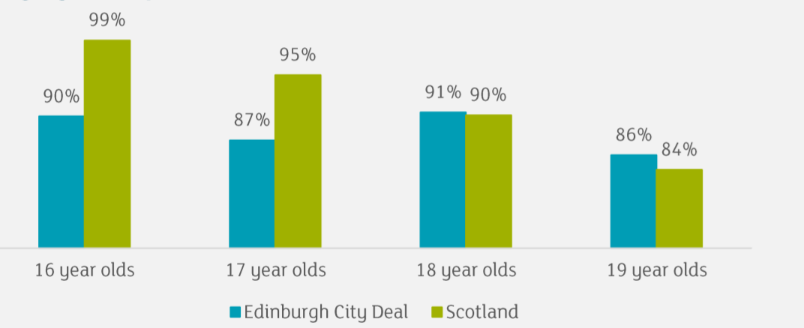

The Annual Participation Measure
Participating in Education, Training and Employment: Example 3 – Edinburgh and South East Scotland
The Annual Participation Measure – Percentage of young adults participating in education, training or employment.
This outlines the percentage of 16-19 year olds participating or not participating in education, training or employment compared to the Scottish average.
The Annual Participation Measure (2020)
Education:
Edinburgh and South East Region 71%
Scotland: 72%
Employment:
Edinburgh and South East Region 20%
Scotland: 18%
Training and Development
Edinburgh and South East Region: 2%
Scotland: 2%
Of those participating in Edinburgh and South East City Region:
49% Female
51% Male
Percentage of participation in education, training or employment by
Age Group:
Notes:
Skills Development Scotland publishes the Annual Participation Measure (APM), with records drawn from their internal Customer Support System (CSS). This measure is now part of the Scottish Government’s National Performance Framework as the measure of young peoples participation within the skills system and labour market. The APM can be defined as the “percentage of young adults (16-19 year olds) participating in education, training or employment”.
We can use the annual participation measure to identify where young people are within the skill system, and to gauge their participation. SDS publishes the APM tool which can provide breakdowns by age, and local authority. It also includes insight on equalities issues such as the status of individuals from areas identified in the Scottish Index of Multiple Deprivation (SIMD).
We can see from the slides that the 18-19 year olds have a lower rate of participation than 16-17) however this is largely due to ‘unconfirmed’ data as individuals become more difficult to reach, i.e. not in school, move away from home etc.
*Not participating includes those who are unemployed and actively seeking employment, education or training and unemployed not seeking.
Not on the slide - Individuals from the least deprived areas are more likely to stay in school, whereas different types of provision and training becomes important for individuals from the most deprived areas.
Sources:
Skills Development Scotland (2020) Annual Participation Measure, available online: https://www.skillsdevelopmentscotland.co.uk/publications-statistics/statistics/annual-participation-measure/?page=1&statisticCategoryId=7&order=date-desc
SOURCES:
Skills Development Scotland (2020) Annual Participation Measure (Statistics), available online at: https://www.skillsdevelopmentscotland.co.uk/publications-statistics/statistics/annual-participation-measure/?page=1&statisticCategoryId=7&order=date-desc

Slide 8

School Leaver Attainment
In 2020, almost 98% of last years school leavers in Scotland left with one or more SCQF level 3 or above.
95.8%
SCQF 4
85.7% SCQF 5
63.9% SCQF 6
23.2%
SCQF 7
Across Edinburgh and South East Scotland 98.3% of last years school leavers left with one or more SCQF level 3 or above:
95.5%
SCQF 4
82.9% SCQF 5
61.3% SCQF 6
24.3%
SCQF 7
Notes:
School leaver attainment
The labour market is constantly changing, shaped by supply and demand. School leavers are a valuable part of that ‘labour supply’ but to find their place in the labour market they need to recognise both what they have to offer – skills, qualification, attitude - and investigate what labour market demand they could fill.
We can use school leaver attainment data to identify the level of education young people are leaving school with. Young people with higher attainment levels are more likely to go into positive destinations. We can view attainment data by local authority and the Scottish Index of Multiple Deprivation (SIMD).
Not on the slide: The 2018-19 data provides individuals from the most deprived areas in Scotland have a lower number of qualification attainments across SCQF level 5 to 7. For example across Scotland, there were 3,191 individuals with at least one of more qualifications at SCQF level 7 from the least deprived areas in Scotland, compared to 920 individuals from the most deprived areas in Scotland.
At a more granular level, the same can be said as true across the 6 local authorities in the Edinburgh city region. Looking at information like this allows us to understand the social context of skills and education. Knowing this allows us to help individuals in the labour market explore options available to them and try to best quip them with the qualifications they need to enter the labour market, and for us to provide support to individuals who might need it most.
SOURCES:
Scottish Government (2021) Summary Statistics for Attainment and Initial Leaver Destinations, No.3: 2021 Edition, available online at: https://www.gov.scot/publications/summary-statistics-attainment-initial-leaver-destinations-no-3-2021-edition/

Slide 9



School Leaver Destinations
School Leaver Destinations: Example 4 – Edinburgh and South East Scotland
In 2019/20 across the Edinburgh and South East Scotland there was 11,083 School Leavers:
These destinations can be broken down as follows:
Higher Education
Edinburgh and South East Scotland: 41%
Scotland: 44.2%
Further Education
Edinburgh and South East Scotland: 30%
Scotland: 28.1%
Employment
Edinburgh and South East Scotland: 17%
Scotland: 16.2%
Training or Voluntary Work
Edinburgh and South East Scotland: 4%
Scotland: 4%
Unemployed
Edinburgh and South East Scotland: 6%
Scotland: 6%
94.9%
were in positive destinations 3 months after leaving school.
Across Scotland were in positive destinations 3 months after leaving school.
93.3%
At a Scotland level:
Females (94.6%) were more likely than males (92.1) to be in a positive initial destination.
Students with additional support needs were less likely to be in a positive destination than those without (89.6%).
Students from ethnic minority groups were on average less likely to be in a positive destination (70.2%).
Notes:
We can look at school leaver destinations to assess the impact of labour market interventions that aim to support young people into positive destinations within the labour market.
School leavers who are engaged in higher education, further-education, training, voluntary work, employment or activity agreements are classified as having a ‘positive destination’.
The initial (3 months after the individual has left school) school leaver destinations are shown on the slide. There is also a follow-up data set that identifies where individuals are 6 months after they leave school:
In Edinburgh and South East Scotland, the follow-up destination finds that 92.6% of individuals were in positive destinations This is marginally lower than the follow-up destinations for Scotland at 92.9%.
Not on the slide: As the figures show, the follow up destination rates are lower than the initial leaver destinations. This is because some destinations are more sustainable than others. For example, those that go into higher education or employment are more likely to stay there for 6 months, than those that go into training or voluntary work.
SOURCE:
Scottish Government (2021) Summary Statistics for Attainment and Initial Leaver Destinations, No.3: 2021 Edition, available online at: https://www.gov.scot/publications/summary-statistics-attainment-initial-leaver-destinations-no-3-2021-edition/

Slide 10
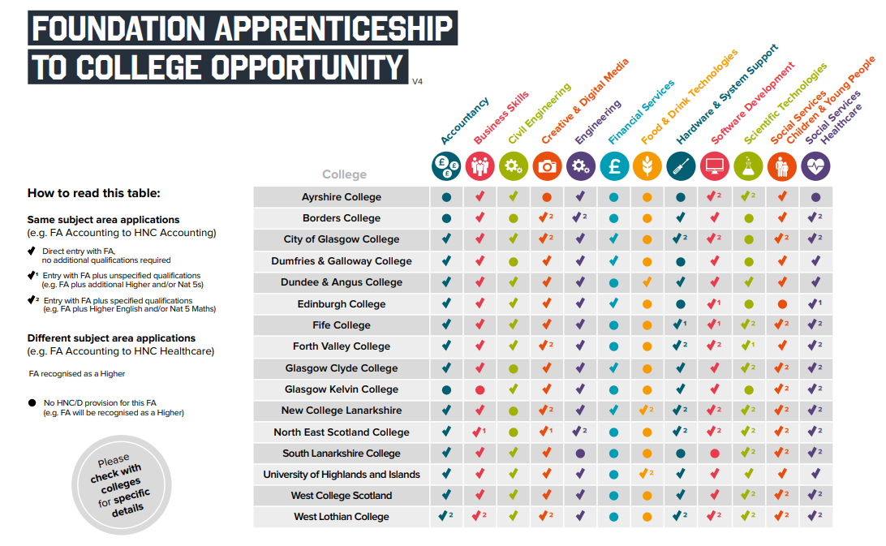
Notes:
Scottish Foundation Apprenticeships (version 4, 2020).
​
We know Foundation Apprenticeships help to develop a wide range of skills and experience, demonstrating and strengthening Career Management Skills. It can also be helpful to show how each Foundation Apprenticeship connect with post-school career pathways. This slides shows how each Foundation Apprenticeship connects with a College Courses in the same subject (e.g. FA Accountancy to HNC Accountancy). A benefit for those moving from a Foundation Apprenticeship to a course in the same subject is that many courses will accept the Foundation Apprenticeship for entry with no other requirements (show by Tick): ​
✓ - Direct entry with FA, no additional qualifications required ​
✓1 - Entry with FA plus unspecified qualifications (e.g. FA plus additional Higher and/or Nat 5s) ​
✓2 - Entry with FA plus specified qualifications (e.g. FA plus Higher English and/or Nat 5 Maths) ​
● No HNC/D provision for this FA (e.g. FA will be recognised as a Higher)​
NOTE: For those applying to different subject areas the Foundation Apprenticeship is recognised as a Higher.
Sources: https://www.apprenticeships.scot/

Slide 11
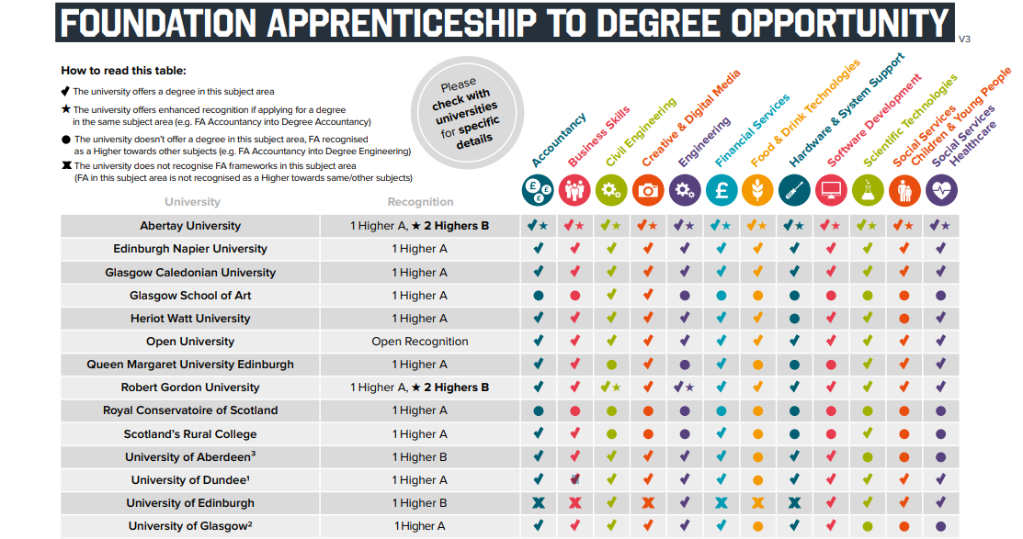
Notes:
Scottish Foundation Apprenticeships (version 2, 2020).
​
We know Foundation Apprenticeships help to develop a wide range of skills and experience, demonstrating and strengthening Career Management Skills. This slides shows how each Foundation Apprenticeship connects with a University Courses in the same subject (e.g. FA Accountancy to BA Accountancy). A benefit for those applying to university with a Foundation Apprenticeship is, while most universities recognise the Foundation Apprenticeship as equivalent to One Higher, the skills and experience gained add value to Personal Statements, plus some universities recognise the ‘Enhanced’ value of the Foundation Apprenticeship as equivalent to 2 Highers (show by Star): ​
​
NOTE EXCEPTIONS - Excludes Medicine and Dentistry; Excludes Law, Medicine, Dentistry, Vet Medicine; Excludes Medicine; Excludes Law. If applying for Engineering, only FA in Civil or Engineering will be recognised; Enhanced recognition varies per framework, equivalent is at 2 Highers for most frameworks.​
Sources: https://www.apprenticeships.scot/

Slide 12



College Leaver Destinations
Example 5: We can look at regional college leaver destinations to understand learner journey pathways.
College Leaver Destinations 2018/19:
Edinburgh and South East Scotland
In 2018/19 there were 9,989 College Qualifiers across Edinburgh and South East Scotland. 85.6% of all qualifiers went on to positive destinations.
Unemployed
2.2%
Fife college had the highest rates of qualifiers transitioning into work (27%) followed by Borders College (23%).
Edinburgh and Fife College had the highest number of qualifiers going on to further study (66.5%) followed by West Lothian (65.6).
Fife College had the highest rate of unemployed qualifiers (4.3) followed by Borders College (3.5%).
Work
20%
Study
66%
Notes:
We can look at college leaver destinations to understand learner journeys and identify career pathways across the region. This provides a narrative on what leavers do post-further education, and helps identify areas where additional area of support is needed to improve leaver destinations.
Sources: http://www.sfc.ac.uk/web/FILES/statisticalpublications_sfcst072020/College_Leaver_Destinations_2018-19_Full_Report.pdf

Slide 13

College Leaver Destinations
Level of Study and Future Destinations
Some courses are more likely to lead to university what ever the level of qualification.
Between 2020 – 2023 across Edinburgh and South East Scotland:
The greatest demand for qualifications will be:
Leaving with SCQF 1-6
Leaving with SCQF 7 or above
Science
Social Sciences
1
SCQF 7 - 10 (49%)
SCQF 5 (19%)
SCQF 6 (12%)
SCQF 11 - 12 (8%)
SCQF 1 – 4 (4%)
Some courses are more likely to lead to work at SCQF level 1-6 or University at SCQF level 7+.
2
Leaving with SCQF 1-6
Leaving with SCQF 7 or above
3
Business, Man & Admin
4
Construction
5
Land-based Industries
Notes:
SCOTTISH FIGURES - Scottish College Leaver Destinations 2017/18. For a full list of destination by subject area see SOURCE.
Some college courses are more likely to lead to employment, others are targeted towards university, many open doors to other pathways such as Modern or Graduate Apprenticeships.
LMI NOT ON SLIDE: Of the 9,519 qualifiers who entered work 78.3% gave feedback on the relationship between their studies and work – two-thirds entered work related to their course of study. Highest correlation occurs in industry driven subjects and those with work placements (for more detail see SOURCE page 17).
The bar charts show only positive destinations to highlight the link between level of study and initial post-college destination, but negative destinations were also varied:
At SCQF 1-6 negative destinations range from 7.5% to 34.4% – highest in: Computing & ICT (34.4%); Media (31%); and Business, Management and Administration (27.4%). Lowest in: Nautical Studies (7.6%); Science (9.7%) and Engineering (10%).
At SCQF 7+ negative destinations range from 2% to 11.3% - highest in: Hairdressing, Beauty and Complementary Therapies (11.3%); Media (10.4%); and Nautical Studies (9.8%). Lowest in: Social Sciences (2%); Science (4%); Sports & Leisure / Engineering (both 4.2%).
Source:
Scottish Funding Council (SFC) (2019) Statistical Publication: College Leaver Destinations, available online at: http://www.sfc.ac.uk/publications-statistics/statistical-publications/2019/SFCST082019.aspx

Slide 14







College to University Pathways
College Course | Entry to University Course 2nd or 3rd Year
Accountancy | ACCOUNTANCY FINANCE BUSINESS STUDIES MANAGEMENT STUDIES
Sports Related | SPORT & EXERCISE SCIENCE HOSPITALITY, LEISURE, SPORT, TOURISM & TRANSPORT ANATOMY, PHYSIOLOGY & PATHOLOGY NUTRITION
Business Studies | BUSINESS STUDIES MANAGEMENT STUDIES HOSPITALITY, LEISURE, SPORT, TOURISM & TRANSPORT HUMAN REOSURCE MANAGEMENT MARKETING
Social Sciences | SOCIOLOGY PSYCHOLOGY POLITICS LAW BY TOPIC ANTHROPOLOGY
Computer Studies | COMPUTER SCIENCE INFORMATION SYSTEMS SOFTWARE ENGINEERING ARCHITECTURE
More than 1 in 4 Scottish Students
entered a first degree via a HNC/HND
Notes:
SCOTTISH FIGURES 2017/18
The Scottish Funding Council identify that “the relationship between college and university subjects is key to observing routes of articulation”.
Articulation is when the content of courses that are transferred between post secondary education institutions are compared. This allows us to understand routes from college to university.
The top college subjects with Advanced Standing (combing all Articulation years from 2014-15 to 2017-18) are: Accountancy with 1,189 students gaining AS; Sports & Hobbies, change to sports related in the slide, with 988; Business Studies with 910; Applied Social Science/Studies with 854; computer studies with 581.
Not on slide: Other Courses leading to Advanced Standing entry included: Management, 565; Mechanical Engineering, 511; Music, 471; Computer science, 424; and administrative management, 415.
SOURCE:
Scottish Funding Council (SFC) (2019) Articulation from Scottish College to Scottish Universities 2017-18, available online at: http://www.sfc.ac.uk/publications-statistics/statistical-publications/2019/SFCST062019.aspx

Slide 15

Scottish Graduate Pay by Sector and Skill
Median Full-Time Salary 1st Degree Graduates Scotland
Notes:
GRADUATE DESTINATIONS – Scottish data 2020. Latest HESA figures published June 2020 reflect 2017-18 leavers 15 months after graduation
In all sectors High Skill jobs paid better. The examples here show the median salary for first degree graduates entering jobs at different skills levels. High Skill wages range from £28,000 (computing science and engineering & technology) to £21,000 (law and creative arts). Medium Skills jobs all ranged from £18,000 to £20,000 with the exception of engineering (£24,000). Low Skill jobs were all £16,000 to £17,000. Not on slide: The three sectors with the highest median High Skill salary were: Medicine & Dentistry £35,000; Education £32,000; and Veterinary Science £31,000, these were not included as examples as all graduates entered High Skill jobs. Supports discussion around entry level jobs/wages, progression, experience and life-long learning. Law may be a useful example as considered high paid job, but high skill starter wage is one of the lowest.
NOTE: For all 18 sectors see Source. Can also view pay differences are available by gender, age group, ethnicity, and disability. You can also view the salary band of graduates by individual university/institution.
SOURCE: HE Graduate Outcomes: UK 2017-18 – Graduate Salaries https://www.hesa.ac.uk/data-and-analysis/graduates/salaries (18 June 2020) and Chart4 - Graduates in The UK Main Reason for taking the job and skills group https://www.hesa.ac.uk/data-and-analysis/graduates/chart-4

Slide 16






Graduate Leaver Destinations
83%
Of Scottish Graduates in 2017/18 were in full or part-time work 6 months after graduation in 2017-18.
Graduate destinations 2017/18 6 months after graduation:
In 2018-19 the majority of Scottish Graduates (43%) were earning between £21,000-£29,000.
Only 250 graduates chose their job because it paid well.
3,480 chose their job because it fitted with their career plan.
62%
11%
10%
6%
3%
8%
Full-time employment
Part-time employment
Work & Study
Further Study
Unemployed
Other
Top 3 Industries for Graduate employment (2017/18):
Health (21%)
Education (19%)
Professional, Scientific & Technical (12%)
How did Scottish graduates find their professional level jobs?
Employer Websites (18%)
Internships etc. (17%)
Recruitment Agencies & Websites (15%)
University/College Career Service (13%)
Personal Contacts (12.5%)
Notes:
This page provides an overview of graduate destination data at a Scotland level (2017-18).
From the slide we can se that 73% of Scottish graduates were in full or part-time work 6 months after graduation.
The top 3 employing industries in 2017/18 was Health and Social Care, Education and Professional, Scientific and Technical. This kind of LMI is useful when supporting individuals within the labour market to make informed decisions about routes into occupations.
For example if someone wished to become a nurse, we know that this is a sector of growth and that there is a strong chance of employment when they graduate from university. However if someone is wishing to access an industry that does not have a high employment rate from university, they may wish to enter the industry via an alternative route. This could also shorten the learner journey.
It is important to encourage people within the labour market seeking education and employment opportunities to consider what they look for in a job and what industry they might want to work in. We can then rely on the LMI to support people into the right pathways into employment.
NOTE: ‘Other’ includes unknown work pattern 1%; voluntary or unpaid work 1%; unemployed due to start work 1%; and other including travel, caring for someone or retired. RUK Stands for Rest of UK.
Source:
HE Graduate Outcomes: UK 2017-18 - by outcome & domicile https://www.hesa.ac.uk/news/18-06-2020/sb257-higher-education-graduate-outcomes-statistics/study (18 June 2020) figures reflect both fully and partially completed survey results of 361,215 (53%) of all UK domicile Graduates.

Slide 17
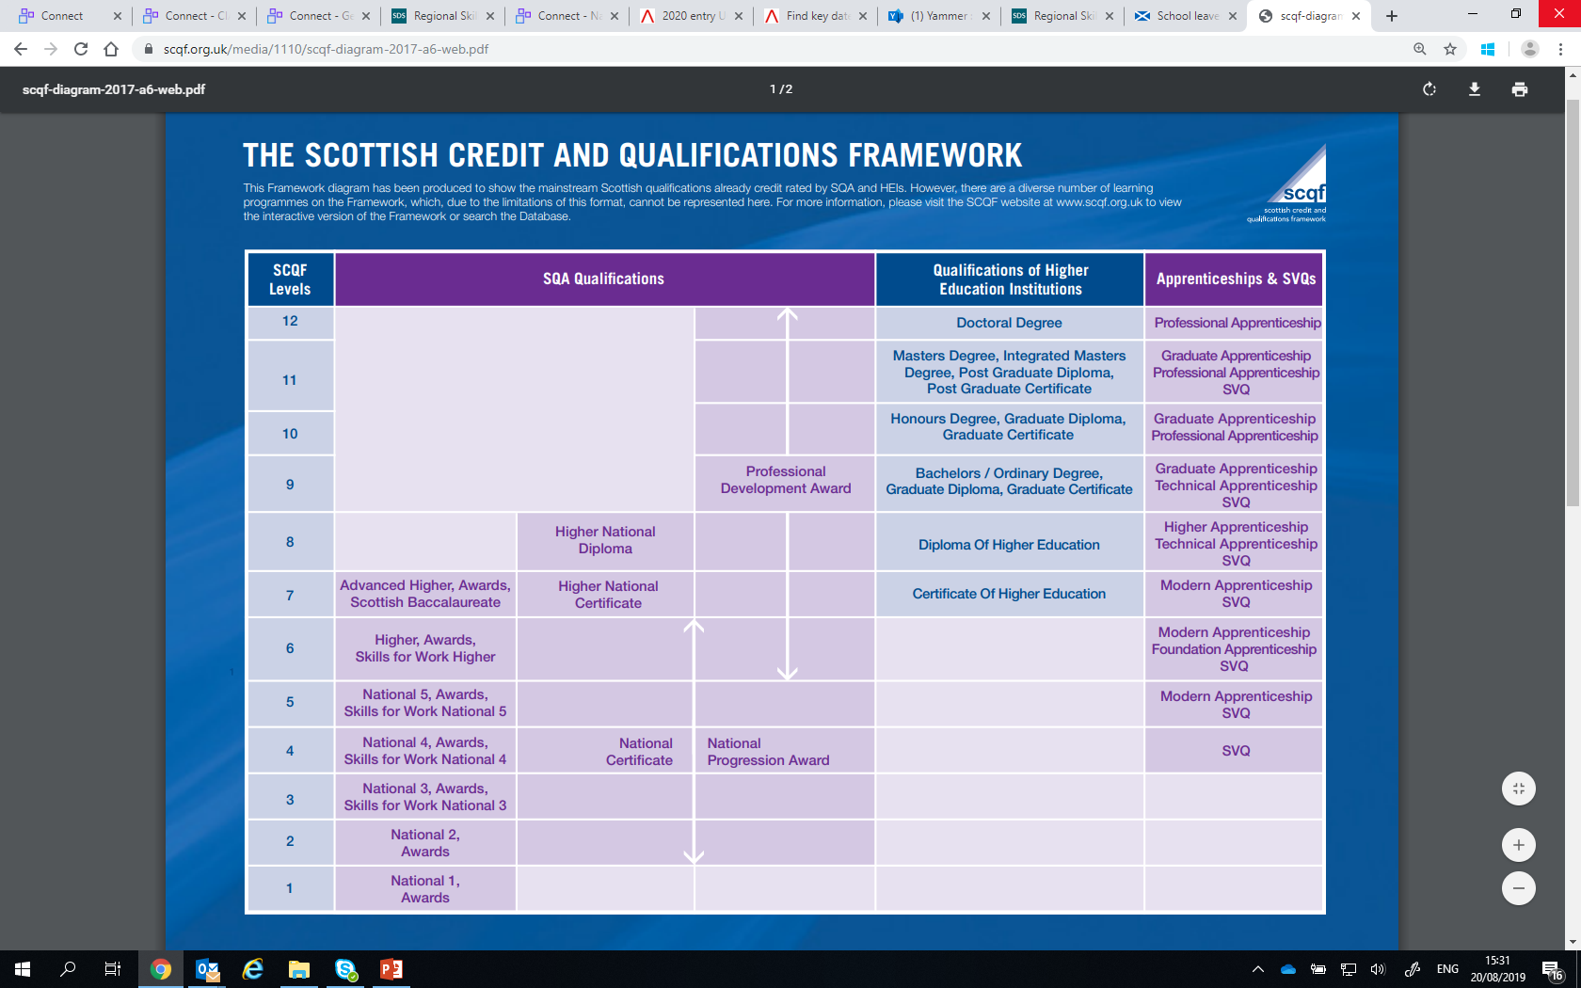
The SCQF Framework
The SCFQ has 12 levels, each level shows the difficulty of a particular qualification from highest to lowest.
The level descriptors outline the general outcomes of learning at SCQF levels under 5 broad headings know as characteristics:
Knowledge and understanding (mainly subject-based)
Practice (applied knowledge, skills and understanding)
Generic cognitive skills (for example, evaluation, critical analysis)
Communication, numeracy and IT skills
Autonomy, accountability and working with others.
Notes:
CLICK ON SCREEN TO GO TO SCQF INTERACTIVE FRAMEWORK
Qualifications change to ensure the labour market has a supply of people with the right skills and qualifications to meet demand.
An example of this is the introduction of Foundation Apprenticeships and Graduate Apprenticeships offering new ways to get the skills, experience and qualifications employers need.
SOURCE:
SCQF (2014) The SCQF: Scotland's framework for lifelong learning – a guide for learners, providers and employers, available online at: https://scqf.org.uk/media/2czjfrud/scqf-a4-purple-leaflet-final-july-2014-web.pdf
RELATED RESOURCES
SCQF Searchable Qualifications Database http://scqf.org.uk/the-framework/search-database/ and SCQF YouTube Channel https://www.youtube.com/user/SCQFPartnership/videos
European Qualifications Framework (EQF) or National Qualifications Framework (NQF) see: https://ec.europa.eu/ploteus/search/site?f%5B0%5D=im_field_entity_type%3A97
Apprenticeship Scotland A-Z https://www.apprenticeships.scot/for-employers/browse-frameworks/

Slide 18
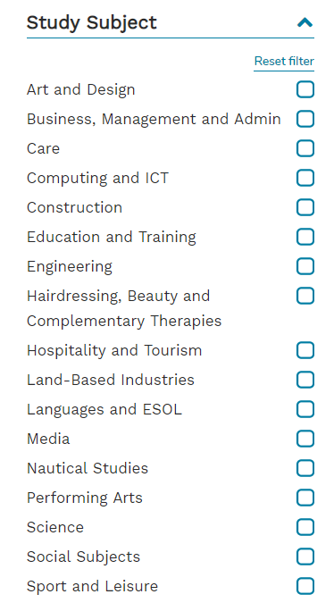
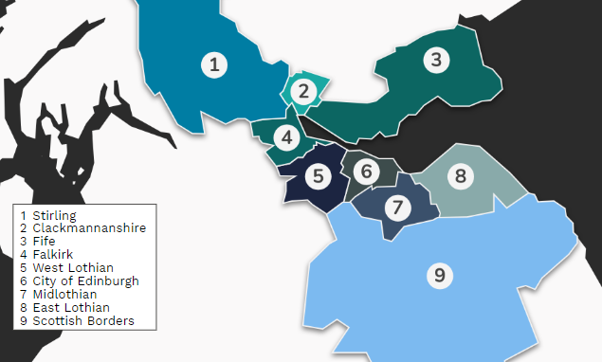
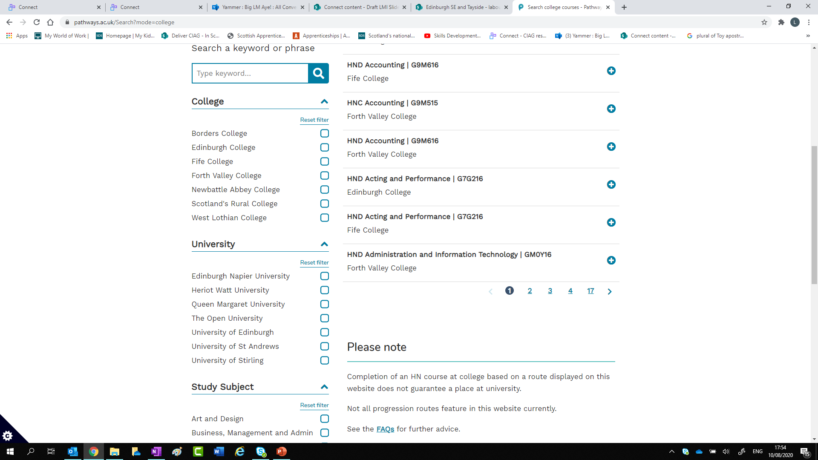
Pathways Search Tool
Notes:
Articulation ‘Pathways’ search tool (launched July 2020)
This new search tool shows pathways between college and university in the regions of Stirling, Clackmannanshire, Fife, Falkirk, West Lothian, City of Edinburgh, Midlothian, East Lothian, and the Scottish Borders.
For school pupils, adult returners, those already in college and considering progression options you can search by college, university or subject area to see agreed pathways for seamless transition from HND to degree level study. Also has information on whether entry is to second or third year of a degree.
SOURCE: Pathways App https://www.pathways.ac.uk/About

