Slide 1


PSN Youth Engagement Covid-19 Impact Workshops 2021

Slide 2

Workshop Aims and Objectives
Aims and objectives of the workshop
Share the results from the PSN Youth Engagement Covid-19 Impact Survey 2020 with the wider Public Sector Network and reflect on the findings.
Provide an opportunity for Public Sector Network members to give feedback on the findings.
Provide an opportunity for Public Sector Network members to raise any additional points regarding youth engagement activity within their organisations.
Guide future activity of the network (e.g., what future events and activities do members want to see).

Slide 3


Young Persons Guarantee
The 5 asks of employers
1. To support young people and prepare them for the world of work
DWY/ work experience and work preparation/ volunteering
2. To help those who need it most
Engaging with and opening opportunities to young people who face barriers to work
3. To invest in a skilled workforce
Apprenticeships/ training and upskilling
4. To create jobs and opportunities for young people
Apprenticeships/ vacancies/ paid apprenticeships and work experience
5. To create a workplace which supports young people
Fair work/ living wage employers/ Investors in Young people

Slide 4




PSN Youth Engagement Covid-19 Impact survey 2020
Background: The Public Sector Network supports the Scottish Government’s goal of increasing youth employment in public sector organisations. This network includes health boards, local authorities and public corporations.
The purpose of this research was to:
Gain insight into youth employment strategies used by Public Sector Network organisations in Scotland.
Provide pre and post COVID-19 measurements for youth employment levels and strategies within the Public Sector Network organisations in Scotland.
The survey was circulated to all PSN members and the response rate was 55%.

Slide 5



Key messages
PSN Network organisations were involved in youth employment/engagement activities pre-Covid-19 (e.g., 82% attended career events targeting young people and 94% offered work experience overall).
There was high awareness of Developing the Young Workforce (82%) and the Scottish Youth Guarantee (72%) in the PSN Network organisations.
70% of respondents report having a youth employment strategy.
The main barriers to establishing youth employment/engagement strategies were limited funding and young people’s lack of awareness of the variety of roles within the public sector. More needs to be done to raise awareness of opportunities to attract young talent in public sector organisations.

Slide 6



Key messages
Pre-Covid-19, 46% of organisations had taken on FAs, 93% had taken on MAs, and 52% had engaged in GAs. Popular frameworks include Business Skills, Children and Young People, Business and Administration, and IT Software Development.
Covid-19 has had a negative impact on the recruitment of FAs, MAs, GAs, interns, and graduates.
However, 60% have taken on 10 or more FAs and MAs and 40-50% have taken on GAs, interns and graduates.
The comments show that organisations have started planning and implementing a recovery plan post covid-19 with a focus on youth employment and engagement.
Further engagement needs to take place with public sector network members to address barriers and improve the uptake of apprenticeship family in response to the pandemic to improve the levels of youth employment.

Slide 7
Workshop topic guide
Questions to guide the discussion
Do you have any comments about the results or any particular points you want to raise regarding your own organisations’ youth employment and engagement strategies?
Is there anything you would like to know more about that could help promote youth employment within your organisation?
What future events/projects would you like to see the network be involved in?

Slide 8
Thank you.

Slide 9
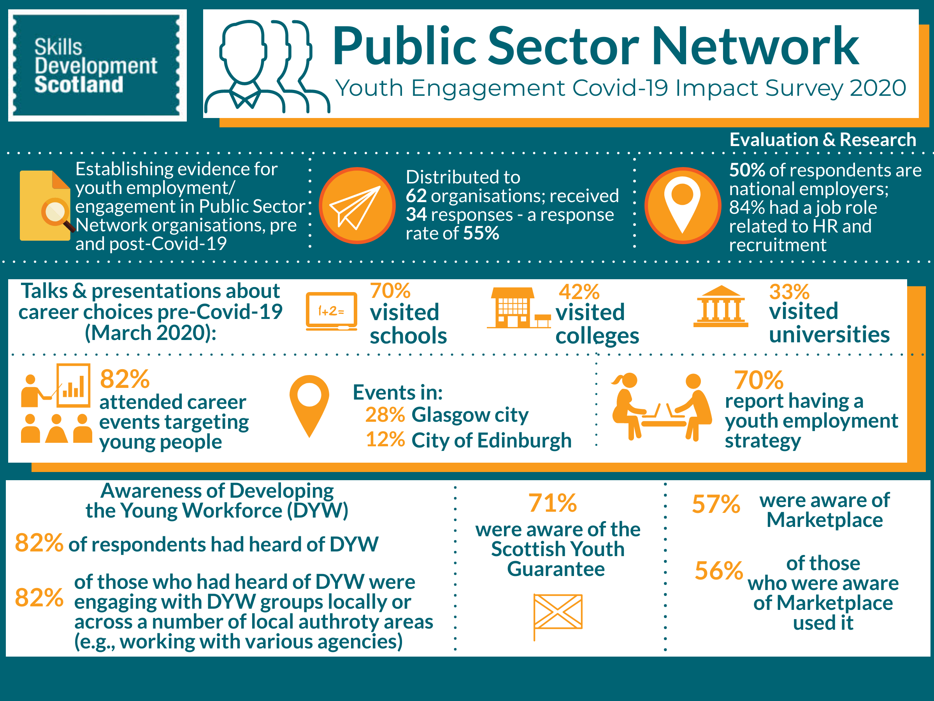

Slide 10
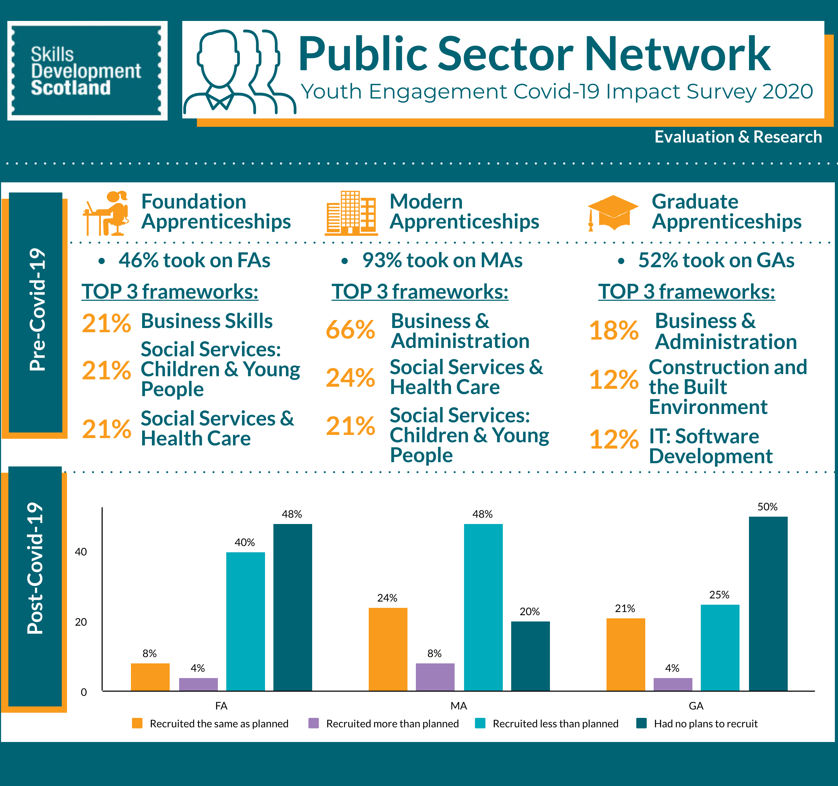

Slide 11
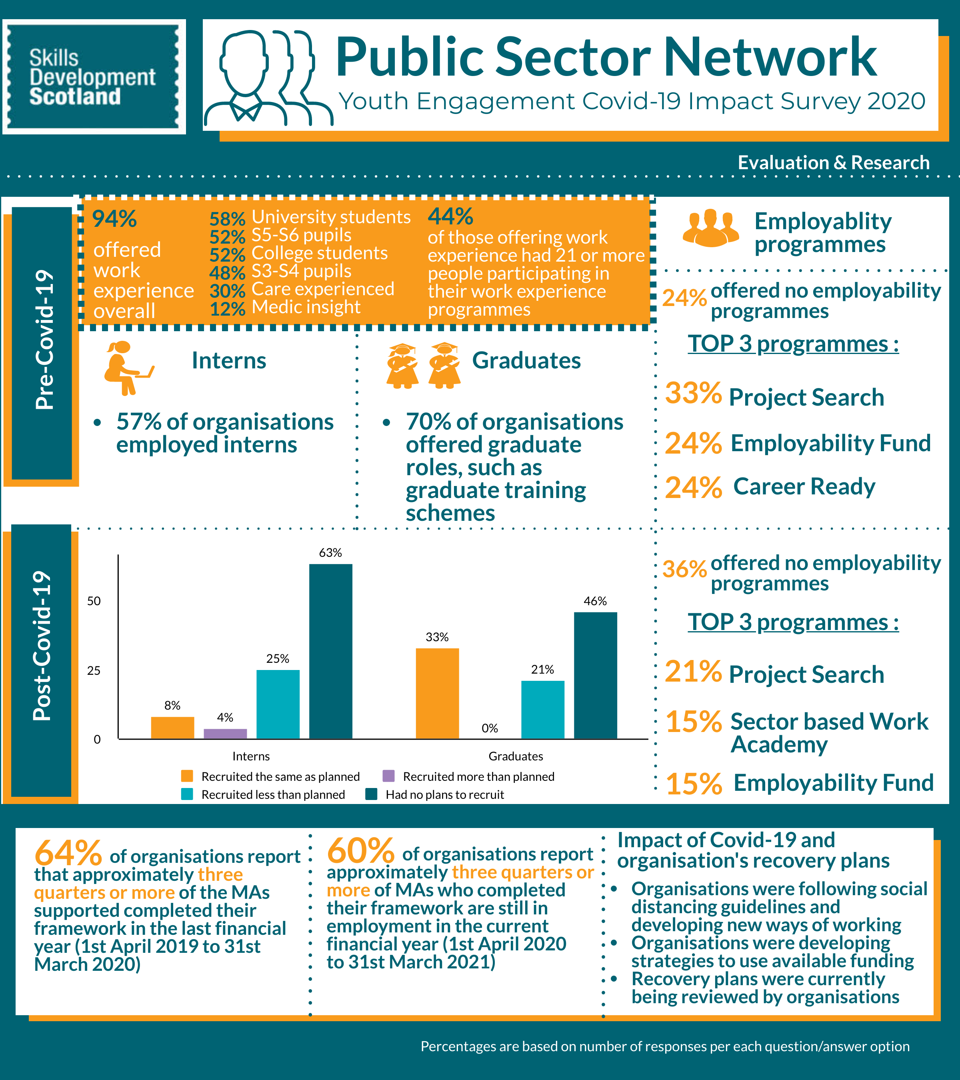

Slide 12
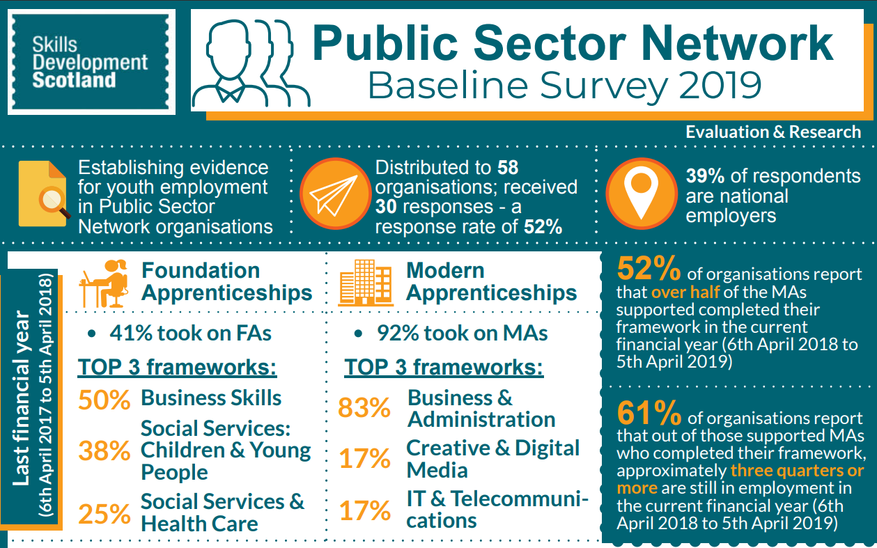

Slide 13
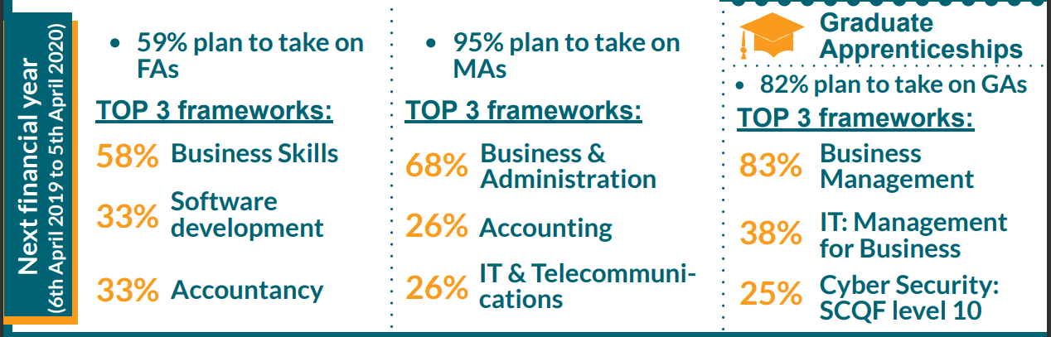

Slide 14
