Slide 1
Community of Practice
Meta-skills
30 April 2026

Slide 2
Welcome, Introduction and Housekeeping
Alison McConnell, SDS

Slide 3
Housekeeping
There will be no scheduled fire alarm test today.
In case of fire, on hearing the alarm bells sound, immediately make your way to the nearest fire exit- doors behind kitchen or next to stairs
Studio fire marshals are recognisable by yellow high-visibility jackets and will assist with directions and evacuation.
The fire marshals will check all areas of the venue to check everyone is evacuated- they can also assist if required
On evacuation of the building, our meeting point is across the road, in front of the Hope Street Entrance to Central Station. Fire marshals will direct you as necessary.
You may re-enter the building when the fire marshal has said it is safe to do so.
Toilets: Located past reception are ladies, gents and disabled toilets.
Please switch your mobile phones off or set them to silent mode during the proceedings of the day.

Slide 4
By the end of today we hope to have:
A shared understanding of current expectations for meta-skill delivery, the support available and future plans for embedding meta-skills in Apprenticeship frameworks
An understanding of the findings from the SDS meta-skill thematic review
Discussed challenges and solutions for delivery of meta-skills in apprenticeships
Agreed some collective actions to continue to embed meta-skill delivery in all Scottish Apprenticeships

Slide 5
AGENDA
09.30 (10.00 start) | Arrival, Registration and Tea/Coffee
10.00 – 10.10 | Welcome, housekeeping | Alison McConnell, SDS
10.10 – 10.20 | Employer/Apprentice video | Alison McConnell, SDS
10.20 – 10.35 | SDS asks, offer and future of meta-skills in frameworks presentation | Karen Murray, SDS
10.35 – 12.00 | Panel / Q&A session: Provider meta-skills journeys | Derek Farrell, Babington Business College Gail Pincott, BPP Holdings Ltd Michelle Batt, MGT Training Ltd Courtney Smith, Hays Travel Frank Quinn, SDS
12.00 - 12.30 | SDS thematic review: findings & recommendations (Q&A) | Michael McHugh, SDS
12:30 – 13.30 | Lunch and Networking
13:30 - 15.00 | Workshop: Embedding Meta-skills in Scottish Apprenticeships | All Learning Providers, facilitated by SDS
15.00 - 15.30 | Feedback, next steps and close | Alison McConnell, SDS

Slide 6
SDS asks, offer and future of frameworks
Karen Murray, SDS

Slide 7
Ask: Learning Provider Role in ALL Scottish Apprenticeship delivery
Support apprentices to self reflect on the strengths and areas for development at the beginning of their apprenticeship
Help apprentices to become self aware of their own meta-skills using appropriate language for each individual apprentice
Support apprentices to identify opportunities in the workplace/in their apprenticeship to develop meta-skills
Support employers in their role in identifying opportunities to develop and evidence their employee apprentices’ meta-skills
Support and facilitate apprentices to evidence reflection on their own meta-skills development and finally at the end of their apprenticeship
Ensure the evidence built by the apprentice meets the requirements of the unit specification(where relevant).

Slide 8
Clarity on positioning of meta-skills in frameworks
Meta‑skills in Modern Apprenticeships (ALL frameworks- old-style and new)
Positioning varies in each framework- due to evolving nature of the apprenticeship product
For all– it’s a requirement of SDS funding
“New style” frameworks to date
Future refreshed frameworks
  Embedded within qualification content
  Recognition through qualification
  Explicit in framework documentation
  Employer‑endorsed certification (MAO)

Slide 9
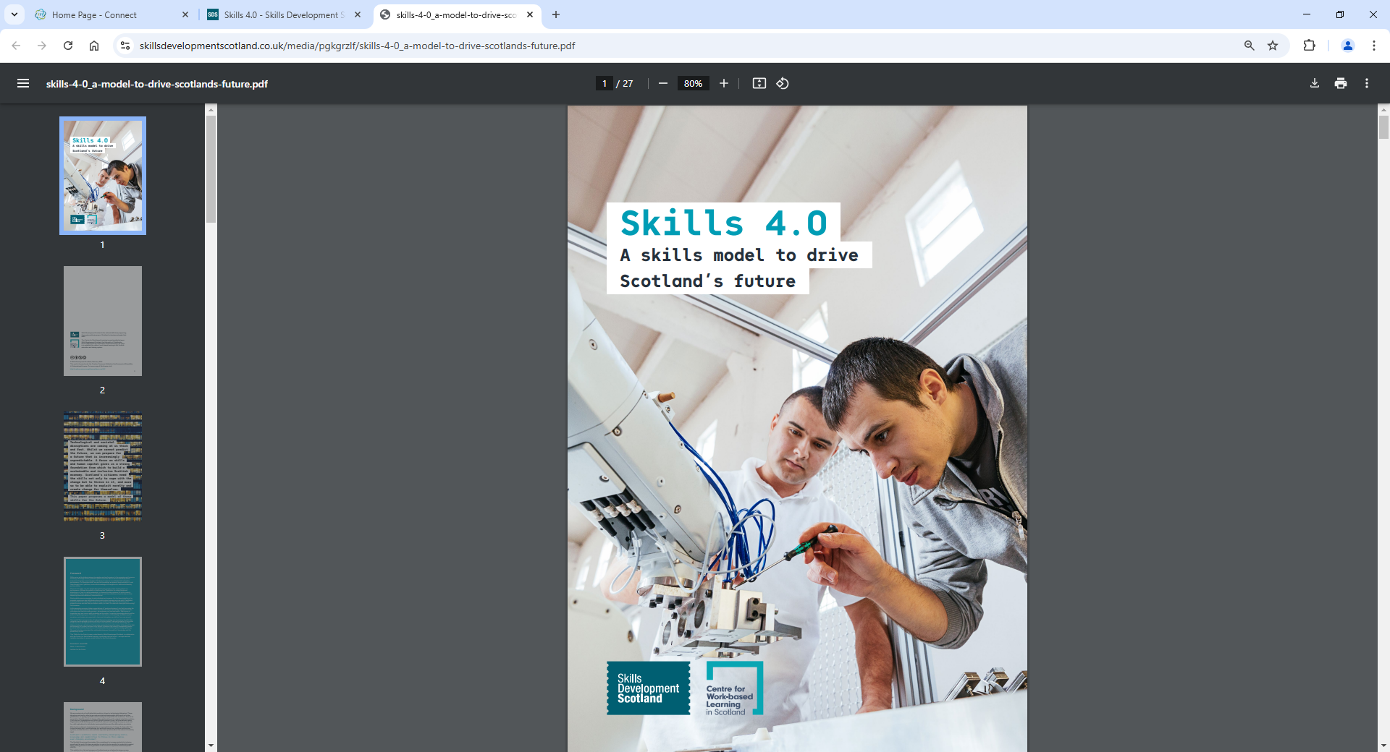
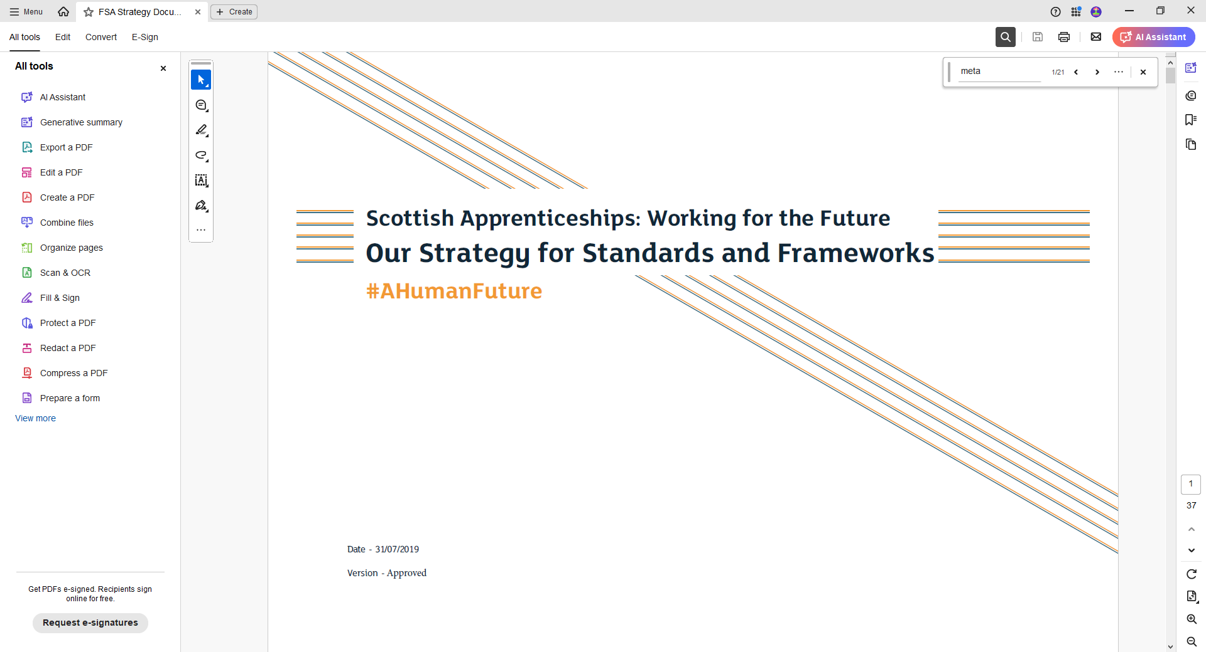
Rationale for change in positioning
Apprenticeships must prepare people not just for today’s job, but for change, progression and mobility across a career.
Meta‑skills (e.g. adaptability, collaboration) now recognised as core capabilities, not optional “soft skills”.
Until recently, assessed through qualifications and now repositioned within the frameworks to support:
  Clear, consistent development expectations for meta‑skills across all frameworks
  Robust assessment and quality assurance at framework level
  Visibility of apprentice progress in meta‑skills throughout apprenticeship journey
  Foundational, future‑focused capabilities alongside technical skills and behaviours
Ensures meta‑skills remain visible, valued and meaningful — not diluted or lost.

Slide 10
Why Meta-skills belong in the Apprenticeship Framework
Strengthens the employer role
Framework placement enables employers to actively shape, observe, and endorse meta‑skills development in real workplace contexts, reinforcing their credibility and relevance
Developed through reflection and experience
Best supported through the whole apprenticeship journey, not point‑in‑time assessment.
Transferable across contexts
Apply across roles, sectors, and career progression — unlike role‑specific qualifications.
Personal and individual
Develop differently for each learner based on experience and context.
Visible without being over‑assessed
Frameworks recognise and value meta‑skills without reducing them to tick‑box criteria.
Developed in the round
Grow cumulatively across learning, work, mentoring, and reflection — not in isolated units.

Slide 11
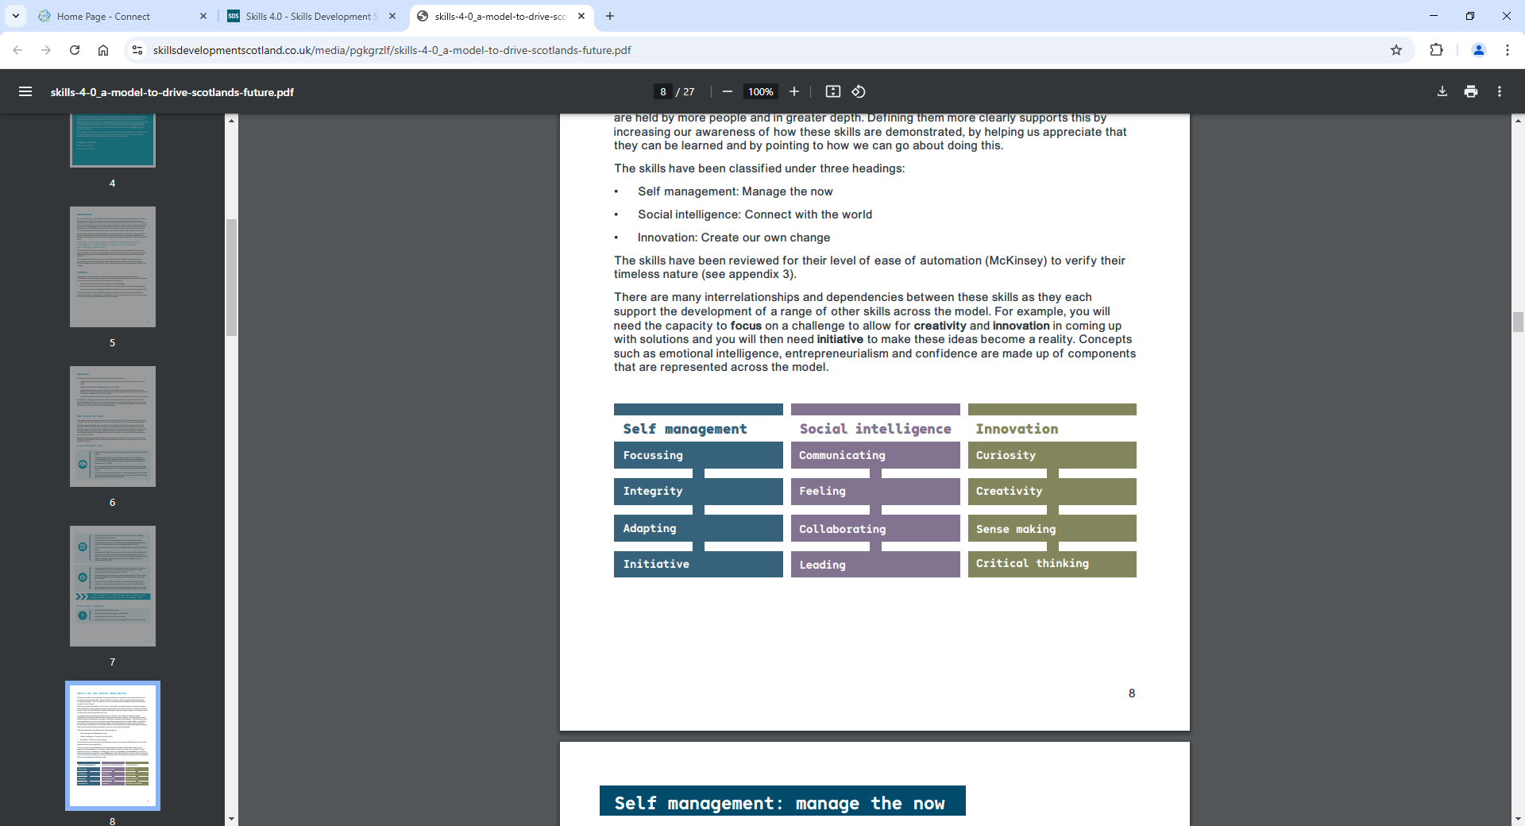
Benefits of positioning in framework
For apprentices
Clear expectations and language around meta‑skills
Recognition of skills developed through real work
Increased confidence, adaptability and employability
Formal recognition of achievement on apprenticeship certification
For the system
Consistent, framework‑level expectations across all apprenticeships
Stronger quality assurance through clearly defined requirements
Reduced reliance on qualification‑specific assessment models
Alignment with national priorities on adaptability, resilience and lifelong learning
For employers and providers
Clearer guidance on what “good” looks like
Integration with normal workplace activity and performance reviews
Less bureaucracy, more meaningful reflection and discussion
Overall: stronger, more credible and future‑ready apprenticeship frameworks.

Slide 12
Role out of future approach for certification of meta-skills
Test- employer endorsement- 2026
Employer endorsement certification- new style- 2026-2027
All framework refreshes and renewed will be as fashion and textiles
Testing the approach in fashion & textiles
Evaluate approach with providers then role out to all new style
Those with qual/ unit still need to meet unit requirement
Cumulative

Slide 13
Panel Session
Derek Farrell, Babington Business College
Gail Pincott, BPP Holdings Ltd
Michelle Batt, MGT Training Ltd
Courtney Smith, Hays Travel
Frank Quinn, SDS

Slide 14
SDS: findings of thematic review and recommendations
Michael McHugh, SDS

Slide 15
Topics
Overview of approach
Key Findings & Conclusions
Effective practice
Post-visit survey feedback

Slide 16
Overview of approach

Slide 17
Review Aim
Provide a current high-level view of how apprentice meta-skill development is being engaged with in apprenticeship delivery by learning providers, apprentices and their employers to inform improvement actions for their future positioning in apprenticeship framework development and delivery.

Slide 18
Methodology
Aug – Dec 25
Jan – Feb 26
Mar 26
May 26
Research and field work
Analysis
Community of Practice event
National Report
Initial intelligence scoping exercise completed; and 4x SDS Quality Assessors carried out fieldwork with 31 providers
Analysis of all intelligence including thematic review outputs; SIA intelligence and HMIE findings.
National webinar to disseminate key findings and share effective practice
Report published with key findings

Slide 19
Themes
Value, awareness and understanding of meta-skills
Embedding and implementation of meta-skills
Employer engagement and integration into workplace practice
Progress reviews and tracking of meta-skills development
Self-evaluation and ownership

Slide 20
Key Findings & Conclusions

Slide 21
Value, awareness and understanding
Where we are…
Future enhancements
Generally, apprentices demonstrate a clear understanding of meta-skills
Apprentices, providers and employers recognise the value of meta-skills
Meta-skills introduced early and development reinforced through consistent language
Strong examples of positive use of reviews and reflective discussion
Structured tools and guided reflection help support apprentices
Improve understanding beyond partial or surface level
Providing clearer explanations and regular reinforcement would deepen understanding
Ensure consistent use of terminology. Use language “comfortable” to provider but ensure it is linked back to the MA framework to avoid confusion for apprentices

Slide 22
Embedding and implementation
Where we are…
Future enhancements
For majority of providers, meta-skills are actively embedded in learning and workplace activities
Assessors routinely encourage apprentices to connect everyday tasks to relevant meta‑skills
At the outset of training, apprentices identify priority meta‑skills linked to their role and aspirations
Ensure early introduction and profiling of meta‑skills
Improve consistency in the use of reflection resources
Strengthen staff awareness and capability
Improve consistency in subcontracted delivery of meta‑skills

Slide 23
Employer engagement & integration into workplace practice
Where we are…
Future enhancements
Employers play a constructive and supportive role in development and application of meta-skills
They offer meaningful workplace opportunities for meta-sills development
Strong collaboration between employers and providers
Employer feedback through reviews further strengthens apprentice progress in key meta‑skills.
Enhance employer understanding and engagement
Improve alignment with employer performance processes
Expand mechanisms for employer engagement

Slide 24
Progress review and development tracking
Where we are…
Future enhancements
Reflective practice is well embedded and supports apprentices to recognise how their meta‑skills develop
Progress reviews provide a structured space for tripartite discussion
Assessors coach apprentices to connect everyday tasks to specific meta‑skills
Wide range of reflective tools and resources support apprentices with meta-skills development
Increase the focus on meta-skills within progress reviews
Enhance employer contribution to progress reviews
Improve systematic tracking of meta-skills development
Ensure apprentices have access to employer feedback
Maintain regular and timely progress reviews

Slide 25
Self-evaluation and ownership
Where we are…
Future enhancements
Most apprentices show good levels of self‑evaluation and ownership of their meta‑skills development
Autonomy is supported through structured processes and tools
Strengthen end-of-apprenticeship reflection
Expand opportunities for independent self-assessment
Introduce a formal mid-point evaluation stage
Enhance recognition and celebration of achievement

Slide 26
Conclusions
Across most providers, apprentices demonstrate a strong understanding of meta‑skills, supported by early introduction during induction and reinforced through the consistent use of meta‑skills language in reviews and reflective discussions.
Across a majority of providers, meta‑skills are effectively embedded within learning and workplace activities, allowing apprentices to develop these skills in meaningful, context‑specific ways.
Across a majority of providers, employers contribute constructively to apprentices’ development by actively supporting the application and strengthening of meta‑skills in workplace settings.
Across most providers, reflective practice is well established and enables apprentices to identify how their meta‑skills are developing and how these are applied within their day‑to‑day work.
Across most providers, apprentices exhibit strong self‑evaluation skills and take clear ownership of their meta‑skills development, identifying specific skills to improve and setting goals aligned to both workplace and individual needs.

Slide 27
Exceptional Practice
Structured reflection that builds self-awareness and ownership
Meta-skills as a “golden thread”
Consistent meta-skills language
Purposeful progress reviews
Visual and accessible tools
Active and strategic employer engagement
Experiential and applied learning opportunities
Learner centred support and relationships
Continuous improvement and future focus
Staff capability and consistency

Slide 28
Post-visit Survey Feedback

Slide 29
Provider Experience of the Review
The majority of providers reported that review visits ran smoothly and as planned, contributing to high overall satisfaction with the process.
Verbal feedback at the end of visits was seen as constructive and clear, helping providers understand strengths and areas for development immediately.
Written feedback reports were valued for their clarity and level of detail, supporting reflection and follow‑up activity after the visit.
Providers reported strong alignment between verbal and written feedback, reinforcing confidence in review outcomes.
(Based on feedback from 21 out of 31 providers)

Slide 30
Provider Experience of the Review
Mean Score 9.5
out of 10
How well do you feel SDS supported you in the preparation?
95%
Of providers reported that their review went as planned
52%
Of providers added new actions to their Quality Action Plan following their review
(Based on feedback from 21 out of 31 providers)

Slide 31
Lunch and Networking

Slide 32
AGENDA
13:30 - 15.00 | Workshop: Embedding Meta-skills in Scottish Apprenticeships | All Learning Providers facilitated by SDS
15.00 - 15.30 | Feedback, next steps and close | Alison McConnell, SDS

Slide 33
Workshop Session (1330 - 1500)

Slide 34
Workshop - Summary Feedback

Slide 35
Alison McConnell
SDS
Event Next Steps and Close

Slide 36
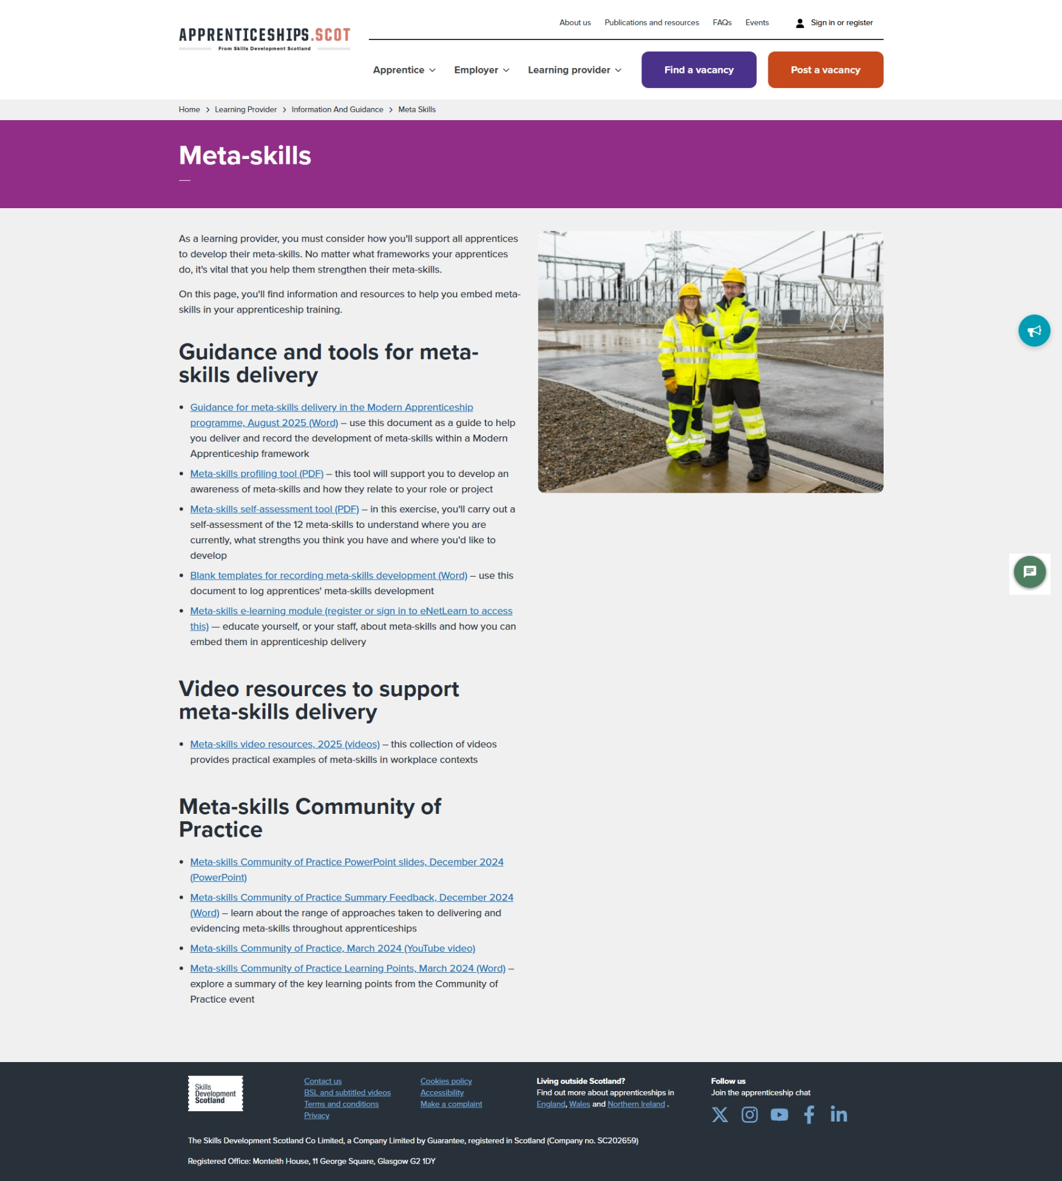
SDS Meta–skills resources to support delivery
As a learning provider, you must consider how you'll support all apprentices to develop their meta-skills. No matter what frameworks your apprentices do, it's vital that you help them strengthen their meta-skills.
On this page, you'll find information and resources to help you embed meta-skills in your apprenticeship training.
Meta-skills | Scottish Apprenticeships – page
Information and guidance for learning providers | Scottish Apprenticeships – new landing page
Provider Webinar – 7th May @10.00am – 11:30am Updated Information and Guidance section on Apprenticeships.scot

Slide 37
30 April 2026

