Slide 1


Introduction to meta-skills

Slide 2
Discussion
1. What are meta-skills?

Slide 3




What are meta-skills?
Self-management
Social Intelligence
Innovation
Self-management is all about organising and managing ourselves; knowing what’s important, being able to focus and using our initiative, and being able to adapt to new ideas.
Social Intelligence is about building and maintaining relationships; communicating effectively and relating to others with empathy, being able to collaborate and knowing when and how to take the lead.
Innovation is about creating positive change; being curious and excited about new ideas and challenges, able to make sense of information, to be creative and think critically in a range of circumstances.

Slide 4
Discussion
2. Why are meta-skills important?

Slide 5
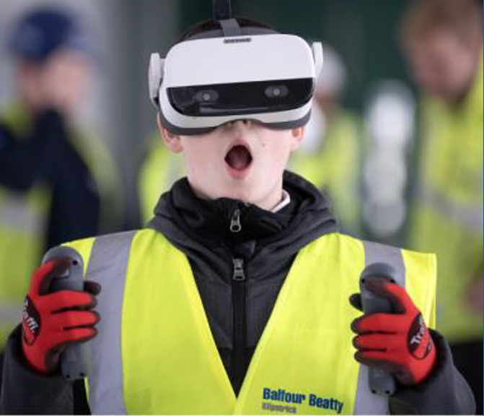
The
changing
world of
work

Slide 6


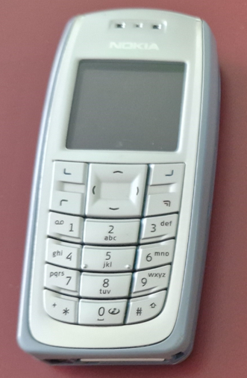

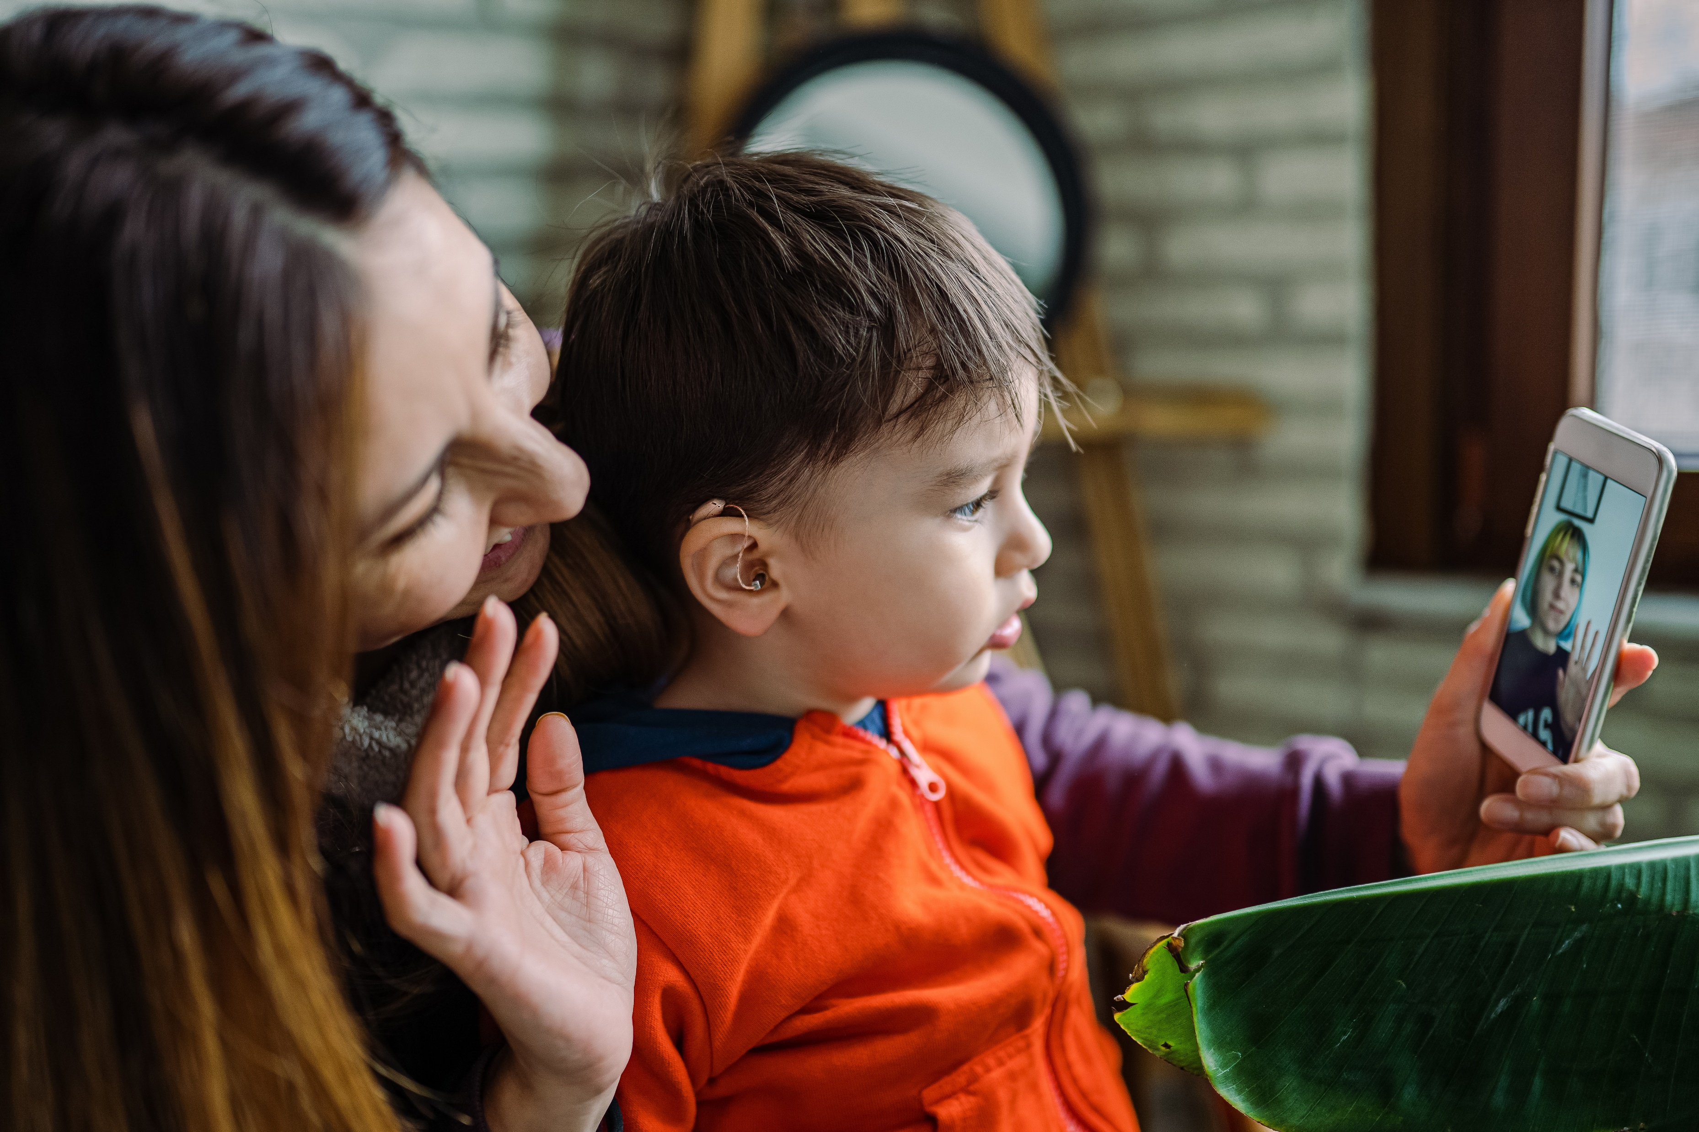


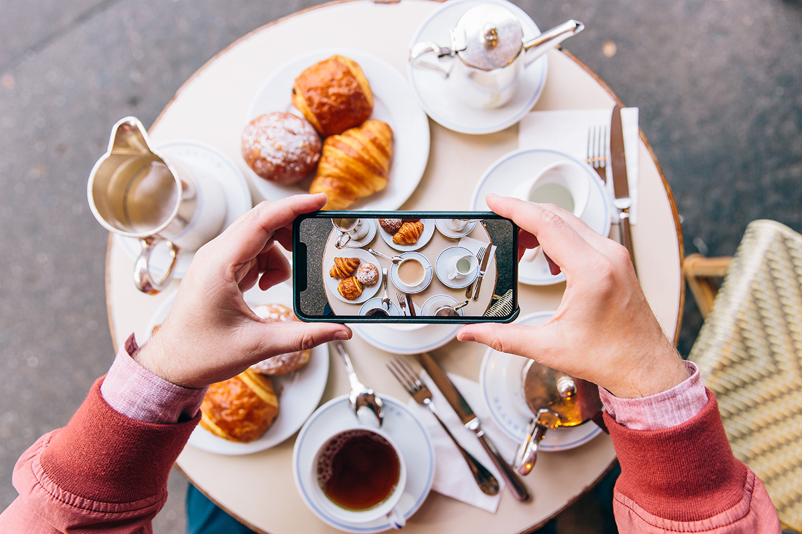
Look how things have changed
No Internet connection / no apps, streaming or music
No camera
Very small storage capacity
Small screen

Slide 7
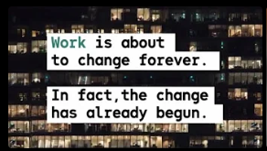

Our changing world
Future Jobs and Industry: Responding to the Speed of Change
Skills 4.0: Thriving in the Future
Notes:
Short films which will also the ‘changing’ world are available :
https://www.youtube.com/watch?v=GtUvovg7wLk&t=17s
https://www.youtube.com/watch?v=ITJUQre19Mg

Slide 8








Job predictions for 2030
Job predictions for 200
Research suggests the best jobs/careers to emerge over the next 10 years will include:
Augmented Reality Journey Builder - will collaborate with talented engineers and technical artists to develop vital elements for clients.
Personal Memory Curator - will consult with patients and stakeholders to generate specifications for virtual reality experiences.
Elderly wellness consultant -will cater to the physical and mental needs of the elderly.
Body part maker – will create living body parts for athletes and soldiers.
Space pilots, tour guides, and architects - will allow pilots, tour guides, and architects to live in lunar outposts.
Virtual Store Sherpa - will focus on customer satisfaction through virtually advising customers using the knowledge of the product line.
GM or recombinant farmer - will transform farming and livestock.
Personal Data Broker - will ensure consumers receive revenue from their data. The broker will establish prices and execute trades.
Highway Controller - will monitor automated road and air space management systems to ensure no errors occur.
Notes:
Sources:
Cognizant - https://www.cognizant.com/us/en/whitepapers/documents/21-jobs-of-the-future-a-guide-to-getting-and-staying-employed-over-the-next-10-years-codex3049.pdf
ZDNet - https://www.zdnet.com/article/top-20-most-popular-future-jobs-of-2030-vertical-farmer-limb-maker-waste-data-handler-narrowcaster/

Slide 9





Job predictions for 2030
Research suggests the best jobs/careers to emerge over the next 10 years will include:
Augmented Reality Journey Builder - will collaborate with talented engineers and technical artists to develop vital elements for clients.
Personal Memory Curator - will consult with patients and stakeholders to generate specifications for virtual reality experiences.
Body part maker – will create living body parts for athletes and soldiers.
Space pilots, tour guides, and architects - will allow pilots, tour guides, and architects to live in lunar outposts.
Virtual Store Sherpa - will focus on customer satisfaction through virtually advising customers using the knowledge of the product line.
Elderly wellness consultant - will cater to the physical and mental needs of the elderly.
GM or recombinant farmer - will transform farming and livestock.
Personal Data Broker - will ensure consumers receive revenue from their data. The broker will establish prices and execute trades.
Highway Controller - will monitor automated road and air space management systems to ensure no errors occur.

Slide 10

3. Activity: What meta-skills did you use today?
Notes:
​
​

Slide 11



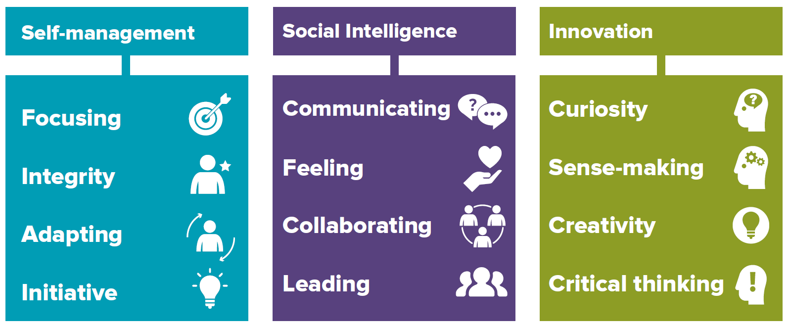


Meta-skills
Focusing
You can maintain interest and concentrate on a
task for a period of time, and not be distracted.
Communicating
You have the ability to openly share information
in the best way that helps everyone understand
your thoughts and ideas.
Curiosity
Being curious is the desire to learn or know
something in order to increase your
Understanding of an opportunity or problem.
Integrity
You are guided by your own principles and
Values and are considered trustworthy, open
and honest by others.
Feeling
You can see things from other people’s point of
view and this helps you understand their
feelings and motivations.
Sense-making
You can determine the deeper meaning of what
is being expressed and organise information into
an understandable form which is easier to use.
Adapting
You can respond confidently and constructively
To new ideas and experiences and unexpected
challenges.
Collaborating
You are good at building and maintaining
relationships with other people so everyone
can work together to achieve shared goals.
Creativity
Using your imagination, you are able to think of
new ways of addressing problems and this
enables you to visualise solutions.
Initiative
You are confident in your own abilities and
judgement. You can take decisions and have
responsibility for your own actions.
Leading
By having a sense of direction and purpose,
You can encourage and motivate others to
work towards agreed tasks and goals.
Critical thinking
You are able to process, analyse and evaluate information to solve complex problems and
form an opinion after careful thought.

Slide 12
4. Why are meta-skills important?

Slide 13
Self-management
Self-management meta-skills are all about organising and managing ourselves; knowing what’s important, being able to focus and using our initiative and being able to adapt to new ideas.
Focusing
Can you pay attention in order to finish what you are doing? By ignoring distractions and concentrating on what’s important you will complete a task quicker and more effectively.
Integrity
Are you respectful of other people and understand that they may have different ideas and ways of doing things? The way you speak and behave has an impact on other people.
Are you able to adjust to new ideas and changes? Having a positive attitude and resilience means you are be able to be flexible in your approach when things don’t go to plan.
Adapting
Initiative
Can you work on your own and do things without being asked? Trusting you own decisions and trying new ways of doing things helps you to create new ideas and solve problems.

Slide 14
Social Intelligence
Social Intelligence is about building and maintaining relationships; communicating effectively and relating to others with empathy, being able to collaborate and knowing when and how to take the lead.
Do you really listen to other people and then ask questions to make sure you understand information? Explaining and sharing information in different ways ensures everyone can understand.
Communicating
.
Feeling
Are you kind and respectful when you talk and work with other people? It is important to respect other people’s views and ideas even when they are different from your own.
Can you work well with other people to tackle problems? Being able to recognise and agree with other people’s ideas makes it more likely that the task will be completed successfully.
Collaborating
Can you take the lead in a group activity or task whilst also recognising and respecting other people’s ideas and feelings? Being able to identify problems, think of ideas and share them with the group you are working with is important.
Leading
Notes:
These are ‘soft skills’ which are so important in school but particularly in the workplace. Cultivating these skills helps you to be more thoughtful, articulate and better at working with others.
Think about these questions:
Am I a good listener?
Do I get my point across clearly?
Do I think before I speak/ act and consider other people’s feelings?
Do I work well in groups?
Can I take a leadership role when working with others? Do I encourage them to do their best?

Slide 15
Innovation
Innovation is about creating positive change; being curious and excited about new ideas and challenges, able to make sense of information, to be creative and think critically in a range of circumstances.
Curiosity
Do you look forward to starting new activities or tasks? Asking questions like ‘why’ and ‘how’ inspires new ideas and help to find out how things work.
Sense-making
Do you have the ability to gather information and then using the new information make decisions about how to improve things?
Creativity
Can you think of new ways of doing things? For example, trying new and different ways of sharing information to make your ideas easier to understand.
Critical thinking
Can you draw conclusions from information to understand what is needed to solve complex problems? Being able to process information in this way helps to make informed decisions.
Notes:
Think about these questions:
Do I ask lots of questions?
Am I good at research and finding out everything I can about the
thing I am working on? Can I use this research to support my points?
Do I see the ‘bigger picture’ and think about the impact of what I say and do?
Am I imaginative and creative?
Can I chunk problems down to help me deal with them more easily?
Can I think things through logically to come to an answer or find a solution?

Slide 16
5. Activity: reflecting on your own skills
Thinking about the meta-skills we have just discussed, answer at least one of the following questions. Identify the meta-skills you used in your example.
Think about a time when you faced an unexpected situation – what did do to overcome any difficulties?
Give an example of a time when you have worked well as part of a team. What made that team successful?
Give an example of a time you successfully solved a problem either at school or at home.
Think of a time when you had an idea about how to approach a task/activity and followed it through successfully.
Give an example of a time when you worked with someone and had to take their feelings and ideas into account.

