Slide 1


MA Specification and MA Conditions revisions and clarifications as extended to 31 March 2024

Slide 2

MA Specification - Clarifications for 23/24
All COVID interim measures removed for 23/24.
FIPS User Access
SA/QAP process
Legal right to work in the UK
Age Eligibility
Signatures and dates
Time scales for validation
Initial Assessment and Learning Plan
Clarifications for 23/24
To develop meta-skills that support the needs and objectives of the business

Slide 3
MA Specification – New for 23/24
New – Definition of BME
New – Start Progression funding allocation criteria
New – Funding for Engineering and Digital Manufacturing
New – Digital Technology Frameworks
New - Heading Health, Safety and Wellbeing
New - Information on Safeguarding
Revised– Equality Monitoring Form and Guidance
Clarifications for 23/24
To develop meta-skills that support the needs and objectives of the business

Slide 4
MA Specification - Review and Updates for 23/24
MA Framework development information
FA timescales
GA SCQF levels
Eligible bus fare costs for reimbursement
Claim Period for travel and subsistence
Period of redundancy for ATP services
Awarding body notification and reports
Registration with the Awarding body/ Sector Skills organisations
Inclusion of time scales as part of induction
Completion of MA Programme
Transfer to another Provider
Transfer to another Employer
Updates for 23/24
To develop meta-skills that support the needs and objectives of the business

Slide 5
MA Specification – Removal from text for 23/24
Pathway Apprenticeships
Date Claimed as a minimum requirement for the SOAR
Removals for 23/24
To develop meta-skills that support the needs and objectives of the business

Slide 6

Eligibility criteria - reminder
Providers must adhere to and apply all the eligibility criteria set out in the MA Specification for the MA Programme.
Apprentices must not be participating in any other employment, education, training or enterprise programme
Employers’ main business premises must be in Scotland;
Apprentices cannot work for an agency or be self employed
Individuals must meet the Statutory School leaving age in Scotland before they become an Apprentice.
Providers must prove demonstrable need that the Apprentice acquires significant new knowledge and skills to fulfil their job role/Occupation
For full list of Eligibility criteria, please see MA Specification section 4.1
**If you fail to meet any of the eligibility criteria set out in the MA Specification you will be in breach of your MA contract and SDS reserves the right to recovery.**
Eligibility
To develop meta-skills that support the needs and objectives of the business

Slide 7


Signatures and dates - reminder
What we will accept:
Wet signatures and dates
Stylus signatures and dates
Signatures captured using electronic signature software e.g. Adobe Sign, DocuSign, Hello Sign etc. and dates
Typed signatures and typed dates only where an audit trail is available via electronic signature software;
Signatures
We will not accept:
  Copied and pasted signatures and dates;
  Typed signatures and typed dates without an electronic signature software audit trail
  **Reminder that SDS will not accept prepopulated dates. Signatures and dates on all forms and documentation must be completed by the Apprentice , Employer and Provider individually.**
To develop meta-skills that support the needs and objectives of the business

Slide 8

SDS Forms – reminder
We introduced flexibilities that allow you to create and use your own forms , in a format that must be accessible to SDS and must meet the requirements set out in the MA Specification -
  QPR & SOAR
  Apprentice progress review (APR)
These requirements are mandatory for all SDS forms and if you fail to comply you will be in breach of your contract and SDS reserves the right to recovery.
The pdfs we publish are fully interactive. Securities have been removed from the pdf forms to allow you to combine the files or to convert the forms to Microsoft word.
SDS will not provide word versions of any published pdf forms
There is no requirement within the MA Specification for SIA approval for face-to-face APRs
We have created an additional SOAR exemplar suitable for use with e- signature software.
More details can be found in the MA Specification & MA Conditions on the requirements for SDS forms and documentation.
SDS Forms
To develop meta-skills that support the needs and objectives of the business

Slide 9

Reminder
Apprentice Transition Plan (ATP)Service is continuing for 23/24, please ensure you review the ATP information set out in the MA Specification and on the web page here.
For ESF tagged apprentices, Providers must continue to follow additional instructions set out in Appendix 7 to the MA Specification and the MA Conditions.
Please Note
To develop meta-skills that support the needs and objectives of the business

Slide 10

MA Conditions - Clarifications for 23/24
FIPS and other SDS software/systems
Claims and Payment Arrangements
Performance Levels (All KPLs) Consequences section
Prevention of Bribery, Anti Slavery and Human Trafficking laws and offences
Appendix 1 – Definitions
Appendix 4 – Information Security Policy
  Encryption issues process
  Personal Data Breach
MA Conditions 23/24
To develop meta-skills that support the needs and objectives of the business

Slide 11

Helpful Links
MA Specification, Conditions and associated documents
Automotive SOAR and Guidance
Work based learning and Quality Assurance Hub
Equality and Diversity
Apprentice Transition Plan ( ATP) Service
MA Programme Frequently Asked Questions
Helpful links
To develop meta-skills that support the needs and objectives of the business

Slide 12

Next Steps
Please read the MA Specification and MA Conditions 23/24 which can be found at the links in the previous slide; As there have been changes for 23/24.
All queries should be directed to your SIA;
Please ensure all your staff are signed up for the latest SDS updates and can access the external newsletter. Information on how to sign up for the external newsletter can be found here and you also can speak to your SIA.
Thank you
Next Steps
To develop meta-skills that support the needs and objectives of the business

Slide 13
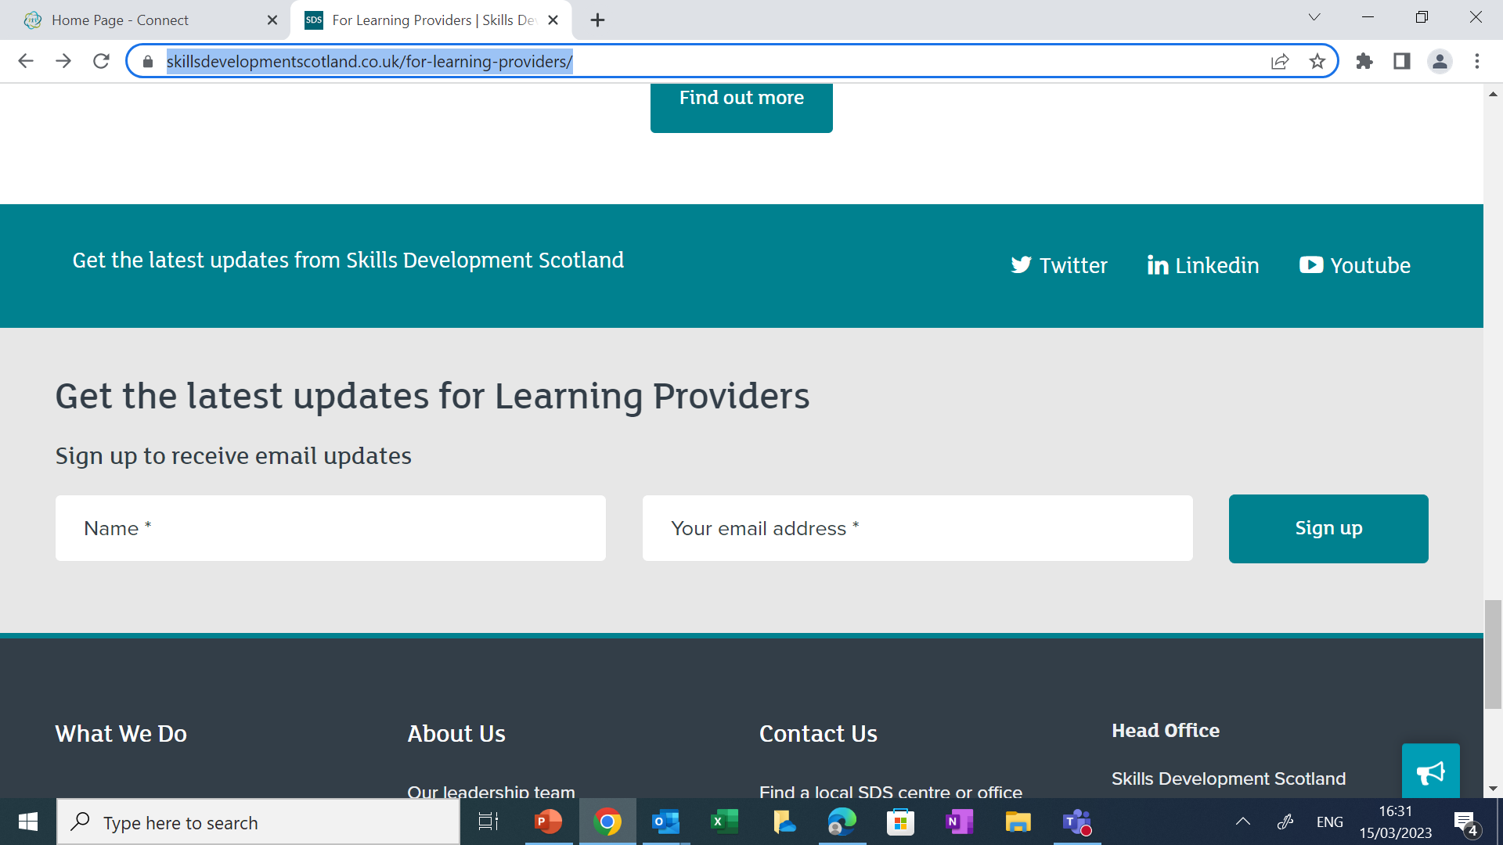
Next Steps
Next Steps
To develop meta-skills that support the needs and objectives of the business

Slide 14
Thank you

