Slide 1
Employer Involvement in Modern Apprenticeships Community of Practice
18 September 2025

Slide 2
Agenda
Time | Agenda item | Presenters
10.00 - 10.05 | Welcome, housekeeping | SDS
10.05 - 10.15 | Event Overview by SDS | Alison McConnell
10.15 - 10.45 | Presentation by Education Scotland | Peter Connelly Education Scotland
10.45 – 11.00 | Provider/Employer Showcase | Kirsty Docherty Bell Group
11.00 - 12.15 | Provider Workshop | Facilitated by SDS & Education Scotland
12.15 – 12.30 | Provider/Employer Showcase | Andrew Macfarlane ACS Clothing Ltd.
12:30– 13.15 Lunch and Networking
13.15 - 13.30 | Provider/Employer Showcase | David McAleese Competence Matters
13:30 – 13.45 | Provider/Employer Showcase | Anne Gordon Crown Office and Procurator Fiscal Service
13:45 - 14.00 | Provider/Employer Showcase | Margaret Saunderson NHS Education for Scotland (NES)
14.00 - 15.00 | Provider Workshop | Facilitated by SDS & Education Scotland
15.00 - 15.30 | Support Resources Event Feedback and Next Steps | Alastair Gillen, SDS Alison McConnell, SDS

Slide 3





Enhancing Support for Apprentices
27%
of leavers cited lack of support from mentor/supervisor as reason for leaving
36%
of apprentices said better support from line manager / employer would have encouraged them to stay
20%
of apprentices identified improved support as key to enhancing their MA experience
39%
of providers flagged employer involvement as a support need
Education Scotland
assess provider-employer collaboration and support for apprentice progression
Source: Apprentice Voice Leavers Survey 2022-25 and Provider Survey 2025

Slide 4




Apprentice Feedback on Employer Support
Apprentice Voice Data: Quotes from those scoring 10/10
Welcoming / Flexible Environment
Respect / Understanding from Employer
The support given by my employer – especially when taking time out for my studies as they are really flexible
I valued the support I got from my employer, management and other members of staff. I was given protected time to complete my XXX and whenever I needed guided through the work
Working in a place where I felt supported and included
The commitment, dedication and support of my supervisor in making it possible for me to understand every aspect of the training in order that I produced good work
Relevant Application of Learning in Workplace
Support during difficult circumstances
Gave me extra support and time when my father became terminally ill during my apprenticeship
The time and effort people within the workplace dedicated to developing and supporting me through work based training that was aligned with the formal qualifications I was undertaking at college
Loved my mentor, XXXXXX, who could not have been more of a supporting role as I completed the apprenticeship

Slide 5
Peter Connelly
Education Scotland

Slide 6
Revised HMIE Modern Apprenticeship Quality Framework 2025

Slide 7
Kirsty Docherty Head of Social Impact
Bell Group

Slide 8
CONTENTS
Believe
Introduction
Support For Apprentices
Employer Involvement In Design and Delivery
Next Steps
Questions
Be Better
Be Bell
#SDSMACoP #SDSMACommunityof Practice #SupportforApprentices #wblapprenticeships

Slide 9
SUPPORT FOR APPRENTICE IN TRAINING.
1. Recruitment: Signposting
2. Onboarding: Set expectations, provide contacts and identify individual learner needs
3. Mentor programme
4. Toolkits
5. Internal conferences
6. Tailored 'off-the-job' learning opportunities
7. Structured peer networks to nurture shared learning, connection, and confidence
8. Quarterly reviews
9. Awareness sessions: Diversity and culture, EAP, and MHFA
10. Talk to us
11. Apprentice showcase
12. Building flexibility into the programme: Adapt to individual circumstances
#SDSMACoP #SDSMACommunityof Practice #SupportforApprentices #wblapprenticeships

Slide 10


Apprenticeships at Bell
#SDSMACoP #SDSMACommunityof Practice #SupportforApprentices #wblapprenticeships

Slide 11
EMPLOYER INVOLVEMENT: DESIGN & DELIVERY.
1. Employer / Provider
2. Management collaboration with TC team to review on/off-the-job training needs
3. Inclusion of business feedback
4. Case studies and real-world projects
5. Problem-based learning tasks: Apprentices apply theory in practice
6. Collaborative review meetings on curriculum delivery
7. Co-delivering training sessions or workshops
8. Collaborative succession planning: Opportunities for cross-department moves
9. Continuous two-way communication between TC and business to identify skills gaps and adapt
#SDSMACoP #SDSMACommunityof Practice #SupportforApprentices #wblapprenticeships

Slide 12
SUPORT FOR LINE MANAGERS AND MENTORS.
R&R: Clear guidance and training for all
Access to resources and toolkits to aid structured learning, feedback and progress reviews
Peer learning and support networks, shared experiences and good practice
Management and mentor training opportunities
Ongoing internal discussions around provision and outcomes
Recognition of the contribution mentors / line managers make to apprentice success
Access to wellbeing and support services for managers themselves
Dedicated points of contact for mentors within business and TC for advice and escalation
Time allocation within workload planning so that managers can give apprentices sufficient support without affecting business priorities
#SDSMACoP #SDSMACommunityof Practice #SupportforApprentices #wblapprenticeships

Slide 13
NEXT STEPS.
Apprenticeships come with a job
Ongoing succession planning occurs
Aspiring leaders
Signposting to further education or higher-level qualifications relevant to their career path
Professional development coaching for personalised guidance
Networking opportunities with industry professionals and presenting at conferences
Information about sector-specific professional bodies and how to pursue membership or accreditation
Continued access to wellbeing support during the transition period
Tailored learning and exchange programme
Completion / Exit interviews to gather apprentice feedback: Directing them toward future opportunities
Growth of provision
#SDSMACoP #SDSMACommunityof Practice #SupportforApprentices #wblapprenticeships

Slide 14


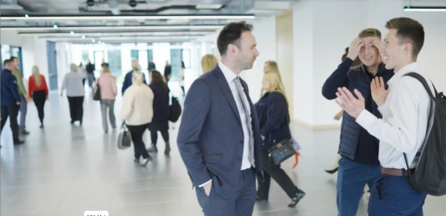
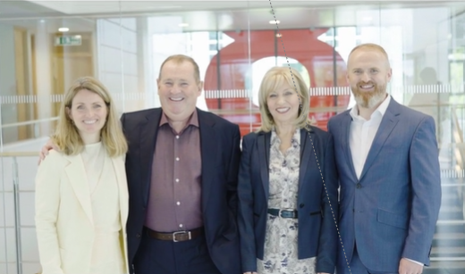
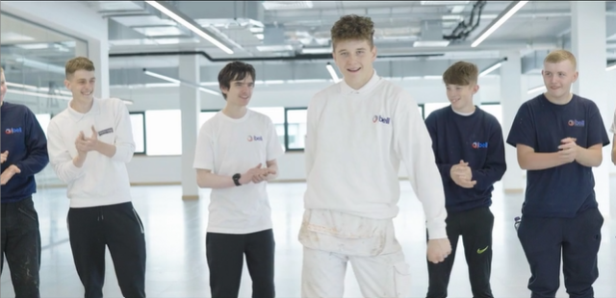
ANY QUESTIONS?

Slide 15
Workshop Discussion

Slide 16
Andrew Macfarlane Head of Circular Operations
ACS Clothing Ltd.

Slide 17

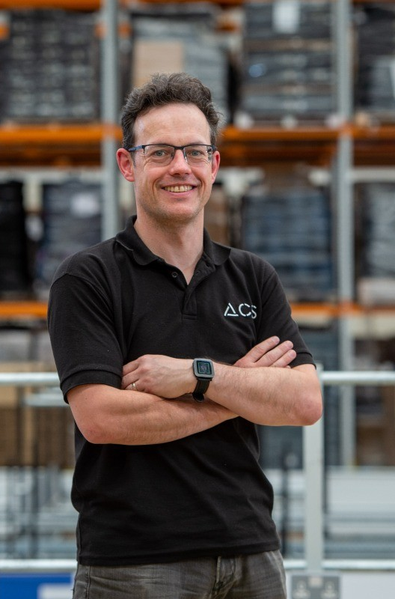


Community of Practice Event 18 September 2025
Andrew Macfarlane Head of Circular Operations ACS Clothing Ltd.

Slide 18










Brief overview of ACS
Types of apprenticeship programmes offered (e.g. MA, GA, FA, Internships etc…)
Core values driving our approach: inclusion, personalised development, and future-focused pathways
Culture of continuous learning and improvement
Number of apprentices currently supported

Slide 19
Support for Line Managers & ASN Apprentices
Structured onboarding + training resources
Ongoing L&D team support
Clear tools for apprentice reviews and feedback
ASN Support:
Early disclosure process & needs assessments
Adjusted delivery and assessment methods
Inclusion-trained line managers
Line Manager Support:

Slide 20
In-Training Apprentice Support
Tailored onboarding experience
Placement with suitable teams/line managers
Role-aligned programme delivery
Buddy/peer networks and wellbeing support
Formal and informal check-ins

Slide 21
Post-Qualification & Progression Support
Career planning conversations 3–6 months before end of programme
Signposting to further learning and internal opportunities
CV/interview prep support
Alumni engagement – 6-month post-programme check-ins

Slide 22
Challenges & Reflections
Main Challenges
Line manager time constraints
Late ASN disclosures
Keeping apprentices engaged after qualification
What’s Working
Proactive manager support
Peer and mentor networks
Trialling alumni support model

Slide 23
Thank You
“We’re proud of the progress made — but always looking to learn from others in this network.”

Slide 24
Lunch & Networking

Slide 25
David McAleese Operations & Quality Director
Competence Matters

Slide 26


Slide 27
Anne Gordon Senior Organisational Development Manager
Crown Office and Procurator Fiscal Service

Slide 28
The Crown Office and Procurator Fiscal Service

Slide 29
Our purpose
Our purpose is to secure justice for the people of Scotland in respect of the investigation and prosecution of crime and the investigation of deaths. Our work helps to ensure that Scotland is safe from crime, disorder, and danger.
#SDSMACoP #SDSMACommunityof Practice #SupportforApprentices #wblapprenticeships

Slide 30
What we do
Investigate and prosecute crime, including allegations of criminal conduct against police officers
Investigate deaths that need further explanation
Remove financial gain achieved through criminal and unlawful conduct
#SDSMACoP #SDSMACommunityof Practice #SupportforApprentices #wblapprenticeships

Slide 31
The COPFS Modern Apprentice Programme
Running since 2012
Business & Administration
Customer Service
Over 200 candidates completed
#SDSMACoP #SDSMACommunityof Practice #SupportforApprentices #wblapprenticeships

Slide 32
Governance of the MA programme
SVQ Policy
External verification visits
Relationship with Skills Development Scotland
Sector skills council
COPFS workforce plan
#SDSMACoP #SDSMACommunityof Practice #SupportforApprentices #wblapprenticeships

Slide 33
Recruitment and resourcing
HR resourcing team
Planning to recruit
Placement of recruits
Other considerations
#SDSMACoP #SDSMACommunityof Practice #SupportforApprentices #wblapprenticeships

Slide 34
Pre-employment and induction
Initial meeting
Reasonable adjustments
Line manager induction
Induction
Pre-employment checks
#SDSMACoP #SDSMACommunityof Practice #SupportforApprentices #wblapprenticeships

Slide 35
Support through the apprentice journey
Probation period
Progress reviews
Workshops & College days
Assessment & Internal Verification
#SDSMACoP #SDSMACommunityof Practice #SupportforApprentices #wblapprenticeships

Slide 36
Continuous improvement
Focus Groups
Evaluation
Collaboration
Networking
#SDSMACoP #SDSMACommunityof Practice #SupportforApprentices #wblapprenticeships

Slide 37
The future
Apprenticeship Strategy
Aligned to business needs
Supporting Talent Management
#SDSMACoP #SDSMACommunityof Practice #SupportforApprentices #wblapprenticeships

Slide 38
Margaret Saunderson Specialist Lead (Dental)
NHS Education for Scotland (NES)

Slide 39


Modern Apprenticeship in Dental Nursing

Slide 40
Learning Outcomes
NHS Education for Scotland
Demonstrate how NES delivers consistent and tailored support to apprentices and their employers throughout the apprenticeship journey—from induction to qualification completion.
Describe how apprentices and employers contribute to the continuous improvement of the programme.
Describe how NES provides structured learning pathways and progression opportunities for dental care professionals.

Slide 41
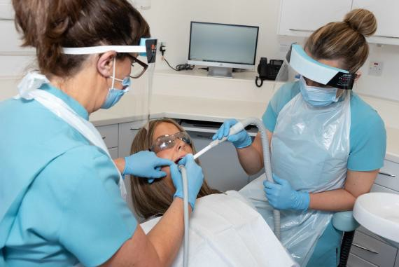
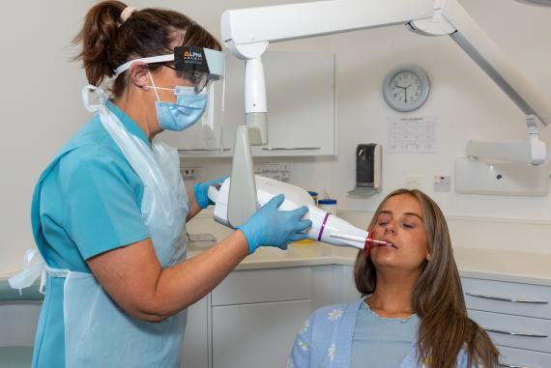
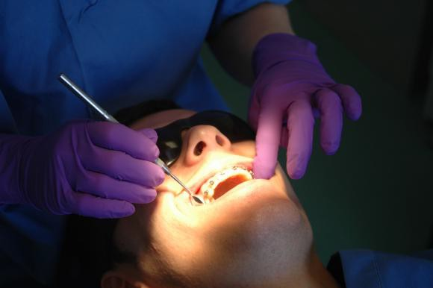
NHS Education for Scotland
Dental Nursing: Career Pathways
Post-Registration
Training Programmes
GDC Registration
(SCQF 8-9)
Modern Apprenticeship in Dental Nursing
Extending DN
Scope of Practice
Employment as a Trainee Dental Nurse.
Pre-registration Training
Development into other DCP roles e.g:
Orthodontic Therapy
Dental Technician
Therapist
Dental Nurse Induction Programme
(SCQF 7)

Slide 42

NHS Education for Scotland

Slide 43






Partnership Working
NHS Education for Scotland
Redesign of the Pre-Registration Dental Nurse qualifications in Scotland:
National Occupational Standards (NOS): Dental Nursing
Scottish Vocational Qualification (SVQ)
Professional Development Award in Dental Nursing (PDA)
Modern Apprenticeship (MA) in Dental Nursing
Safe Practitioner Framework

Slide 44
Roles and Responsibilities
NHS Education for Scotland
NHS Education Apprentice for Scotland
Employer
Off the Job Learning
On and off the Job Learning
On the Job Learning
Design and Delivery of Education Programme
Development of workplace
learning - Skills
Undertake SVQ & PDA in Dental Nursing
Assessment of Apprentice
e.g. Workplace Observation
Supervision Support & Feedback
Quality Assurance and
Continuous Improvement
Participate in Evaluation
Participate in Evaluation
IALP & QPR
IALP & QPR
QPR

Slide 45

Off the Job Learning Programme
NHS Education for Scotland
19 study days over 10 months
Blended approach – in person and online study days
Option: 6 or 1 in person study days at a Dental Education Centre
Online study days delivered via MS Teams
Online portfolio and e-assessment
Assessors support: MS Teams, or at in person days
Use a range of interactive teaching methods to ensure inclusivity and accessibility

Slide 46
NHS Education for Scotland
Initial Stages for Trainee Dental Nurses
Initial Assessment & Learning Plan (IALP) pre-course meeting with assessor to ascertain any Additional Support Needs (ASN)
Completion of e- learning module –
Introduction to MA in Dental Nursing - Turas Learn
Online application to undertake the programme
Registration and Induction into the MA in Dental Nursing

Slide 47
Additional Support Needs (ASN)
NHS Education for Scotland
Programme Lead monitors and adapts as required throughout programme
Assessor informs Programme Lead
Programme Lead meets Apprentice to discuss and confirm ASN
Action Plan created, agreed and implemented
IALP identifies ASN for apprentice

Slide 48

E-learning module
NHS Education for Scotland
Mandatory for apprentices
Recommended to employer/mentors

Slide 49
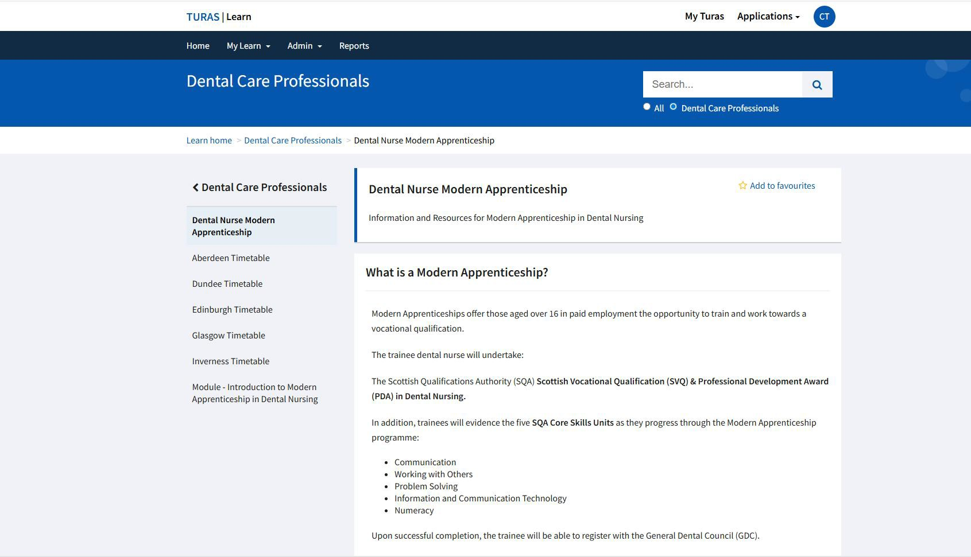

Turas: MA in Dental Nursing webpage resources
NHS Education for Scotland

Slide 50
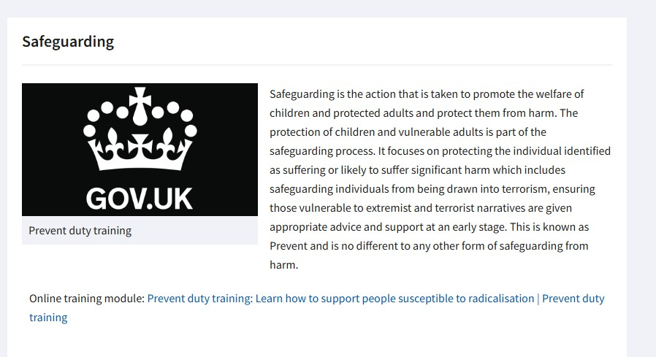

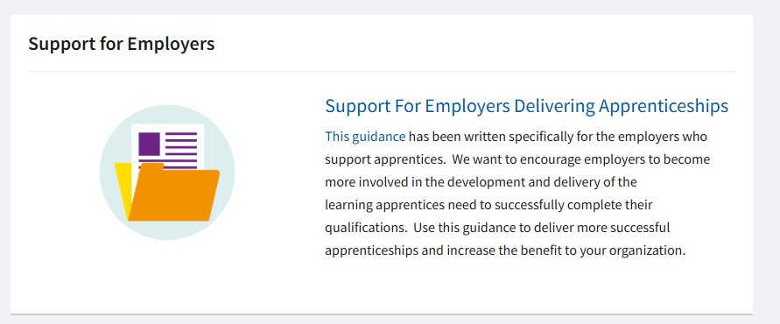
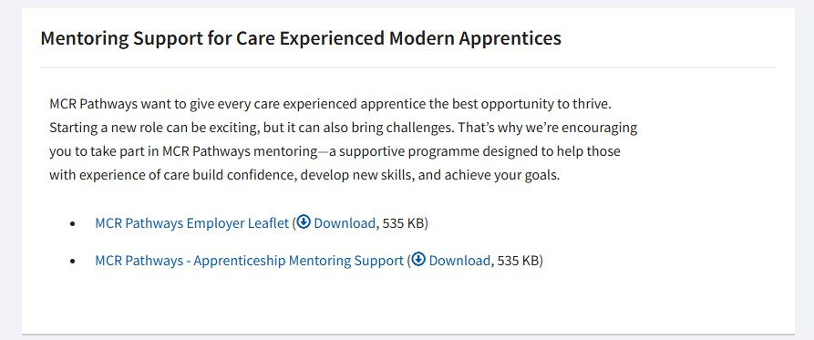
Information and resources:
NHS Education for Scotland

Slide 51
Support for Employers and Workplace Mentors
NHS Education for Scotland
MA SWAY - Modern Apprenticeship in Dental Nursing (Information on the apprenticeship and requirements)
NES - Practice Team Guide (information guide on qualification assessment requirements)
General Dental Council Guidance e.g. Student Fitness to Practice
SDS Modern Apprenticeship in Dental Nursing Framework document

Slide 52
Support and Signposting for Apprentices
NHS Education for Scotland
Mental Health & Wellbeing for the Dental team - Turas link: Mental Health and Wellbeing Support for the Dental Team in Scotland | Turas | Learn
General Dental Council Safe Practitioner Framework – requirements –focus on wellbeing, adaptability and growth.

Slide 53
Introduction of Meta Skills
NHS Education for Scotland
Introduced during the Induction process
New SVQ Unit: OH34 –embedding meta skills and application of SDS meta skills resources – e.g. wheel for reflection (also includes health and wellbeing strategies

Slide 54

OH34
NHS Education for Scotland

Slide 55
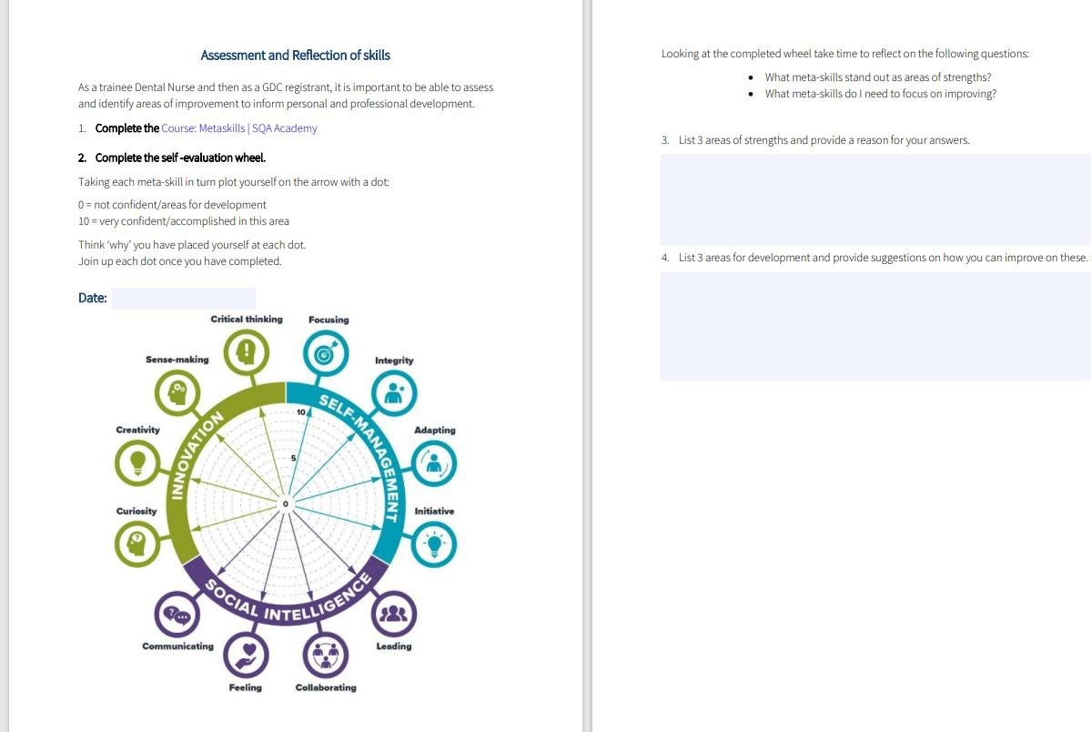
NHS Education for Scotland

Slide 56
Partnerships
NHS Education for Scotland
The importance of the Employer and Apprentice Voice
#SDSMACoP #SDSMACommunityof Practice #SupportforApprentices #wblapprenticeships

Slide 57
NHS Education for Scotland
Information sharing with Employers/Mentors
Completed IALP
QPR Process and Records
Assessment results and progression
ASN – action planning and monitoring
(where required)
Absence reporting

Slide 58
Quarterly Progress Review (QPR) Process
NHS Education for Scotland
Virtual meetings arranged includes
Apprentice
Assessor
Workplace mentor/supervisor
Enabling discussion between all parties in
Reviewing progress
Agreeing short term goals
Identifying ASN

Slide 59
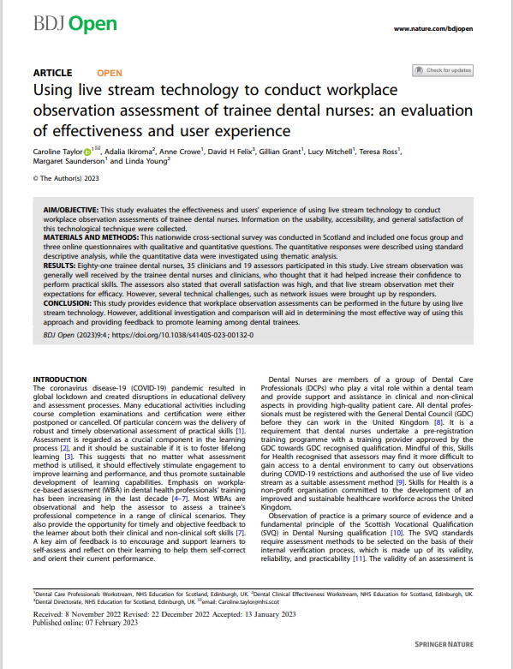
Workplace Observation Assessment
NHS Education for Scotland
Devised 2021
Employer and Apprentice voice
Informed creation of a robust assessment process
Creation of Workplace Guidance and Support

Slide 60
NHS Education for Scotland
Apprentice and Employer Voice within Programme Evaluation
Systematic gathering, analysis and use of learner and employer perception data.
Apprentice
3 stages:
Induction & Initial Study Days
Mid Point Evaluation
End of Programme
Evaluation and Continuous Improvement
NES DCP
Education Team
Employer
Informs our Quality Action Plan and
‘Areas for Improvement’

Slide 61

Evaluation data
NHS Education for Scotland
Informs Self Assessment & Quality Action Plan
e.g.
Have clear evidence that the employer voice is integral to the design and delivery of all provision and clearly adds value to the delivery
How satisfied are employers and stakeholders with our service and relationship?
How satisfied are learners with our provision?

Slide 62
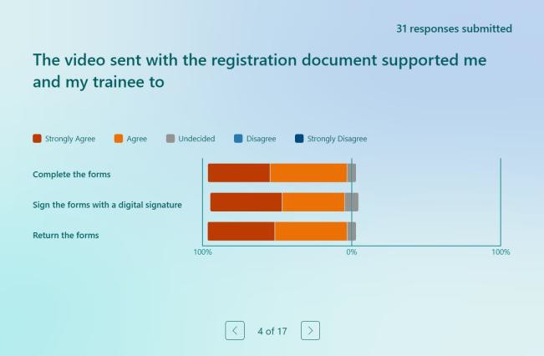
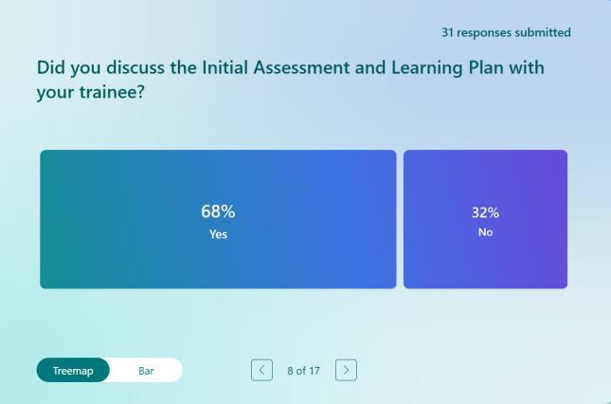
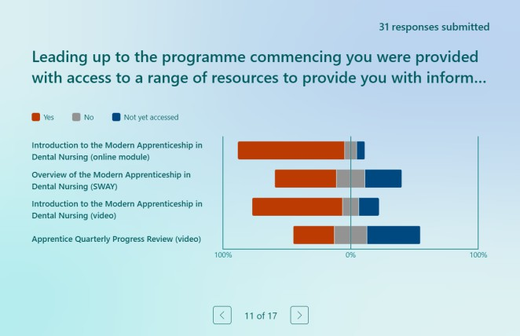
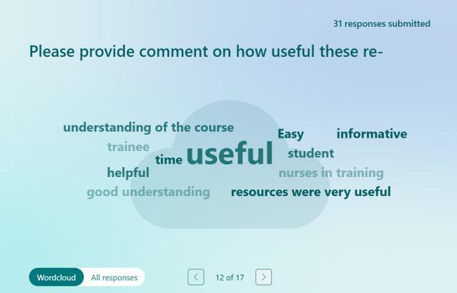
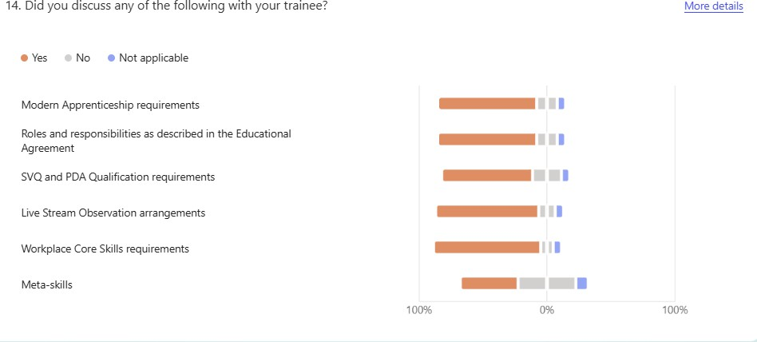
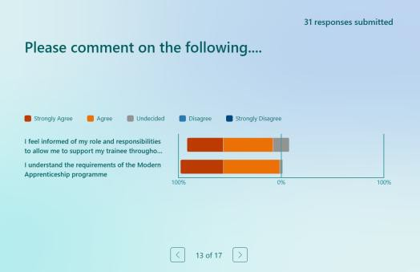
Introduction: Employers’ feedback:
NHS Education for Scotland

Slide 63
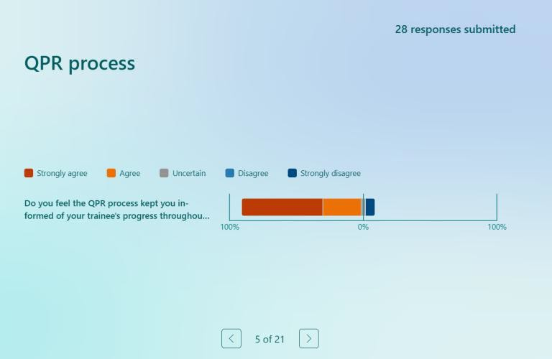
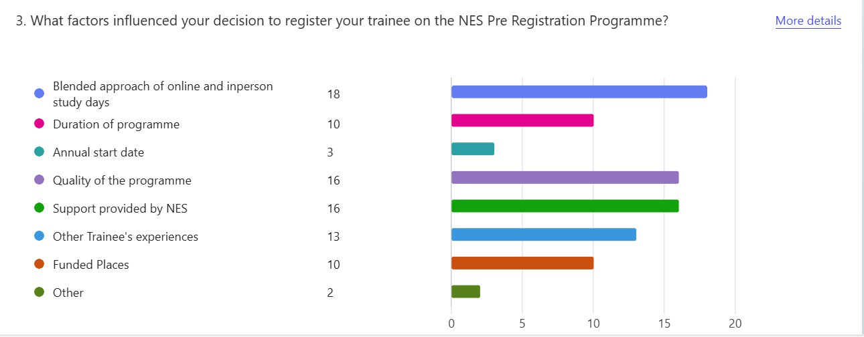
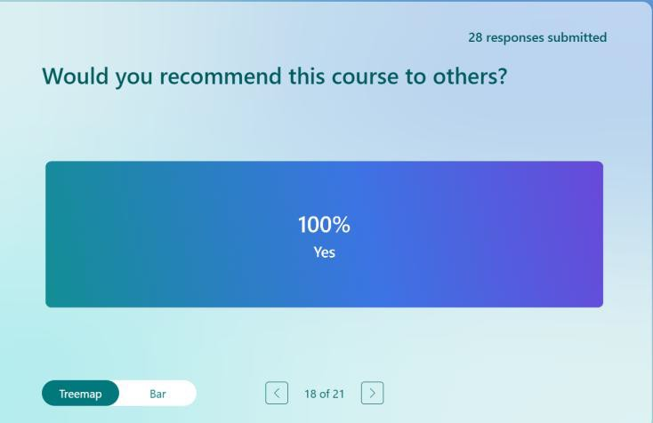
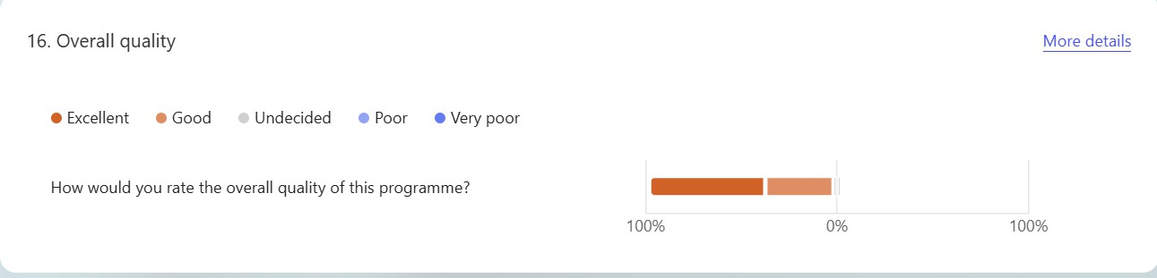
End of Programme: Employers’ feedback
NHS Education for Scotland

Slide 64
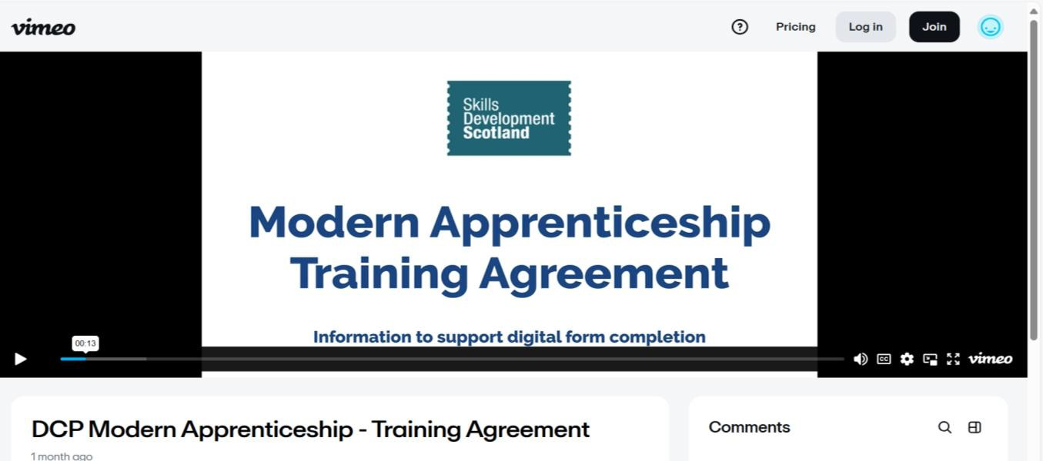
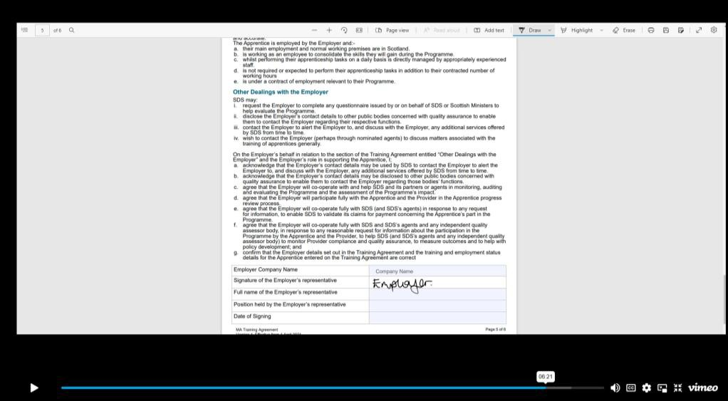
Electronic Signatures – video resources
NHS Education for Scotland

Slide 65
24-25 Annual Report
NHS Education for Scotland
Feedback through SIA monitoring
‘Effective planning was valued by apprentices and employers as, from the outset, they were clear on how and when learning and assessment would take place’.
‘Employers value the clarity provided by the reviews, enabling them to fully understand apprentice progress and objectives and, as a result, they were better equipped to support apprentice progress and achievement of their MA’.
‘Overall feedback indicates reviews were effective, provider support extends beyond SDS requirements and is effectively contributing to progression and achievement of apprentices’.

Slide 66

Apprentice’s next steps..
NHS Education for Scotland
Professional Registration with the General Dental Council
Continued Professional Development
Professional Scope of Practice
Career Pathways

Slide 67
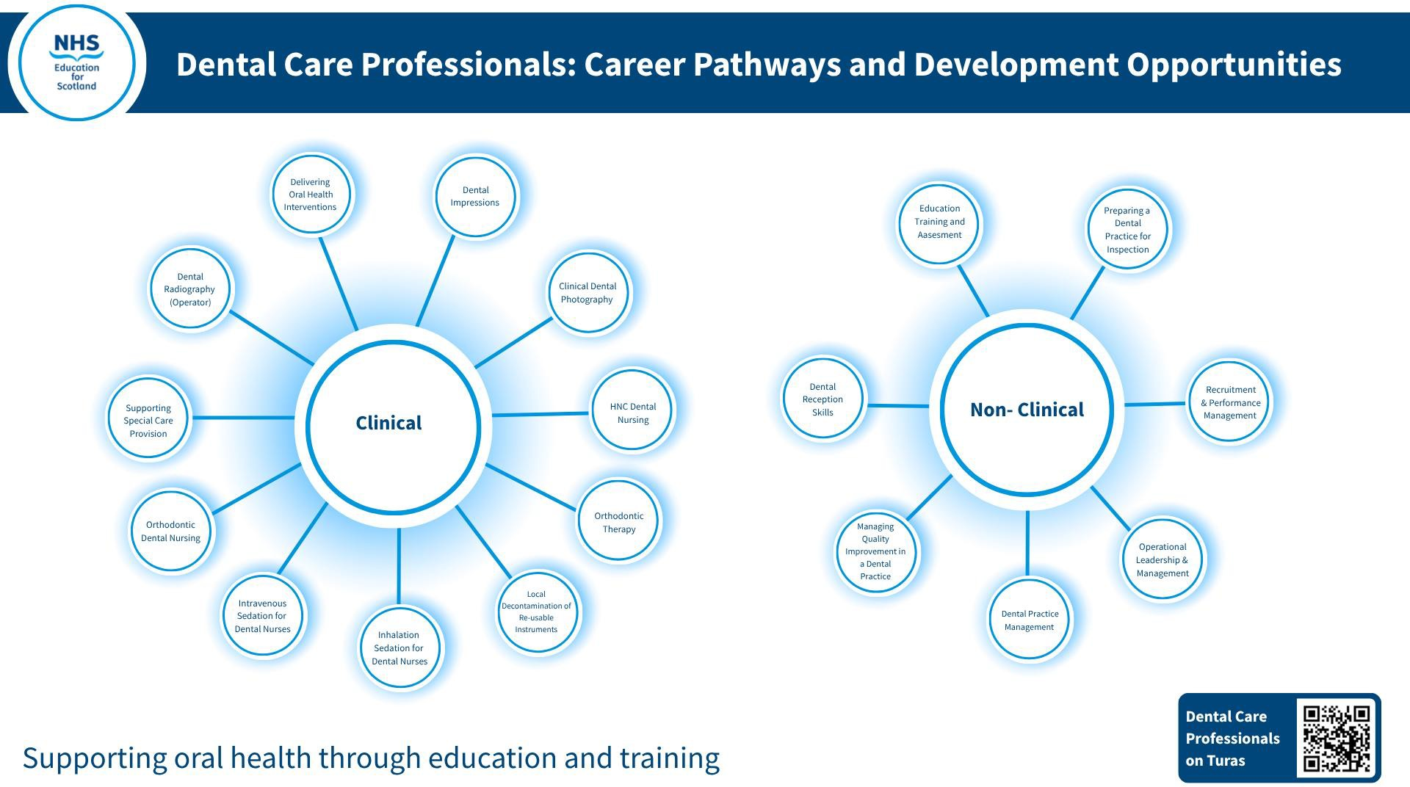
NHS Education for Scotland

Slide 68
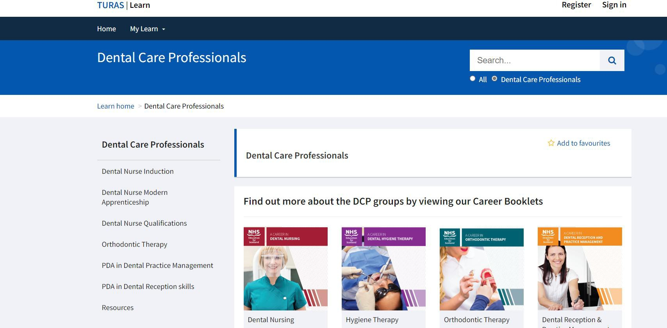
Dental Care Professionals Workstream
NHS Education for Scotland

Slide 69
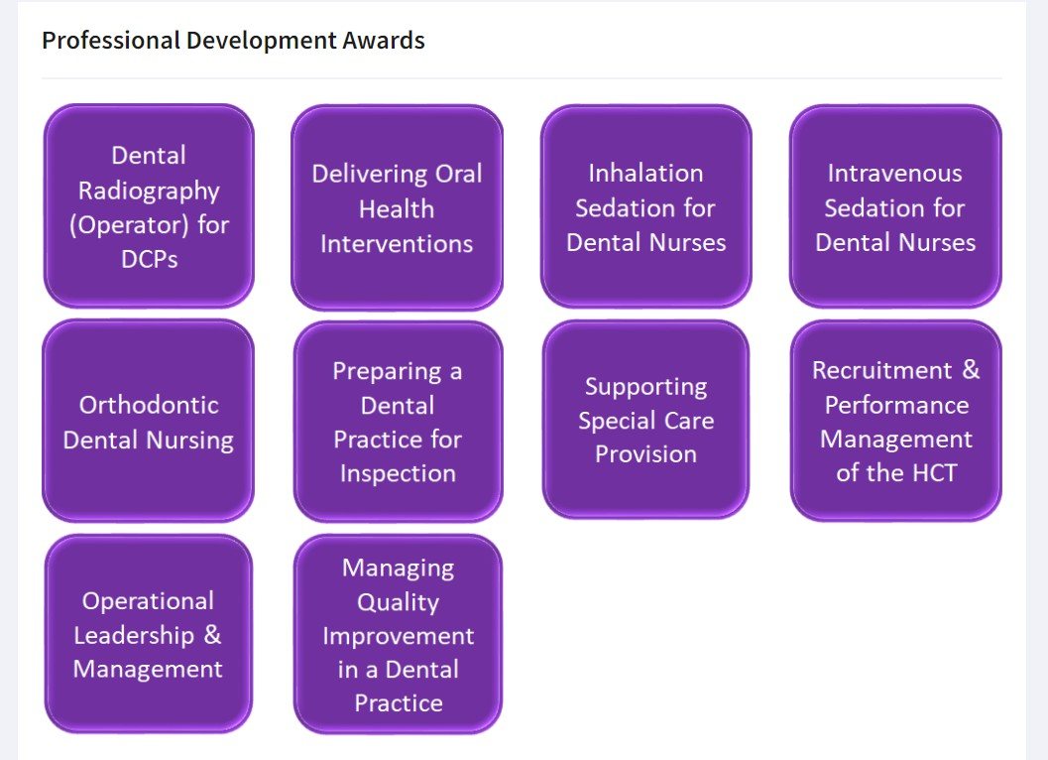
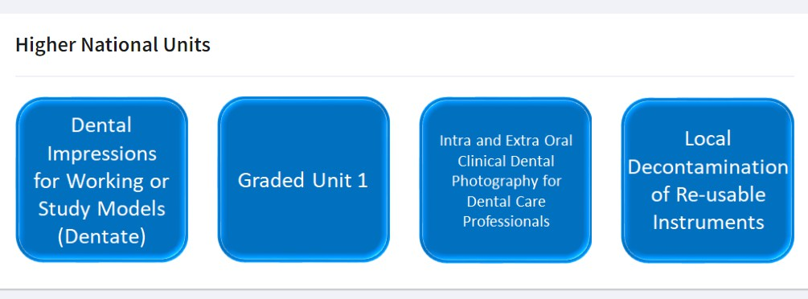
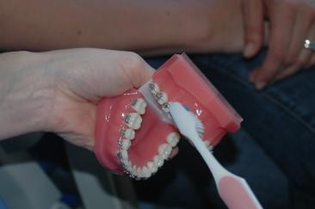


Professional Development Awards and Higher National Units
NHS Education for Scotland

Slide 70
Questions and Discussion
NHS Education for Scotland

Slide 71


NHS Education for Scotland
© NHS Education for Scotland 2019. You can copy or reproduce the information in this resource for use within NHSScotland and for non-commercial educational purposes. Use of this document for commercial purposes is permitted only with the written Permission of NES.

Slide 72
Alastair Gillen
SDS Support Resources

Slide 73

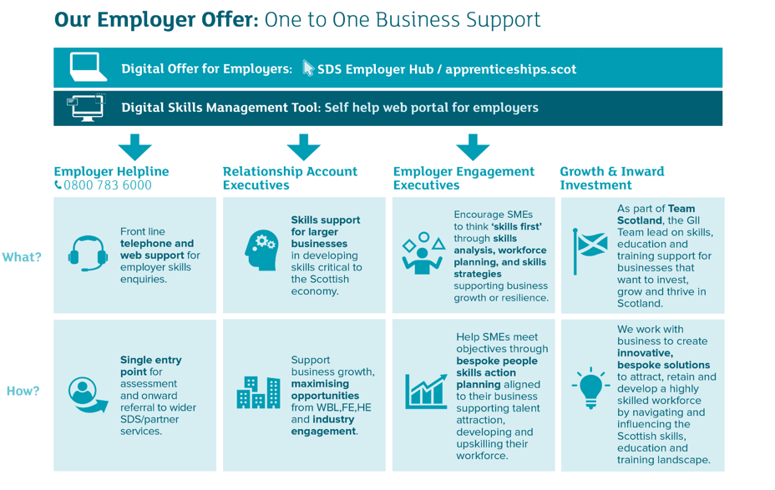
Employer Offer

Slide 74








Employer Hub
Helping employers manage the skills needs of their business
The employer hub supports businesses to:
Create skills action plan
Define future skills needs
Assess skills in business
Get advice & guidance
On-demand webinars
Skills Management Tool
Role Comparison Tool
Organisational Profile Tool

Slide 75
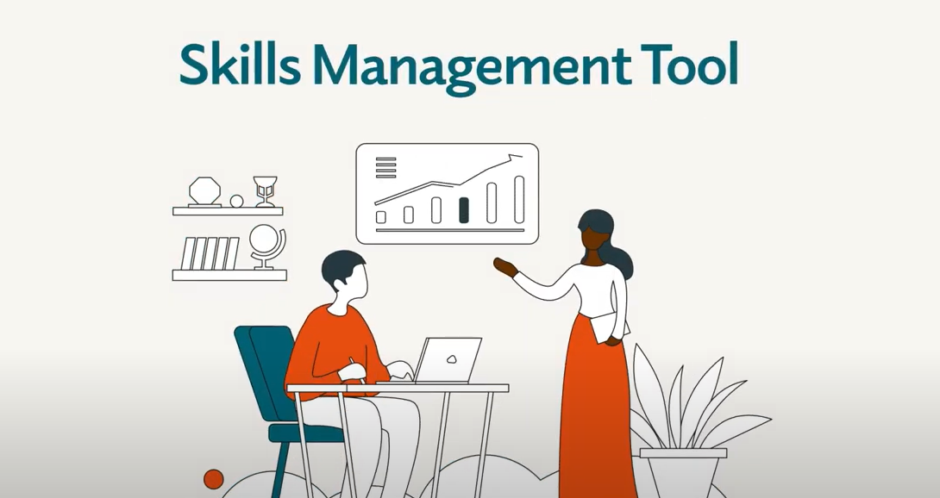



Employer Hub

Slide 76


Slide 77








Skills For Growth
Increase Performance
Skills and knowledge are key to growth and resilience
Build Confidence
Reflect on what skills the business currently has and identify those needed for the future
Attract the right people
Recruit for the skills you don’t already have in the business
Manage
Change
Introduce innovative workplace practices
Support Employees
Staff have the opportunity to be listened to and given an opportunity to develop

Slide 78





Helpful resources

Slide 79

Inclusive recruitment guides and equality resources to support your apprentices
All our resources and guides can be found by clicking this link
Resources cover topics from how to recruit people from diverse back grounds such as young men into care. Or how to support neurodiverse learners.
Notes:
These resources are free to use
They are available on SDS’ corporate website in the Equality and Diversity pages
Equality guides and resources - Skills Development Scotland
We encourage you to share them with your employers
There is information related to the different protected characteristics and care experienced.
The resources are developed by expert organisations.
We add new resources all the time and our new supporting refugees resource will be added soon with advice on employment.
We are also looking to have gambling awareness training in the new year., acting on feedback from providers in the Provider Survey.
We are keen to support providers.
Let us know if there are resources or training you need diversity@sds.co.uk

Slide 80



Guides developed by experts with links to support and tools
There are links to mental health support funded by DWP, mentoring for care experienced apprentices delivered free by MCR Pathways. Take a look here
We organise CPD for providers on topics from improving cross cultural communication to addressing the gender pay gap, check the Provider newsletter or ask your SIA.
Notes:
MCR mentoring available where employer is based in:-
Glasgow
Edinburgh (City of Edinburgh Council area)
Aberdeen (Aberdeen City Council area)
Highland (Highland Council area)
Falkirk
Clackmannanshire
Inverclyde
North Ayrshire
South Lanarkshire
Argyll and Bute
East Dunbartonshire

Slide 81
Alison McConnell
SDS Next Steps, Event Feedback and Close

