Slide 1

Workshop checklist
Read the embedding skills audit tool workshop guidance (slides 2-3).
Review slides and adjust as required to suit the time you have available and the number of participants.
If you are using the embedding skills audit excel scoresheet, save this in a shared space for staff to access during the session and amend the department names.
Print out worksheets (slides 23-32) or store them in a shared space for staff to access electronically. Remind staff to bring a device with them if accessing electronically.
If applicable, amend slide 10 to capture example of your embedding skills journey so far.
Notes:
Overview: This checklist will support you to have a smooth workshop experience. Start by reviewing the skills audit tool guidance in slides 2-3 to familiarize yourself with the framework. Adjust the slide deck according to your available time and participant numbers to keep the session relevant. If you're using the embedding skills audit excel scoresheet, make sure it's saved in a shared location for easy access during the workshop. It's also important to print or digitally share the worksheets from slides 23-32, reminding participants to bring devices if accessing them electronically. Lastly, if relevant, update slide 10 to reflect your embedding skills journey so far, which can provide context for the discussion and support you to celebrate achievements so far.

Slide 2
Workshop guidance
This guidance outlines how the embedding skills audit tool can be used by establishments to self-evaluate the implementation of their skills approach. It is based on the embedding skills approach outlined on page 5 of ‘A Guide to Meta-skills Across the Curriculum’.
What is the embedding skills audit tool?
The embedding skills audit tool supports establishments to self-evaluate their skills approach against illustrative statements highlighting good practice within the commit, embed and mainstream stages of embedding skills.
Who is the embedding skills audit tool for?
This guidance is for using the embedding skills audit tool with extended leadership teams.
How to use the embedding skills audit tool
It is important that a suitable amount of time is set aside to complete the audit tool and allow for meaningful reflection and discussion. Establishments should use the embedding skills audit worksheet and illustrative statements to support them going through the following 3 steps:
Step 1: Scoring – Individuals
Taking each statement in turn, read through the illustrative statements and evaluate whether you are at the emerging, progressing or fully established stage.
  • Emerging is depicted by a score of 1-2
  • Progressing is depicted by a score of 3-4
  • Fully established is depicted by a score of 5.
These examples are not the only ways in which these statements could be scored, and we would ask you to use your own judgement (supported by evidence) when considering your position against the statements. Practitioners can add other examples to determine their score.
After reflection, note down the identified score for each statement using the worksheet provided. There are reflective questions within the individual scoring worksheet to support you to determine your individual score.
Once initial scoring has been completed, assess the overall picture and identify any evidence you have to support your scoring, any examples of interesting practice or any challenges that you would like to discuss at the departmental meeting.
The commit stages give the foundations to a skills approach, and it is advised to concentrate on this stage first if your scoring does not reflect strong foundations in which to build on the embed and mainstream stages.
Notes:
Overview: This slide outlines the purpose and usage of the embedding skills audit tool. The embedding skills audit tool is a mechanism for establishments to self-evaluate their skills approach against a 3-stage model of embedding skills. The tool is designed for extended leadership teams, emphasising the importance of time for reflection and discussion during the evaluation process. The three-step scoring system allows individuals to categorise their progress, to help establishments identify their strengths and areas for improvement.

Slide 3
Workshop guidance
Embedding skills audit tool
Step 2: Focused discussion – In pairs
Once all scores have been inputted into the excel document, reflect on your department score across all statements discuss in pairs:
What you are doing well
What the challenges are
What the opportunities are
Capture the key points of your discussion within the focused discussion worksheet provided. There are reflective questions within the worksheet to support your discussion. Use the last box in the worksheet to capture what you feel the priorities should be regarding your establishments approach to embedding skills moving forward. For example, any specific statements, concerns or areas for improvement that you think need to be prioritised and actioned against.
Within the ‘Embedding Skills Audit Tool- Scoresheet’ excel document, an overall establishment score for each statement across the commit, embed and mainstream stages has been automatically generated. You can view your establishment’s average scores as a bar chart within the ‘Bar Chart’ tab. Prior to moving into the actin planning step, the facilitator should show staff the average whole school scores, depicted in a bar chart within the ‘Embedding Skills Audit Tool- Excel Scoresheet’ and discuss any themes highlighted.
  Step 3: Action planning – As a group
Using this quantitative data and the qualitative data captured on the focused discussion worksheets, consider the following:
  What are your establishments overall areas of strength
  What are your establishments overall areas for improvement
Capture key points within the action planning worksheet provided. From these key points, identify key areas for improvement that you would like to action against. Taking each key area for improvement in turn, identify targets you would like to meet and break these down into:
Tasks
Staff responsible
Resource required
Timescale
Success criteria
Finally, decide the best way to monitor progress with your key areas for improvement and communicate these to all staff.
Notes:
Overview: In these steps, participants will engage in focused discussions in pairs, reflecting on their department’s scores. This collaborative approach encourages the sharing of insights on strengths, challenges, and opportunities. The goal is to capture key points in the provided worksheet, which will guide future action planning. The subsequent action planning phase will utilize both quantitative and qualitative data to identify areas for improvement and set actionable targets.

Slide 4


Embedding Skills Audit Tool
Professional learning for practitioners
Presenter name
Notes:
Face to Face workshop
Timings: Minimum of 75 mins
Background:
This workshop is aimed at extended leadership teams (both primary and secondary) to evaluate their whole school approach to embedding skills across the curriculum.
Resource checklist
Read the skills audit tool guidance (slides 2-4)
Go through slide deck and amend to suit the time you have and amount of participants.
If you are using the embedding skills audit excel scoresheet, save this is a shared space for staff to access during the session.
Print out worksheets (slides 23-33) or store them in a shared space for staff to access electronically. Remind staff to bring a device with them if accessing electronically.
If applicable, amend slide 11 to capture example of your embedding skills journey so far.

Slide 5
Aim and Outcomes
Aim:
To support extended leadership teams to undertake a self-evaluation of their whole school approach to embedding skills against statements of good practice within the three stages of embedding skills: commit, embed and mainstream.
Learning Outcomes:
By the end of the session, you will have:
Completed a self-evaluation against illustrative statements within the embedding skills audit tool
Had a focused discussion on what is working well, what are the challenges and what are the opportunities in relation to the statements.
Completed an introductory action plan based on your reflections.
Notes:
Overview: The aim of this session is to empower extended leadership teams to evaluate their school's approach to embedding skills. By the end, participants will have completed a self-evaluation, engaged in meaningful discussions about their practices, and developed an introductory action plan based on their reflections.

Slide 6








Skills in the curriculum
Curriculum for Excellence
UNCRC
The curriculum for excellence aims to provide learners with the knowledge, skills and attributes needed to thrive in the 21st century.
Promote the development of children and young people’s personalities and talents to their full potential, including mental, physical, and creative pursuits.
Embedding Skills
National Improvement Framework
Career Education Standard/ Career Review
Highlights the importance of the development of knowledge, skills, values, and attributes that give learners the best opportunity to navigate and contribute to Scotland’s society and economy.
Learners are entitled to develop skills for learning, life and work as an integral part of their education and be clear about how all their achievements relate to these. They should have opportunities to engage in profiling that supports learning and the development of skills for work and future career choices
HMIe
Education Reform
Enhanced expectations on schools having a shared skills framework, the ability of young people to talk about their skills development ​and on the systematic tracking and profiling of skills and achievements .
Clarifying the role and purpose of skills will be a key area of work in the CIC process; working towards a clearer alignment of skills across the curriculum.
Notes:
Key message: a number of key policy drivers within the education system highlight the importance of embedding skills in the curriculum.
Notes:
Curriculum for Excellence: The curriculum for excellence aims to provide learners with the knowledge, skills and attributes needed to thrive in the 21st century.
National Improvement Framework: Highlights the importance of the development of knowledge, skills, values, and attributes that give learners the best opportunity to navigate and contribute to Scotland’s society and economy.
HMIe: Enhanced expectations on schools having a shared skills framework, the ability of young people to talk about their skills development ​and on the systematic tracking and profiling of skills and achievements .
UNCRC: Promote the development of children and young people’s personalities and talents to their full potential, including mental, physical, and creative pursuits.
Career Education: Learners are entitled to develop skills for learning, life and work as an integral part of their education and be clear about how all their achievements relate to these. They should have opportunities to engage in profiling that supports learning and the development of skills for work and future career choices
Education Reform: Clarifying the role and purpose of skills will be a key area of work in the CIC process; working towards a clearer alignment of skills across the curriculum.
This approach aims to nurture the holistic development of children and young people, ensuring they are prepared for future challenges.
Links:
Curriculum for Excellence refreshed narrative: https://home.scotlandscurriculum.scot/
National Improvement Framework: https://www.gov.scot/binaries/content/documents/govscot/publications/strategy-plan/2024/12/achieving-excellence-equity-2025-national-improvement-framework/documents/achieving-excellence-equity-2025-national-improvement-framework/achieving-excellence-equity-2025-national-improvement-framework/govscot%3Adocument/achieving-excellence-equity-2025-national-improvement-framework.pdf
HMIe: https://education.gov.scot/inspection-and-review/find-an-inspection-report/find-an-inspection-report/?searchFor=schoolsOrganisations&orderAlias=relevance
UNCRC: https://www.playscotland.org/resources/print/CRC_POSTER_LEAFLET_FINAL.pdf?plsctml_id=11961
Career Education Standard: https://education.gov.scot/media/1okhy35c/dyw2-career-education-standard-0915.pdf
Career Review: https://www.skillsdevelopmentscotland.co.uk/media/xvync3xg/career-review-final-report-230306-final.pdf
Education Reform Curriculum Improvement Cycle: https://blogs.glowscotland.org.uk/glowblogs/cices/

Slide 7


The importance of skills in the economy
Future Trends for Scotland 2025, highlighted the focus on lifelong learning and skills will grow in the future
There is increasing focus on ‘meta-skills’, i.e. skills that create adaptive learners and thinkers such as communication, collaboration, creativity and critical thinking.
Did you know
71%
of over 5000 Scottish employers considered
meta-skills to be of ‘significant’
or ‘critical’ importance when recruiting
Scottish Government (2025) Future Trends for Scotland
Scottish Government (2022) Employer Skills Survey
Notes:
Overview: Future trends indicate a growing emphasis on lifelong learning and the development of meta-skills, which are critical for adaptive learners. The Employer Skills Survey 2022 noted the importance employers place on skills.
These reports provide future evidence that providing opportunities for learners to develop their skills is key to supporting them for the future.
Key message:
The importance of skills has been highlighted in Future Trends for Scotland forecasts for the economy as well as within the 2022 Employer Skills Survey.
Notes:
The recent Future Trends for Scotland 2025 publication provides robust evidence of trends likely to be important in Scotland over the next 10 to 20 years. The trends cover a broad range of themes including the economy.
Within this theme it was noted that the focus on skills will grow in the future. With an increasing focus on ‘meta-skills’, i.e. skills that create adaptive learners and thinkers such as communication, collaboration, creativity and critical thinking.
The importance of skills has also been highlighted by over 5000 employers within the 2022 Employer Skills Survey. Within this survey seven in ten (71%) employers considered meta-skills such as problem-solving, critical thinking, communication and leadership, to be of critical or significant importance when recruiting.
Further information:
Future Trends for Scotland 2025
https://www.gov.scot/binaries/content/documents/govscot/publications/research-and-analysis/2025/06/future-trends-scotland-findings-2024-25-horizon-scanning-project/documents/future-trends-scotland-findings-2024-25-horizon-scanning-project/future-trends-scotland-findings-2024-25-horizon-scanning-project/govscot%3Adocument/future-trends-scotland-findings-2024-25-horizon-scanning-project.pdf
The Employer Skills Survey 2022 - Scotland
https://www.gov.scot/binaries/content/documents/govscot/publications/statistics/2023/11/uk-employer-skills-survey-2022-scotland-report/documents/employer-skills-survey-2022-scotland-report/employer-skills-survey-2022-scotland-report/govscot%3Adocument/employer-skills-survey-2022-scotland-report.pdf published in November 2023.

Slide 8
A whole school approach to embedding skills
Notes:
Key message: A whole school approach to embedding skills is essential to support learners to identify, understand, harness and articulate their skills.

Slide 9
A whole setting approach to embedding skills
Commit
Embed
Mainstream
Review the skills framework
Practitioners understand the language/framework
Practitioners understand their role and responsibilities
Establish a common language/skills framework
Learners have time to reflect on their skills within learning activities
Space is given within the curriculum for learners to record, discuss and explore their skills
Skills are identified when planning learning and are included in the learning intentions and success criteria
Review if skills conversation is woven across the curriculum
Skills language used - Primary school to Secondary school and College.
Skills are visible in the classroom
Notes:
Overview: This slide presents a structured approach to embedding skills within educational settings. It outlines the commit, embed, and mainstream stages, emphasising the importance of establishing a common language and framework, integrating skills into everyday practice, and ensuring consistent application across all levels of education.
Key Message: There are three stages to embedding skills into the curriculum
Notes: On screen now we can see the stages involved to best embed skills into the curriculum.
The first stage focuses on commitment. It starts with establishing a common language/ skills framework as well as developing an understanding of this language/framework and practitioner's roles. This initial stage will support the ability to embed skills within the curriculum, by laying strong foundations.
The embed stage focuses on identifying skills when planning learning and recognises the importance of making skills visible in the classroom. It is very clear that learners develop skills within their learning. By making skills more explicit in learning, learners will be able to recognise these skills within themselves.
Therefore:
Making skills more visible
highlighting how they link to learning
giving time to reflect,
Providing space to record and explore skills
enables learners to develop and understand their skills, supporting them to manage and grow in their future
The final stage is mainstream. This stage recognises the need to review and reflect on this process as well as supporting the learner journey by using a shared skills language through primary to secondary and beyond.

Slide 10
Our embedding skills journey so far…
This is an optional slide to capture any information/images about your embedding skills journey so far to recognise progress and that this session is about building on our progress so far and identifying next steps. You could organise your examples within the themes of commit, embed and mainstream to put these terms into context for staff.
Notes:
Overview: This is an optional slide to capture any information/images about your embedding skills journey so far to recognise progress and that this session is about building on our progress so far and identifying next steps. You could organise your examples within the themes of commit, embed and mainstream to put these terms into context for staff.

Slide 11
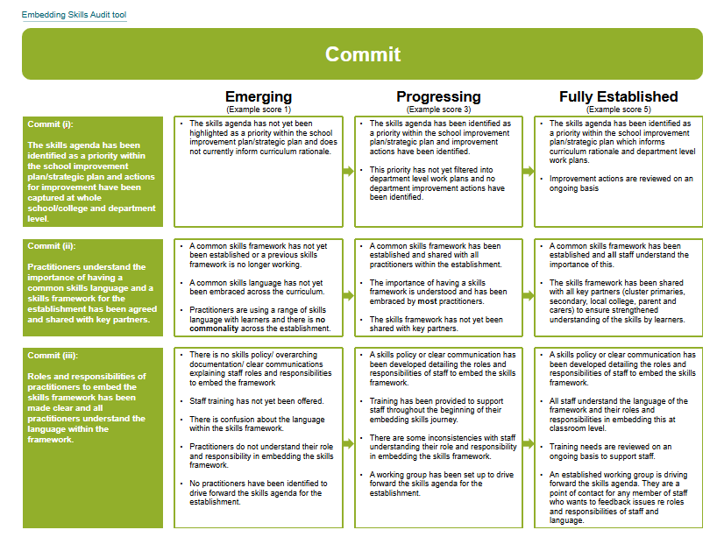
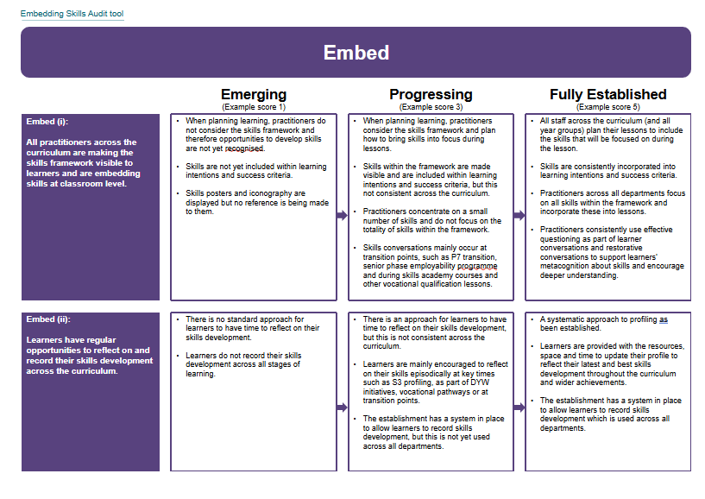
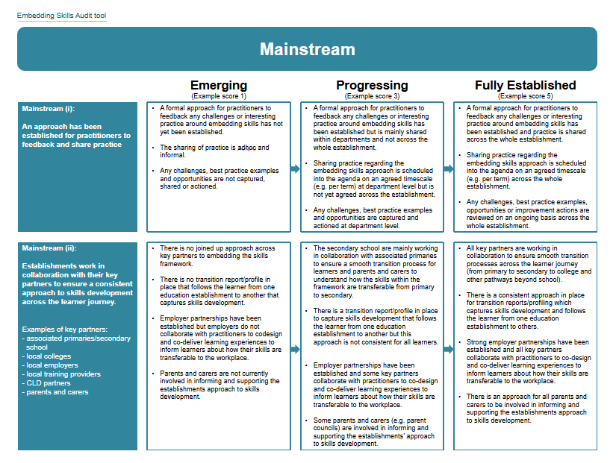
Embedding Skills Audit Tool
​The embedding skills audit tool supports establishments to self-evaluate their skills approach against illustrative statements highlighting good practice within the commit, embed and mainstream stages of embedding skills.
Notes:
Key Message: The embedding skills audit tool supports establishments to self-evaluate their skills approach against illustrative statements highlighting good practice within the commit, embed and mainstream stages of embedding skills.

Slide 12






Embedding Skills Audit Tool
Individually score where you feel your department are on the emerging, progressing or fully established scale.
In pairs discuss and capture your strengths, challenges and opportunities as a department.
As a group
Identify and capture agreed key areas for improvement.
10 minutes
20 minutes
30 minutes
Notes:
Overview: Participants are encouraged to individually score their department's progress on the emerging, progressing, or fully established scale. They will then participate in a collaborative discussion on strengths, challenges, and opportunities, leading to a collective understanding of areas for improvement.
Key Message: There are three steps to completing the embedding skills audit tool: individual scoring, focused discussion and action planning.
Notes:
Outline the three steps, the activities that staff will be completing and timings associated with each activity:
(1) Individually score where you feel your department are on the emerging, progressing or fully established scale.
(2) In pairs discuss and capture your strengths, challenges and opportunities as a department.
(3) As a group Identify and capture agreed key areas for improvement.
Note: Timings can be amended to suit the time you have available and group sizes can be amended or removed based on how many practitioners are expected to participate. For example, you might ask staff to complete the first step prior to attending the workshop.

Slide 13
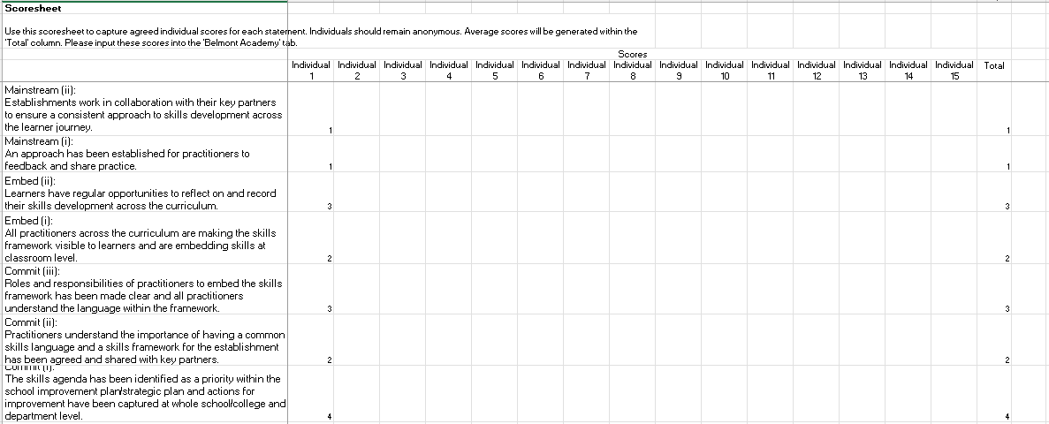
Scoring
Taking each statement in turn, evaluate where you feel your department are on the emerging, progressing or fully established scale.
​
Emerging is depicted by a score of 1-2​
Progressing is depicted by a score of 3-4​
Fully established is depicted by a score of 5.​
Capture your scores on the ‘skills audit excel scoresheet’, using the reflective questions to support you.
Illustrative Statements
Excel Scoresheet
Notes:
Activity duration: 10 minutes
Overview: This slide introduces illustrative statements and the Excel scoresheet, which are essential for capturing and analysing data related to the embedding skills audit. These tools will support departments in their self-evaluation process.
Key message: Ask staff to take each statement in turn and evaluate where they feel their department are on the emerging, progressing or fully established scale.
Notes:
​
Emerging is depicted by a score of 1-2​
Progressing is depicted by a score of 3-4​
Fully established is depicted by a score of 5.​
The provided examples are not the only ways in which these statements could be scored, and we would ask you to use your own judgement (supported by evidence) when considering your position against the statements. Staff can add other examples to determine their score.
Capture your scores on the ‘embedding skills audit excel scoresheet’, using the reflective questions on the individual scoring worksheet to support you.

Slide 14
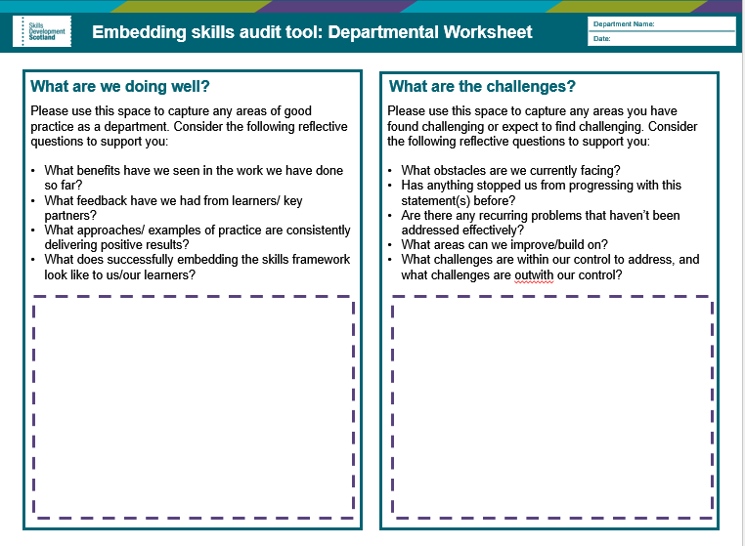
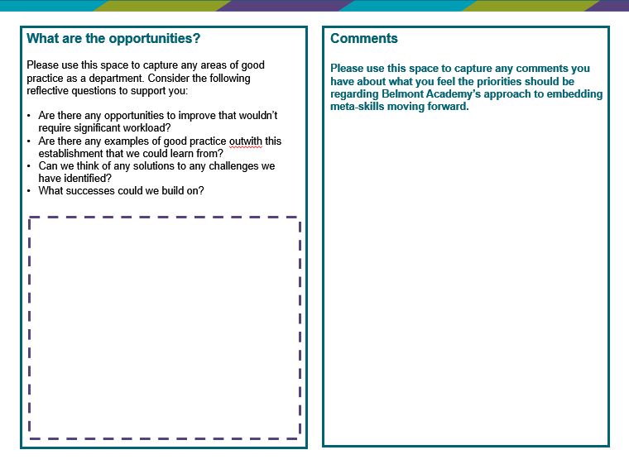
Focused Discussion
Discuss your strengths, challenges and opportunities as a department and key points on the ‘department worksheets’ provided.
Department Worksheets
Notes:
Activity duration: 20 minutes
Overview: This slide introduces department worksheets which can be used to document discussions and reflections during the embedding skills audit process. They provide a structured format for capturing insights and action points to support step 3.
Key message:
Ask staff to work in pairs and discuss their strengths, challenges and opportunities as a department and key points on the ‘department worksheets’ provided.
Notes:
Staff can use discussion prompts provided within the worksheets to support discussion, if necessary.
Whilst staff are working on department worksheets, check the bar chart depicting the average score for the school. You can keep this open as a tab on your device to show prior to action planning or screenshot/right click and copy the chart into a slide.

Slide 15
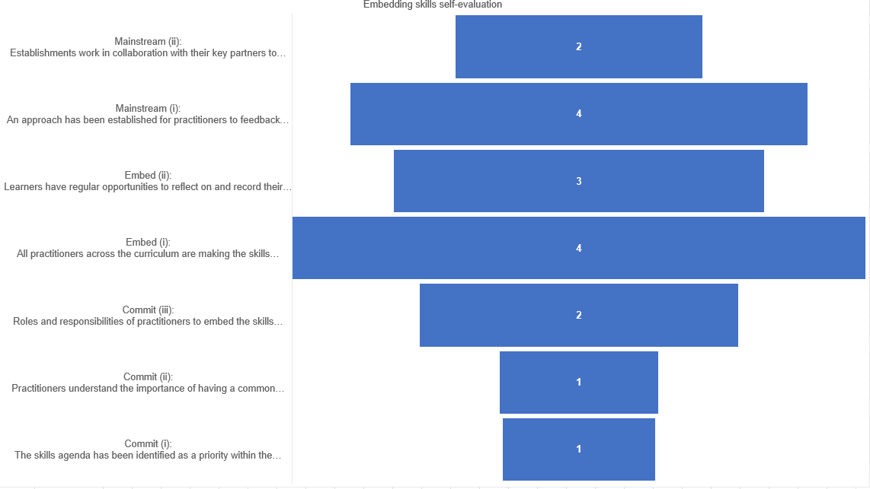
Optional slide for whole school bar chart
Capture any common themes here.
Notes:
Overview: This optional slide for the whole school bar chart allows participants to visualize common themes identified during the embedding skills audit. It serves as a tool for summarising findings and guiding further discussions.
Key message: This slide shows the average whole school score, depicted as a bar chart within the ‘Embedding skills audit tool – excel scoresheet’.
Notes:
The commit statements appear at the bottom of the chart to represent that we want to ensure that we a build strong foundation and structure to ensure that we can fully implement our skills framework to support learners to understand their skills. If this foundation isn’t strong, it could impact consistency across the embedding stage.
This is an optional slide for you to amend to copy and paste the average whole school score bar chart generated for you within the embedding skills audit tool excel scoresheet. (right click and copy on the excel and then paste into the PowerPoint. Alternatively, use snipping tool or print screen or you can show the chart from the excel.

Slide 16
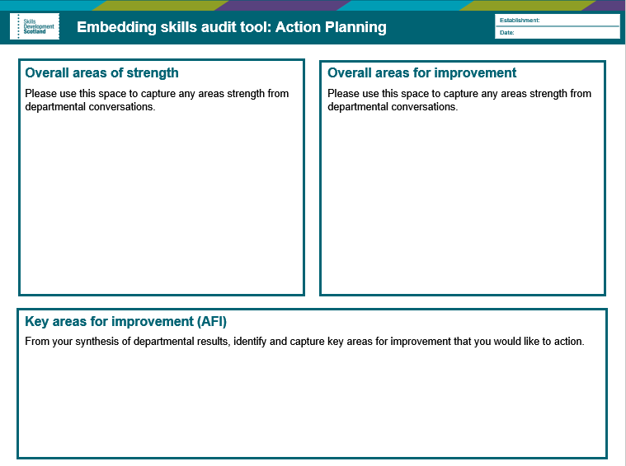
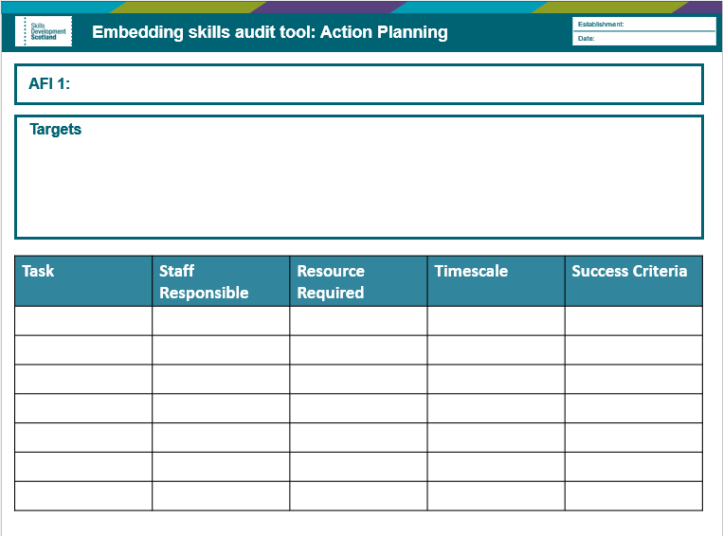
Action Planning
From quantitative and qualitative data captured, identify common themes for strengths and areas for improvement.
Identify and capture agreed key areas for improvement
For each area of improvement, identify targets and break down targets into manageable tasks with agreed timescales.
Action Planning Worksheets
Notes:
Activity duration: 30 minutes
Overview: This slide introduces action planning worksheets which support staff to translate insights from reflective discussions into actionable steps. They help teams identify specific areas for improvement and outline strategies for implementation.
Key message: Ask staff to work as a whole group to identify key areas of strength and key areas for improvement before voting/agreeing the areas for improvement that would have the most impact/ that you want to take forward as measurable actions.
Notes:
Working as a whole group:
From quantitative (excel score) and qualitative (worksheets) data captured, identify common themes for strengths and areas for improvement.
Identify and capture agreed key areas for improvement
For each area of improvement, identify targets and break down targets into manageable tasks with agreed timescales.
If you would prefer, please use your own action planning template.

Slide 17
Thank you
Making skills work for Scotland
Notes:
Key message: As we conclude, thank you for your engagement and contributions. Action planning will help us to ensure our approach best supports our learners to recognise and develop their skills within our setting and beyond

Slide 18
Illustrative statements
Notes:
Illustrative statements – slide 20-22

Slide 19
Embedding Skills Audit tool
Embedding skills: commit stage
Commit
 |  | Emerging (Example score 1) |  | Progressing (Example score 3) |  | Fully Established (Example score 5)
Commit (i): The skills agenda has been identified as a priority within the school improvement plan/strategic plan and actions for improvement have been captured at whole school/college and department level. |  | The skills agenda has not yet been highlighted as a priority within the school improvement plan/strategic plan and does not currently inform curriculum rationale. |  | The skills agenda has been identified as a priority within the school improvement plan/strategic plan and improvement actions have been identified. This priority has not yet filtered into department level work plans and no department improvement actions have been identified. |  | The skills agenda has been identified as a priority within the school improvement plan/strategic plan which informs curriculum rationale and department level work plans. Improvement actions are reviewed on an ongoing basis
Commit (ii): Practitioners understand the importance of having a common skills language and a skills framework for the establishment has been agreed and shared with key partners. |  | A common skills framework has not yet been established, or a previous skills framework is no longer working. A common skills language has not yet been embraced across the curriculum. Practitioners are using a range of skills language with learners and there is no commonality across the establishment. |  | A common skills framework has been established and shared with all practitioners within the establishment. The importance of having a skills framework is understood and has been embraced by most practitioners. The skills framework has not yet been shared with key partners. |  | A common skills framework has been established, and all staff understand the importance of this. The skills framework has been shared with all key partners (cluster primaries, secondary, local college, parent and carers) to ensure strengthened understanding of the skills by learners.
Commit (iii): Roles and responsibilities of practitioners to embed the skills framework has been made clear and all practitioners understand the language within the framework. |  | There is no skills policy/ overarching documentation/ clear communications explaining staff roles and responsibilities to embed the framework Staff training has not yet been offered. There is confusion about the language within the skills framework. Practitioners do not understand their role and responsibility in embedding the skills framework. No practitioners have been identified to drive forward the skills agenda for the establishment. |  | A skills policy or clear communication has been developed detailing the roles and responsibilities of staff to embed the skills framework. Training has been provided to support staff throughout the beginning of their embedding skills journey. There are some inconsistencies with staff understanding their role and responsibility in embedding the skills framework. A working group has been set up to drive forward the skills agenda for the establishment. |  | A skills policy or clear communication has been developed detailing the roles and responsibilities of staff to embed the skills framework. All staff understand the language of the framework and their roles and responsibilities in embedding this at classroom level. Training needs are reviewed on an ongoing basis to support staff. An established working group is driving forward the skills agenda. They are a point of contact for any member of staff who wants to feedback issues re roles and responsibilities of staff and language.
Notes:
Can be printed or used electronically. If printing, A3 is recommended.

Slide 20
Embedding Skills Audit tool
Embedding skills: commit stage
Embed
 |  | Emerging (Example score 1) |  | Progressing (Example score 3) |  | Fully Established (Example score 5)
Embed (i): All practitioners across the curriculum are making the skills framework visible to learners and are embedding skills at classroom level. |  | When planning learning, practitioners do not consider the skills framework and therefore opportunities to develop skills are not yet recognised. Skills are not yet included within learning intentions and success criteria. Skills posters and iconography are displayed but no reference is being made to them. |  | When planning learning, practitioners consider the skills framework and plan how to bring skills into focus during lessons. Skills within the framework are made visible and are included within learning intentions and success criteria, but this not consistent across the curriculum. Practitioners concentrate on a small number of skills and do not focus on the totality of skills within the framework. Skills conversations mainly occur at transition points, such as P7 transition, senior phase employability programme and during skills academy courses and other vocational qualification lessons. |  | All staff across the curriculum (and all year groups) plan their lessons to include the skills that will be focused on during the lesson. Skills are consistently incorporated into learning intentions and success criteria. Practitioners across all departments focus on all skills within the framework and incorporate these into lessons. Practitioners consistently use effective questioning as part of learner conversations and restorative conversations to support learners’ metacognition about skills and encourage deeper understanding.
Embed (ii): Learners have regular opportunities to reflect on and record their skills development across the curriculum. |  | There is no standard approach for learners to have time to reflect on their skills development. Learners do not record their skills development across all stages of learning. |  | There is an approach for learners to have time to reflect on their skills development, but this is not consistent across the curriculum. Learners are mainly encouraged to reflect on their skills episodically at key times such as S3 profiling, as part of DYW initiatives, vocational pathways or at transition points. The establishment has a system in place to allow learners to record skills development, but this is not yet used across all departments. |  | A systematic approach to profiling as been established. Learners are provided with the resources, space and time to update their profile to reflect their latest and best skills development throughout the curriculum and wider achievements. The establishment has a system in place to allow learners to record skills development which is used across all departments.
Notes:
Can be printed or used electronically. If printing, A3 is recommended

Slide 21
Embedding Skills Audit tool
Embedding skills: commit stage
Mainstream
 |  | Emerging (Example score 1) |  | Progressing (Example score 3) |  | Fully Established (Example score 5)
Mainstream (i): An approach has been established for practitioners to feedback and share practice |  | A formal approach for practitioners to feedback any challenges or interesting practice around embedding skills has not yet been established. The sharing of practice is adhoc and informal. Any challenges, best practice examples and opportunities are not captured, shared or actioned. |  | A formal approach for practitioners to feedback any challenges or interesting practice around embedding skills has been established but is mainly shared within departments and not across the whole establishment. Sharing practice regarding the embedding skills approach is scheduled into the agenda on an agreed timescale (e.g. per term) at department level but is not yet agreed across the establishment. Any challenges, best practice examples and opportunities are captured and actioned at department level. |  | A formal approach for practitioners to feedback any challenges or interesting practice around embedding skills has been established and practice is shared across the whole establishment. Sharing practice regarding the embedding skills approach is scheduled into the agenda on an agreed timescale (e.g. per term) across the whole establishment. Any challenges, best practice examples, opportunities or improvement actions are reviewed on an ongoing basis across the whole establishment.
Mainstream (ii): Establishments work in collaboration with their key partners to ensure a consistent approach to skills development across the learner journey. Examples of key partners: - associated primaries/secondary school - local colleges - local employers - local training providers - CLD partners - parents and carers |  | There is no joined up approach across key partners to embedding the skills framework. There is no transition report/profile in place that follows the learner from one education establishment to another that captures skills development. Employer partnerships have been established but employers do not collaborate with practitioners to codesign and co-deliver learning experiences to inform learners about how their skills are transferable to the workplace. Parents and carers are not currently involved in informing and supporting the establishments approach to skills development. |  | The secondary school are mainly working in collaboration with associated primaries to ensure a smooth transition process for learners and parents and carers to understand how the skills within the framework are transferable from primary to secondary. There is a transition report/profile in place to capture skills development that follows the learner from one education establishment to another but this approach is not consistent for all learners. Employer partnerships have been established and some key partners collaborate with practitioners to co-design and co-deliver learning experiences to inform learners about how their skills are transferable to the workplace. Some parents and carers (e.g. parent councils) are involved in informing and supporting the establishments’ approach to skills development. |  | All key partners are working in collaboration to ensure smooth transition processes across the learner journey (from primary to secondary to college and other pathways beyond school). There is a consistent approach in place for transition reports/profiling which captures skills development and follows the learner from one education establishment to others. Strong employer partnerships have been established and all key partners collaborate with practitioners to co-design and co-deliver learning experiences to inform learners about how their skills are transferable to the workplace. There is an approach for all parents and carers to be involved in informing and supporting the establishments approach to skills development.
Notes:
Can be printed or used electronically. If printing, A3 is recommended.

Slide 22
Individual scoresheet
Notes:
The Individual Scoresheet slide is designed for participants to record their scores during the embedding skills audit process. Slides 24-25

Slide 23
Embedding skills audit tool: Individual scoring worksheet
Name:
Date:
Scoring: Commit
Scoring: Embed
Alongside the skills audit tool illustrative statements, consider the reflective questions below to support you to identify your department score for each statement:
To what extent do I see alignment between our strategic goals and department goals?
To what extent do I feel that my department understand the benefits of embedding the skills framework/ benefits of embedding the framework have been clearly communicated to me?
How well my department understand their role in embedding the skills framework?
Alongside the skills audit tool illustrative statements, consider the reflective questions below to support you to identify your department score for each statement:
To what extent does my department actively incorporate the skills framework in day-to-day practice?
How consistently my department use and reference the skills framework when engaging with learners?
Does my department integrate skills development reflections into their practice? E.g. class feedback, learner and restorative conversations.
Does the department use an agreed approach to support learners to record their skills development?
(ii) To what extent do staff encourage learners to record their skills
development?
Record your scores below:
Record your scores below:
Commit (i)
Embed (i)
Commit (ii)
Embed (ii)
Commit (iii)
Notes:
Can be printed or used electronically. If printing, A4 or A3 is suitable.

Slide 24
Embedding skills audit tool: Individual scoring worksheet
Name:
Date:
Scoring: Mainstream
Comments
Use this space to capture any evidence you have that supports your scoring.
Alongside the skills audit tool illustrative statements, consider the reflective questions below to support you to identify your department score for each statement:
Is my department aware of a whole school approach to sharing practice with my colleagues in relation to skills development?
Do all staff within the department actively participate in opportunities to collaborate and share ideas with colleagues re. embedding skills?
Do all staff within the department actively engage with partners to co-design opportunities for skills development?
Record your scores below:
Mainstream (i)
Mainstream (ii)
Notes:
Can be printed or used electronically. If printing, A4 or A3 is suitable.

Slide 25
Focused discussion worksheet
Notes:
The Focused Discussion Worksheet supports participants to reflect on their department's strengths and challenges. Slides 27-28

Slide 26
Embedding skills audit tool: focused discussion worksheet
Department/Faculty:
Date:
What are we doing well?
What are the challenges?
Please use this space to capture any areas of good practice as a department. Consider the following reflective questions to support you:
What benefits have we seen in the work we have done so far?
What feedback have we had from learners/ key partners?
What approaches/ examples of practice are consistently delivering positive results?
What does successfully embedding the skills framework look like to us/our learners?
Please use this space to capture any areas you have found challenging or expect to find challenging. Consider the following reflective questions to support you:
What obstacles are we currently facing?
Has anything stopped us from progressing with this statement(s) before? ​
Are there any recurring problems that haven’t been addressed effectively?
What areas can we improve/build on?​
What challenges are within our control to address, and what challenges are outwith our control?
Notes:
Can be printed or used electronically. If printing, A4 or A3 is suitable.

Slide 27
Embedding skills audit tool: focused discussion worksheet
Department/Faculty:
Date:
What are the opportunities?
Comments
Use this space to capture any comments you have about what you feel the priorities should be regarding your approach to embedding skills moving forward.
Please use this space to capture any potential opportunities moving forward. Consider the following reflective questions to support you:
Are there any opportunities to improve that wouldn’t require significant workload?
Are there any examples of good practice outwith this establishment that we could learn from?​
Can we think of any solutions to any challenges we have identified? ​
What successes could we build on? ​
Notes:
Can be printed for used electronically. If printing, A4 or A3 is suitable.

Slide 28
Action planning template
Notes:
The Action Planning Template slides 30-33. Please use your own action planning template if you would prefer.

Slide 29
Embedding skills audit tool: action planning
Establishment:
Date:
Areas of strength
Areas for improvement
Use this space to capture areas of strength that were identified during departmental conversations.
Use this space to capture areas improvement that were identified during departmental conversations.
Key areas for improvement (AFI)
From your synthesis of departmental results, identify and capture 3 key areas for improvement that you would like to action.
Notes:
Can be printed or used electronically. If printing, A4 or A3 is suitable.

Slide 30
AFI 1:
Targets
Task | Staff Responsible | Resource Required | Timescale | Success Criteria
Notes:
Can be printed for used electronically. If printing, A4 or A3 is suitable.

Slide 31
AFI 2:
Targets
Task | Staff Responsible | Resource Required | Timescale | Success Criteria
Notes:
Can be printed for used electronically. If printing, A4 or A3 is suitable.

Slide 32
AFI 3:
Targets
Task | Staff Responsible | Resource Required | Timescale | Success Criteria
Notes:
Can be printed for used electronically. If printing, A4 or A3 is suitable.

