Slide 1


Developing meta-skills

Slide 2
1. Why are meta-skills important?
We can’t predict what the future holds, so it’s important that people can adapt their skills and experience to take on new jobs with new challenges.
Understanding your own skills better can help you think more effectively about learning and work.

Slide 3




Let’s remind ourselves about meta-skills?
Self-management
Social Intelligence
Innovation
Social Intelligence is about building and maintaining relationships; communicating effectively and relating to others with empathy, being able to collaborate and knowing when and how to take the lead.
Innovation is about creating positive change; being curious and excited about new ideas and challenges, able to make sense of information, to be creative and think critically in a range of circumstances.
Self-Management is all about organising and managing ourselves; knowing what’s important, being able to focus and using our initiative, and being able to adapt to new ideas.

Slide 4



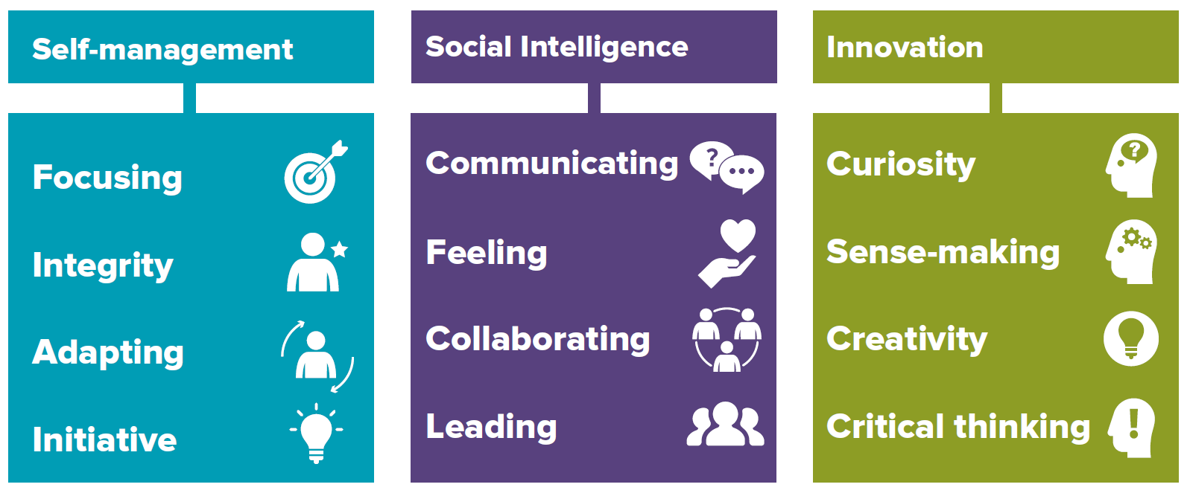


Meta-skills
Focusing
You can maintain interest and concentrate on a
task for a period of time, and not be distracted.
Communicating
You have the ability to openly share information
in the best way that helps everyone understand
your thoughts and ideas.
Curiosity
Being curious is the desire to learn or know
something in order to increase your
Understanding of an opportunity or problem.
Integrity
You are guided by your own principles and
Values and are considered trustworthy, open
and honest by others.
Feeling
You can see things from other people’s point of
view and this helps you understand their
feelings and motivations.
Sense-making
You can determine the deeper meaning of what
is being expressed and organise information into
an understandable form which is easier to use.
Adapting
You can respond confidently and constructively
To new ideas and experiences and unexpected
challenges.
Collaborating
You are good at building and maintaining
relationships with other people so everyone
can work together to achieve shared goals.
Creativity
Using your imagination, you are able to think of
new ways of addressing problems and this
enables you to visualise solutions.
Initiative
You are confident in your own abilities and
judgement. You can take decisions and have
responsibility for your own actions.
Leading
By having a sense of direction and purpose,
You can encourage and motivate others to
work towards agreed tasks and goals.
Critical thinking
You are able to process, analyse and evaluate information to solve complex problems and
form an opinion after careful thought.

Slide 5
Activity
2. Why do we need to develop meta-skills?

Slide 6

Developing meta-skills
Focusing
Being able to maintain interest and concentrate on a task for a period of time and not be distracted.
I would like to be able to manage my time/schoolwork better
It is easy to get distracted by my phone, messages,
TikTok, WhatsApp etc
I would like to be able to ignore distractions around me
I would like to be able to listen better so I can understand what I have to do
Reasons why I’d like to work on Focusing
I would like to be able to finish a task on time

Slide 7

Developing meta-skills
Initiative
Being confident in your own abilities and judgment. You can take decisions and have responsibility for your own actions.
I would like to be confident finding different ways to manage tasks on my own
I want to be more resourceful which will help me see opportunities that others might miss
I would like to be more confident about sharing my ideas
Reasons why I’d like to work on Initiative
I would like to manage my own schoolwork better
I would like take more initiative but I need to be better organised

Slide 8

Developing meta-skills
Adapting
Responding confidently and constructively to new ideas and experiences and unexpected challenges.
I would like to be proactive and able to change the way I work in order to fit in with other people
I would like to be able to think through a problem carefully in order to come up with
different solutions
I would like to be able to respond positively when face with new ideas or unexpected situations
Reasons why I’d like to work on Adapting
When working with others I would like to able to compromise and solve problems together
I enjoy learning new things and developing
new skills

Slide 9

Developing meta-skills
Integrity
Being guided by your own principles and values and are considered trustworthy, open and honest by others.
I would like people to know that I respect other people’s contribution in group work
I respect others by always completing my own task when working with a group
I would like people to think that I am honest and take responsibility for my own actions
I would like people to respect me because I always try to be accountable for my mistakes
Reasons why I’d like to work on Integrity
I would like people to think I am trustworthy, reliable and honest

Slide 10

Developing meta-skills
Collaborating
Building and maintaining relationships with other people so everyone can work together to achieve shared goals.
I want to be able to work with people successfully in a group to take forward ideas and actions
I would like to develop a more positive outlook to help me work with others better.
I want to be confident enough to put my ideas forward
Reasons
why I’d like
to work on Collaborating
I can take on different roles and jobs in a group to achieve shared goals.
I am able to listen better to other people so that we can work together and share ideas and plans.

Slide 11

Developing meta-skills
Leading
Having a sense of direction and purpose as well as being able to encourage and motivate others to work towards agreed tasks and goals.
.
Taking the lead in group work or play by listening and talking to people to reach agreements
Helping and encouraging others to take part in group activities in your class
I would like to be able to bring out the best in others and motivate and build confidence.
Being able to identify problems, think of ideas and then share them with the group I am working with
Reasons why I’d like to work on Leading
I can recognise and respect other people’s feelings and ideas

Slide 12

Developing meta-skills
Communicating
Responding confidently and constructively to new ideas and experiences and unexpected challenges.
I would like to be able to explain and share ideas when working in a group
I listen but am not always able to understand or communicate information clearly
I would like to know when to change the way I communicate to suit different situations
Reasons
why I’d like to work on Communicating
I would like to be more confident when speaking in front of others
I would like to be better at writing information in a way that is understood by others

Slide 13

Developing meta-skills
Feeling
Seeing things from other people’s point of view which leads to a better understand of other people’s feelings and motivations.
I would like to be able to show empathy and deal with difficult situations with friends better
I would like to develop better ways to help with other people’s difficult situations
I would like to be able to really listen to others’ points of view before I speak my mind
I understand that how I behave can have an impact on other people in a positive or negative way
I respect other people’s views and ideas even when they are different to my own
Reasons why I’d like to work on Feeling

Slide 14

Developing meta-skills
Curiosity
Being curious is the desire to learn or know something in order to increase your understanding of an opportunity or problem.
I enjoy asking questions like ‘why’ and ‘how’ to understand subjects I am studying
I like to listen to other people’s ideas and combine with my own to make something
new
I look forward to and enjoy starting new activities and projects
I would like be more confident when asking questions as I like to know more about how things work
Reasons why I’d like to work on Curiosity
I would like to actively seek out new ideas and be able to ask unexpected
questions

Slide 15

Developing meta-skills
Creativity
Using your imagination, you are able to think of new ways of addressing problems and this enables you to visualise solutions.
I would like to become more confident in sharing my ideas and new approaches
with others
I enjoy experimenting and trying different approaches to creating solutions
I would like to be able to approach a task in different ways
I understand that learning from my mistakes can lead to new ways of doing
things
Reasons why I’d like to work on Creativity
I would like to be better at turning my creative
ideas into reality

Slide 16

Developing meta-skills
Sense-making
You can determine the deeper meaning of what is being expressed and organise information into an understandable form which is easier to use.
In my project work I need to find and understand key information from different research sources
I would like to feel confident sharing my ideas and be able to justify my answers
My studies involve a lot of knowledge and information which I need to understand
I would like to be able to organise my thinking in order to present ideas in a logical order
Reasons why I’d like to
work on
Sense-making
I would like to be able to experiment with different ideas and questions to improve my understanding of a topic

Slide 17

Developing meta-skills
Critical thinking
You have the ability to process, analyse and evaluate information to solve complex problems and form an opinion after careful thought.
I would like to have better research skills to help
with my studies
I would like to be better at sorting different types of information in order to solve problems
I would like to explain complex ideas in an appropriate
way to suit different audiences
I’d like to be able to ask focused questions in order to understand what I have to do
Reasons why I’d like to work on Critical thinking
I would like to be able to work out the best way to complete a task by trying different types of
approaches

Slide 18
3. Questions
Which meta-skills would you like to develop further?
Why would you like to develop these meta-skills?

Slide 19
Activity
4. How do we develop meta-skills?

Slide 20


Developing meta-skills
Lewis
Lewis is 14yrs old he is really shy especially when he is working in a group. He has lots of good ideas but never shares them with the group, he is not confident, he doesn’t speak up because he is afraid of saying the wrong thing.
He would really like to be able to share his ideas and contribute to the group work and he feels left out and frustrated as he is not contributing to the group work at all.
Which meta- skills do you think Lewis should work on?
How can Lewis start to develop these meta-skills?

Slide 21

Developing meta-skills
Lewis has a really good idea that he hasn’t felt able to share with the group so far. He decides that he wants to definitely share his idea in the next lesson, but he needs to feel more confident.
He prepares himself by thinking through his idea - working out the best way to explain it, the different steps etc. He makes sure to write down the important points as a reminder.
He practices speaking out loud at home which helps to put his thoughts in order. He now feels a little more confident that he will be able to share his thoughts in a logical and clear way, which will make it easier to speak up.

Slide 22

Developing meta-skills
During the lesson while Lewis is working in the group, he takes a breath and finds himself speaking up to share his idea with the group. Once he starts speaking, he finds he is able to explain his idea properly and the other members of the group are listening and interested. They start a discussion about how they can take this idea forward and Lewis’s idea becomes part of the overall group task. Lewis’s increasing confidence make it easier to contribute to the ongoing discussion and planning.
Eventually the group ask Lewis to take the lead on the part of work that relates to his idea. He feels a little uncertain at first, but he finds he is enjoying supporting the other members of the group and his confidence is starting to increase.
As well a Communication and Collaboration which other meta-skills has Lewis been developing?

Slide 23
5. On your worksheets answer the following questions:
Which meta-skills would you like to develop further?
Why would you like to develop these meta-skills?
How will you start to develop these meta-skills?

Slide 24
Summary
Remember:
You are using your meta-skills every day in different ways and your meta-skills are unique to you depending on your own experiences.
You develop meta-skills by taking part in activities and experiencing different situations.
You should continually reflect and think about the meta-skills you are developing or wish to develop.
You will continue to develop your meta-skills throughout your life.

