Slide 1


Evaluating meta-skills

Slide 2
1. Why are meta-skills important?
We can’t predict what the future holds, so it’s important that people can adapt their skills and experience to take on new jobs with new challenges.
Understanding your own skills better can help you think more effectively about learning and work.

Slide 3




Let’s remind ourselves about meta-skills?
Self management
Social Intelligence
Innovation
Social Intelligence is about building and maintaining relationships; communicating effectively and relating to others with empathy, being able to collaborate and knowing when and how to take the lead.
Innovation is about creating positive change; being curious and excited about new ideas and challenges, able to make sense of information, to be creative and think critically in a range of circumstances.
Self-Management is all about organising and managing ourselves; knowing what’s important, being able to focus and using our initiative, and being able to adapt to new ideas.

Slide 4



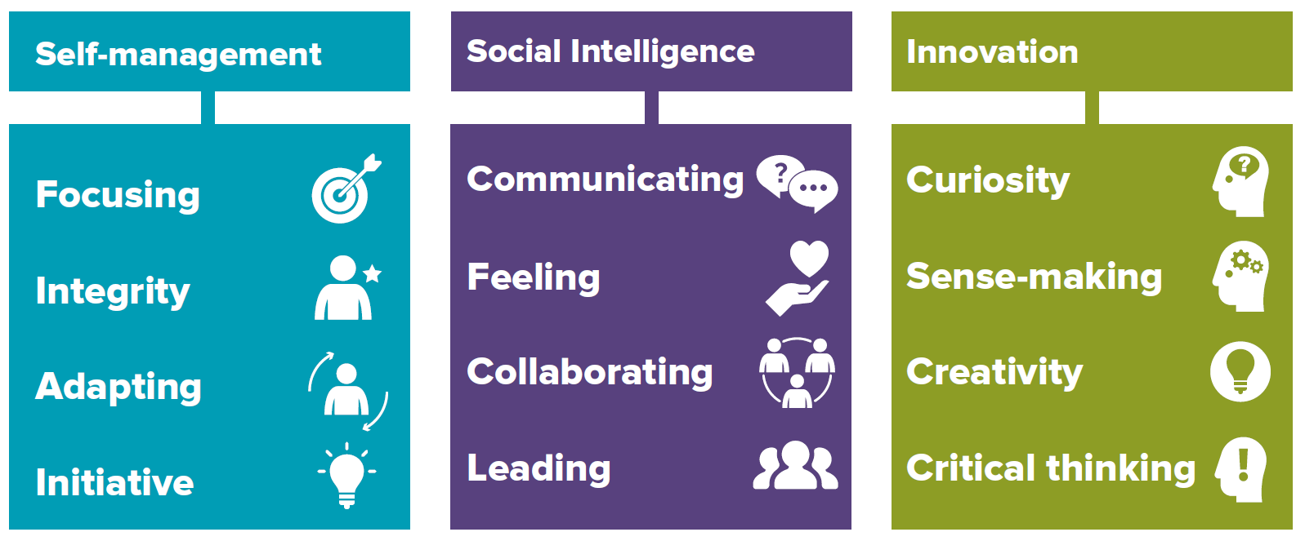


Meta-skills
Focusing
You can maintain interest and concentrate on a
task for a period of time, and not be distracted.
Communicating
You have the ability to openly share information
in the best way that helps everyone understand
your thoughts and ideas.
Curiosity
Being curious is the desire to learn or know
something in order to increase your
Understanding of an opportunity or problem.
Integrity
You are guided by your own principles and
Values and are considered trustworthy, open
and honest by others.
Feeling
You can see things from other people’s point of
view and this helps you understand their
feelings and motivations.
Sense-making
You can determine the deeper meaning of what
is being expressed and organise information into
an understandable form which is easier to use.
Adapting
You can respond confidently and constructively
To new ideas and experiences and unexpected
challenges.
Collaborating
You are good at building and maintaining
relationships with other people so everyone
can work together to achieve shared goals.
Creativity
Using your imagination, you are able to think of
new ways of addressing problems and this
enables you to visualise solutions.
Initiative
You are confident in your own abilities and
judgement. You can take decisions and have
responsibility for your own actions.
Leading
By having a sense of direction and purpose,
You can encourage and motivate others to
work towards agreed tasks and goals.
Critical thinking
You are able to process, analyse and evaluate information to solve complex problems and
form an opinion after careful thought.

Slide 5
2. Evaluating meta-skills

Slide 6

Evaluating meta-skills: Jess
Jess
Jess is 13 yrs old, she is part of a large social group and enjoys school. She is drawn to working in Healthcare in the future, possibly in children's nursing. She is a very kind and caring person and finds it easy to get on with people. However, she is very easily distracted by her phone and by other people, so doesn’t always pay enough attention in class. She’s also aware that sometimes she is the one distracting other people in the class.
Consequently, her schoolwork is suffering.
Which meta-skills do you think Jess should work on?

Slide 7
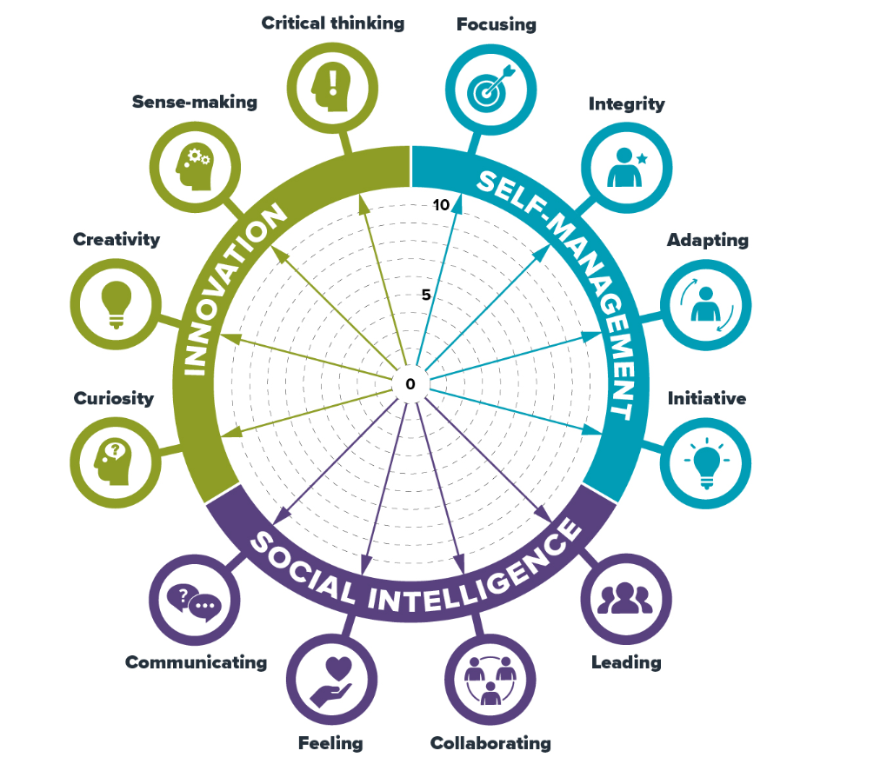

Evaluating meta-skills: Jess
Using the self-evaluation wheel Jess has scored herself from 1 to 10 against each individual meta-skill.
She has scored herself low on Focusing and Integrity and realises that she needs to work on developing these meta-skills.
Why do you think Jess has scored herself low on Focusing and Integrity?
How can she work on these meta-skills?

Slide 8
3. Evaluating your meta-skills

Slide 9
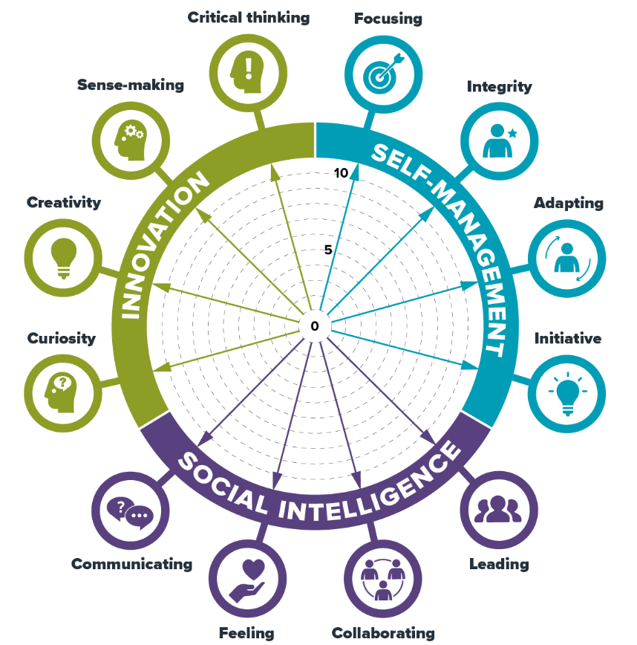
Activity – Evaluating your meta-skills
Using the following resources complete a meta-skills self-evaluation wheel.
Self-evaluation wheel worksheet
Self-evaluation wheel guide to scales

