Slide 1



Summary overview

Slide 2


Slide 3
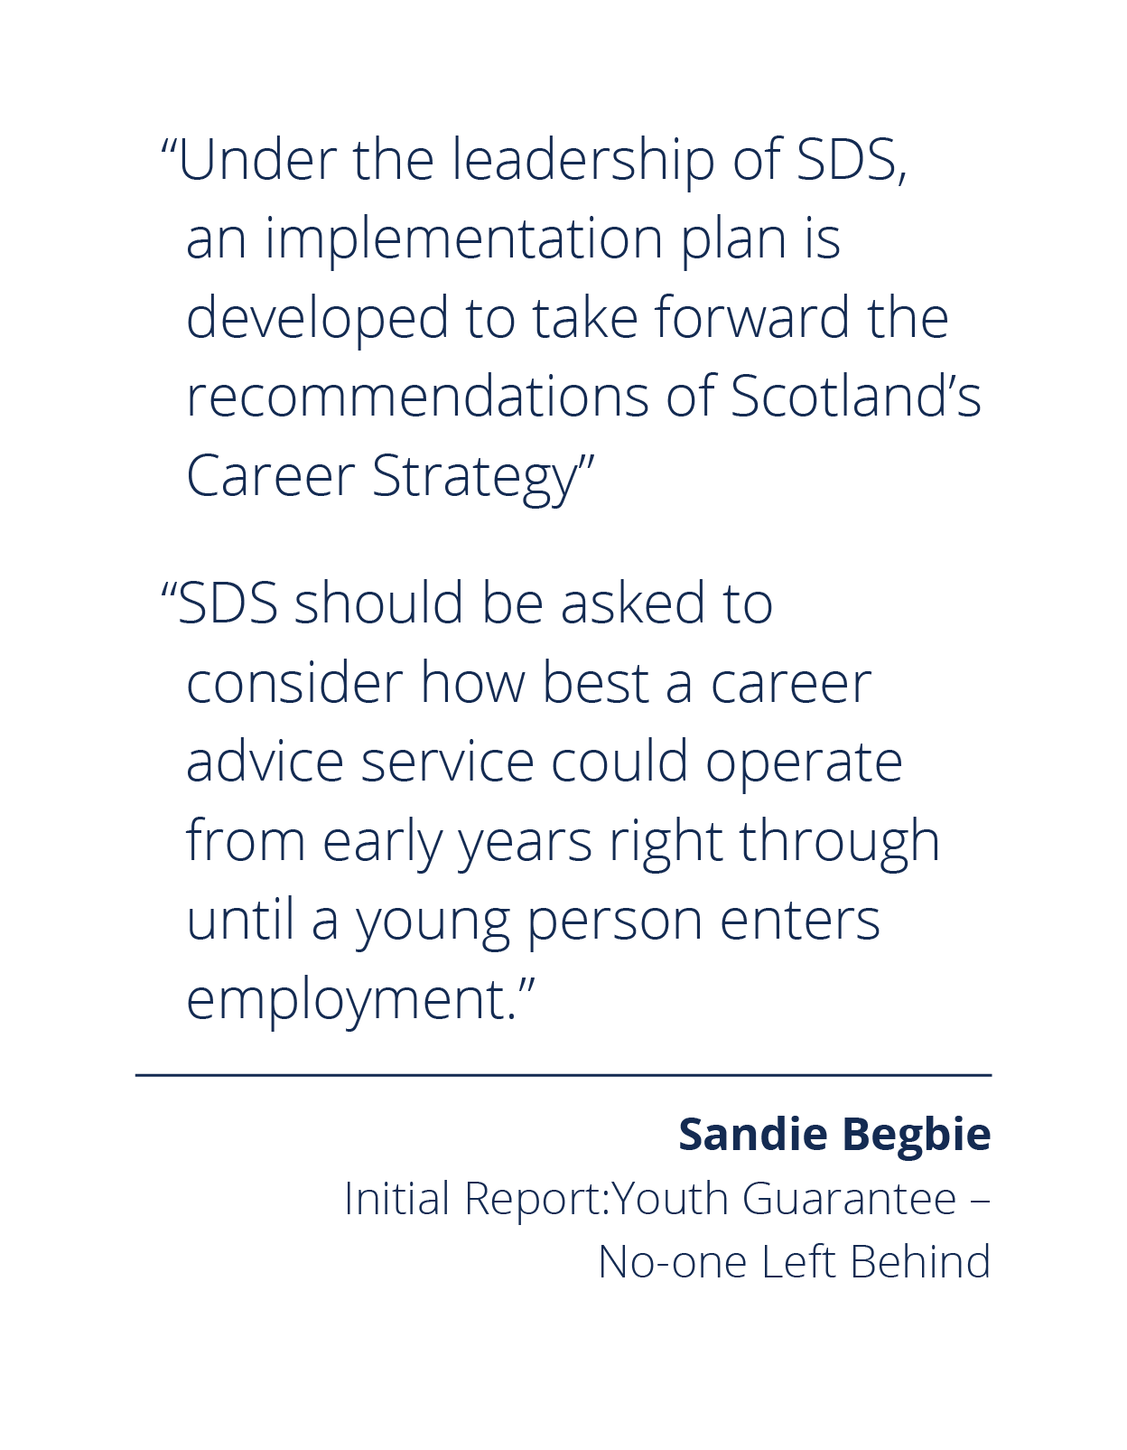
About the review
Feb 2020
Scottish Government published
Scotland’s Career Strategy, Moving Forward
Strategy recognises rapidly changing labour market and
need to ensure CIAG is more obvious, accessible,
personalised and joined up
Scottish Government published Sandy Begbie’s Initial Report:
Youth Guarantee – No-one Left Behind
Identifies wide ranging resource devoted to career services
and employability support – highlights importance of
maximising impact
Recommends review of career services, highlighting
importance of engaging with the third sector
Independent Programme Board, chaired by Grahame Smith,
established to oversee SDS’s work to undertake review
Sept 2020
Dec 2020

Slide 4





Defining career services
Career Information: providing career and labour market information about further
and higher education, career assessments and tests
Career Advice: employment, job search and career advice (can be provided by someone other than a qualified careers professional)
Career Guidance: career counselling / one‐to‐one career guidance
(cannot be provided by anyone other than a qualified careers professional)
Career Education: delivering career education as part of the curriculum either as
a discrete subject or embedded in wider subject provision. Such learning can be both classroom-based and experiential
Brokerage: career learning by organising encounters with employers, trade unions and others (e.g. talks, career fairs, mentoring, work experience, volunteering and helping young people develop an understanding of fair work and work-related rights and responsibilities).

Slide 5
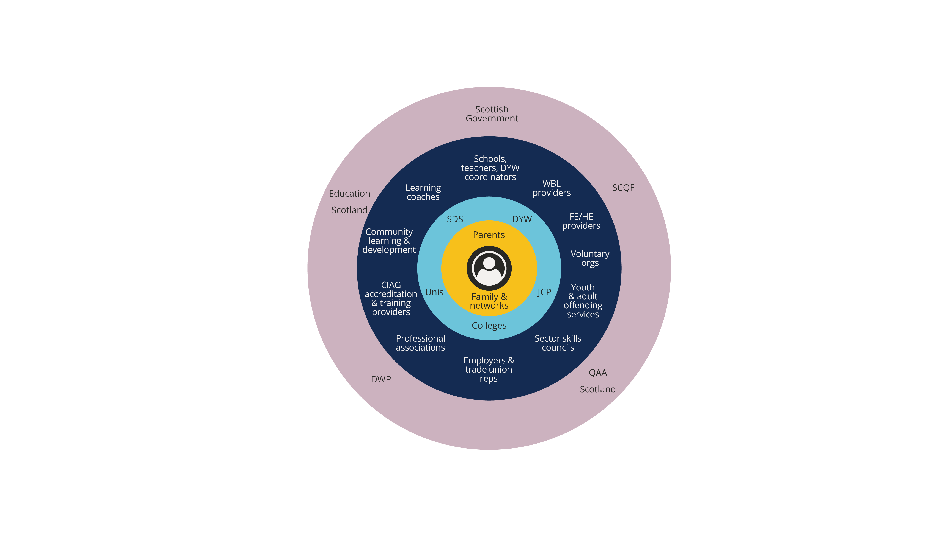
The career ‘ecosystem’ in Scotland
Career services are provided by a wide range of organisations and institutions
The following were in scope for the review:
  Skills Development Scotland
  Developing the Young Workforce
  Schools
  Colleges
  Universities
Our research indicates the organisations in scope:
  invest between £159m – 216m in career services each year
  have over 1,700 career related staff
  (1.2 million young people between ages of 5-25)
  career-related specialisms and qualifications are high in SDS and universities and low (but variable) within DYW and colleges
Notes:
NB – the funding figures used here are estimations identified through the evidence gathering phase of the review. They have been drawn from budget line item reviews from published government data, internal management information, estimates provided directly by interviewees, previous research, and extrapolation from survey responses by an independent contributor as part of the review process. There are no known published figures by any organisation other than SDS that detail funding of career services.

Slide 6



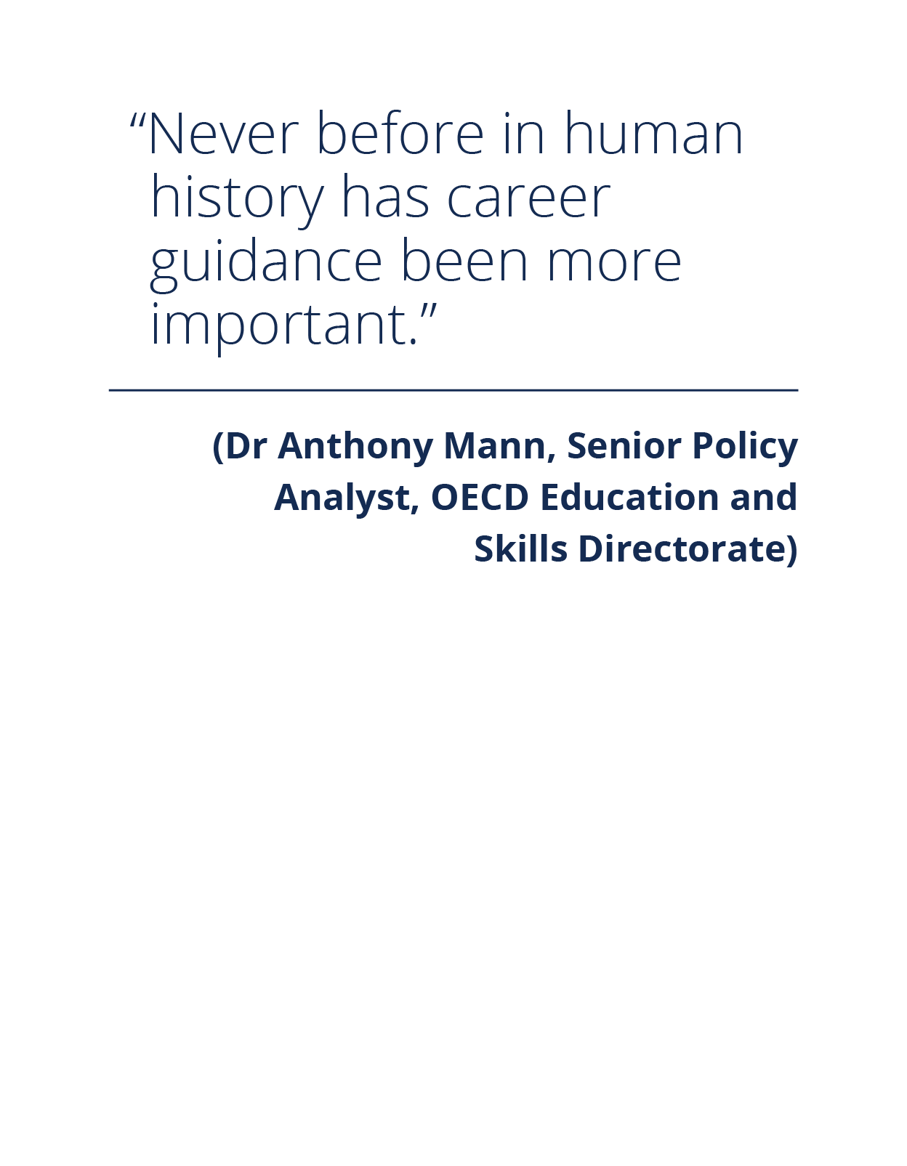



Context: drivers of change
COVID-19
The climate
emergency
Industry 4.0 &
disruptive technologies
Stretched public
finances
A dynamic
labour market
Poverty and
inequality
Education
reform
The changing
nature of work

Slide 7


Slide 8
Review approach
The most comprehensive review of Scotland’s career services in a generation
Leadership provided by independent Programme Board with representatives from all parts of the career system, chaired by Grahame Smith
Evidence-led, driven by insight and co-design
Equity at the core of the approach:
each recommendation seeks to address inequality, informed by a comprehensive Career Review Equality Impact Assessment
Remit focused on young people however in line with the all-age approach outlined in career strategy
Recommendations represent transformational and deliverable redesign of career system
Critical dependencies on and alignment to ongoing interventions in education, economy and society
Burning need and opportunity to act quickly to maximise recovery and minimise scarring impact of pandemic

Slide 9
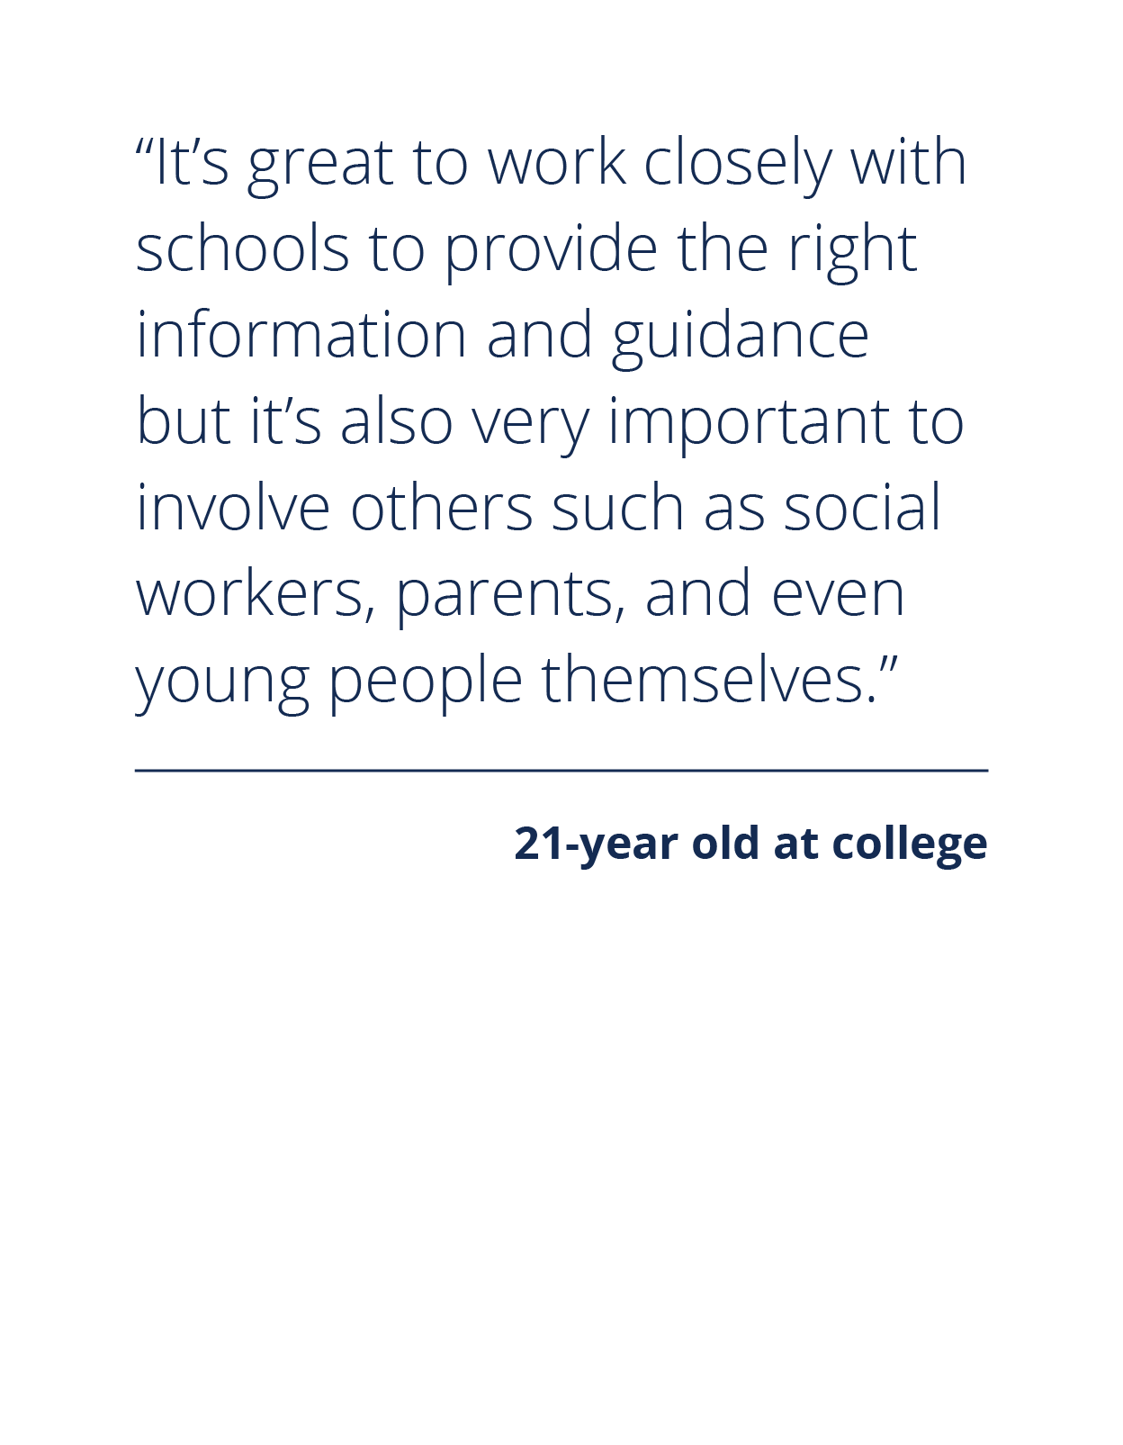





Customer centred, evidence led
Over 250 customer interactions via:
Co-design labs
Engagement sessions
In-depth workshops
1-2-1 engagements
representing the range of service areas and
protected characteristics

Slide 10


Slide 11

Services in the ‘ecosystem’ are working…
Internationally recognised
Scotland has protected funding for services that are envy of many other countries
Prioritised within policy
Career services are central to Scottish Government policy
In demand and valued
Young people value career services - demand is high and growing
High quality national career service
Over 75% of SDS services are independently assessed as very good or excellent by Education Scotland
Professional workforce in schools and university
In-person career services are delivered by highly qualified practitioners in schools and universities
Growing partnerships between education and employment
The DYW infrastructure has started to bridge the gap between employers and education
Local structures, inc third sector, are effective at connecting people to services
Local Employability Partnerships and other local structures are key to joining up delivery on the ground and making sense of competing policies and priorities

Slide 12
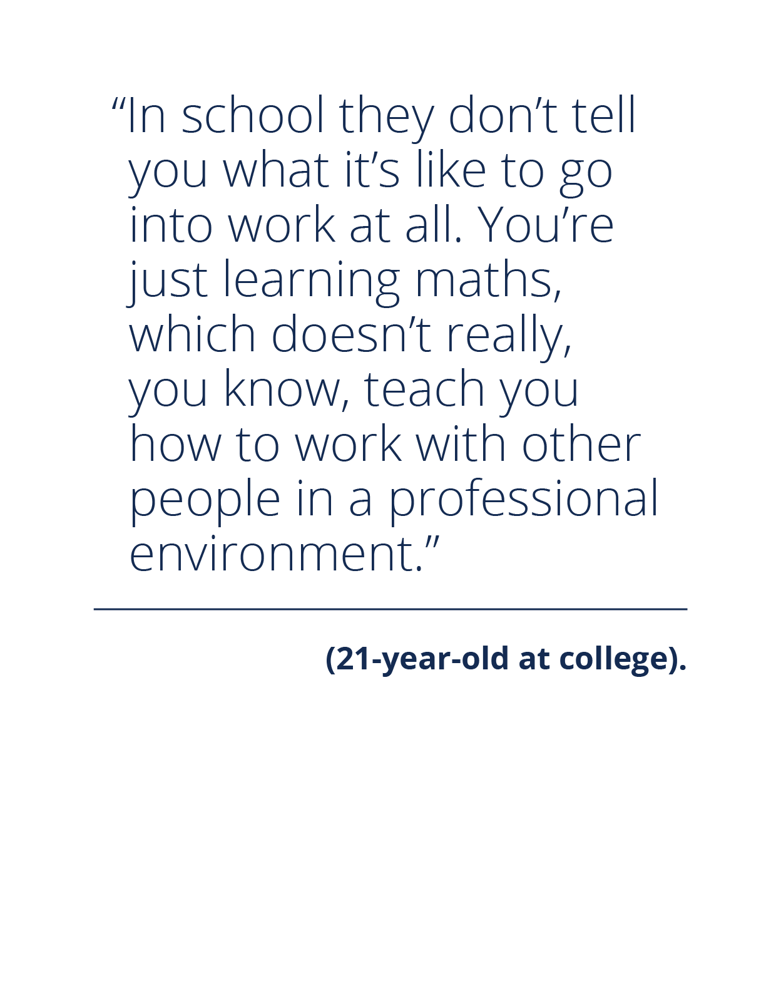
…but not for everyone
Career education is not embedded or prioritised in curricula systematically
Insufficient resource to provide personalised 1-2-1 support to every young person
Fragmented and complex delivery landscape
Limited oversight of the ecosystem
Demand often goes unmet and is likely to increase
Not all young people have equal access
Limited professional guidance resource in colleges
Pressure on finances and ‘initiative overload’
Largely measured on activity not outcomes
Inequality and discrimination continue to damage the life chances of many young people

Slide 13







How we can improve: design principles
The Service
1. Career services meet the dynamic aspirations and different needs of all young people
2. Career services build agency and equip young people with the skills to thrive in a changing world
3. Career services enable young people to expand their knowledge and experience of Fair Work
The Curriculum
4. Career experiences are integrated into curricula, practice and culture of the education system
The Ecosystem
5. An eco-system of assets delivering coherent and impactful career services for Scotland

Slide 14










Our recommendations
1. A new career development model
A simple model should be established that defines career services, bringing definition to the variety of career services across Scotland.
2. Developing skills and habits essential for the future world of work
Career education and services should be designed to develop, recognise and accredit the skills and habits essential for the future world of work.
3. Creating person centred career services
Individuals should be involved in identifying what they need from career services based on their own circumstances and context, which leads to a flexible and personalised service offer.
4. Experiential career education
There should be dedicated curriculum time for experiential work-related learning in all settings.
5. Community based services
Young people have a right to have to a wide range of opportunities, to experience the workplace and understand what fair work is.
6. Exposure to fair work
People should have a right to have a wide range of meaningful opportunities to experience work and understand what fair work is.
7. Digital enablement, empowerment & engagement
Enhanced digital services and online tools should be developed that present information about the world of work in an inspiring and accurate way.
8. Clear roles for the delivery of career services
Where appropriate, the roles across career services should be defined, to deliver the career development model in a coherent way.
9. Strengthening evaluation and continuous improvement
The effectiveness and impact of the whole career system should be measured using a suite of outcome-based measures that are integrated in all settings, supporting the delivery of responsive and flexible services.
10. Creating a career services coalition
A coalition should be established that ensures the implementation of the Review’s recommendations and the coherence of career services across Scotland, where young people, practitioners, employers and stakeholders are represented.

Slide 15

A new career development model
A simple model should be established that defines career services, bringing definition to the variety
of career services across Scotland.
The change
A new career development model that provides a national delivery framework for any organisation supporting career choices.
Its adoption drives coherence and consistency in the delivery of career services and ensures improved outcomes.
It helps clarify roles and responsibilities across the ecosystem and ensures that reflection on career experiences is fundamental to the individual’s progress
The outcome
“I know what learning experiences I
can expect to take part in to help me make decisions about my career.”
The equity impact
The model recognises each person as an individual with their own distinct needs. It offers meaningful and accessible support in career development, tailored to them when they need it.
It supports equity of access in any setting – meaning everyone experiences a similar standard of service irrespective of who is offering it.

Slide 16
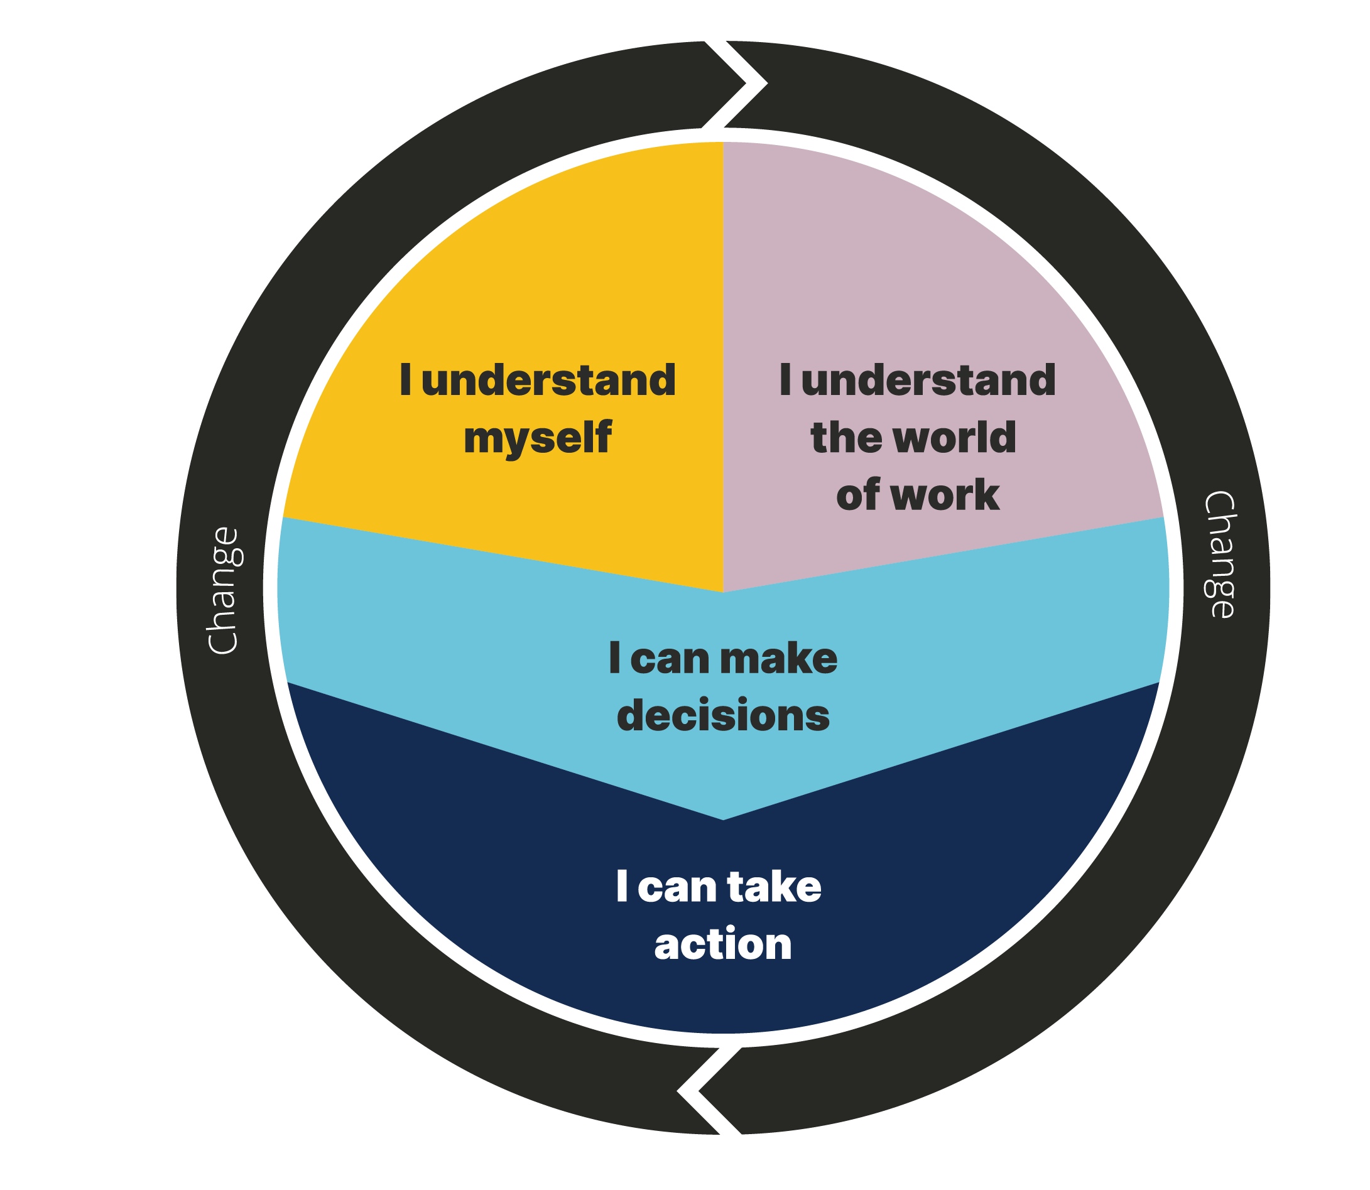
A new career development model
A simple model should be established that defines career services, bringing definition to the variety
of career services across Scotland.
This DRAFT model defines what career services need to do. It simplifies and brings definition to the disparate set of services that exist today.
The evidence tells us that customers are most likely to benefit from at least one of the aspects of the service we have set out.
The model is described in an active way - its success for the individual is dependent on services providing experiences.
Actions can be carried out at different levels depending on age and stage.
We will continue to develop and co-design this model through the next phase of the review.

Slide 17
Developing skills and habits essential for the future world of work
Career education and services should be designed to develop, recognise and accredit the skills
and habits essential for the future world of work.
The change
Career education and services which develop, recognise and accredit the skills and habits that help people make informed choices, adapt and respond to the changing labour market.
Skills are given currency, and the development of the skills to manage a career and thrive in the world of work are a cornerstone of all learning, education and employment related support.
The outcome
“I can describe, and I am developing, a set
of skills for the world of work and that will
help me manage my career.”
The equity impact
Collaborating with individuals throughout
their own unique journey will offer diverse and equitable experiences, enabling the development of skills and career habits
that help them thrive in the future.

Slide 18
Creating person centred career services
Individuals should be involved in identifying what they need from career services based on their own circumstances and context, which leads to a flexible and personalised service offer.
The change
A shift from a needs based approach to a universal and lifelong asset based approach, focused on strengths, building agency, resilience and flexibility
Young people’s voices are fundamental to all future career service development and delivery
Services are more relevant, impactful and universally accessed.
Services and practitioners have space to ‘explore’ changing need on an ongoing basis through professional practice
Data sharing is enhanced in line with relevant legislation and regulations with information being shared between professionals at appropriate and relevant stages of transitions
The outcome
“I know that career services understand me, that they are there when I need them, and
will help me get to where I want to be.”
The equity impact
Encouraging the exploration of each person’s life, interests, morals, skills and values, building a narrative of their own story, deepening self-worth and belief in their contribution to the world.

Slide 19
Experiential career education
There should be dedicated curriculum time for experiential work-related learning in all settings.
The change
Experiential work-related learning is part of the ‘fabric’ of curriculum design and delivery in primary, secondary, college and university
Those delivering the curriculum are supported to make connections to the world of work
Elements of the curriculum are delivered in the practical setting of the workplace
Young people understand the practical value of what they are learning and how this learning can be applied in the world of work
The outcome
“In my learning I know there will be a range of meaningful activities that are hands on and help me understand and experience fair work.”
The equity impact
Each individual is entitled to access fair, just and purposeful work-related learning embedded within their curriculum that aligns with their goals and ambitions. All learning incorporates equality and diversity principles that challenge and overcome entrenched ideas about the world of work, such as gender stereotypes.

Slide 20
Community based services
Career services should be delivered within communities in a way that is aligned to social justice values and provides access to consistent national services.
The change
Services are available within and through the communities with which young people identify and those involved in delivery are trusted by their community
Services are accessible and approachable and able to relate to the situation and needs of those who may otherwise be disengaged
Services are designed and delivered to meet the needs of those with lived experience of protected characteristics and other equality factors
Local Employability Partnerships ensure that services are integrated, and investment meets the needs of individuals and the economy
Formal career services work in strong collaboration with LEPs to
deliver, leading to an improved learner journey
The outcome
“I know that within my community there are people who I trust to help me explore careers and I have access to the same chances as everyone else.”
The equity impact
All communities, their needs and values are appreciated, understood and accepted, so there will be fair and equitable career services.

Slide 21
Exposure to fair work
People should have a right to have a wide range of meaningful opportunities to experience work and understand what fair work is.
The change
Young people understand their entitlement to work experiences at different stages of their learning journey
Work experiences incorporate a wide range of offers, e.g. job shadowing, mentoring, employer / sector tasters, projects, challenges and other experiences
A systematic approach is taken to shape services against these entitlements
Entitlements are captured in a framework, which defines outcomes, roles and responsibilities
Education and career service providers understand employer needs
and how to engage effectively to overcome barriers to participation
Young people understand fair work practices and
their expectations of employers
The outcome
“I know I’ll get lots of chances to explore jobs and work in different ways.”
The equity impact
Every person is entitled to accessible and inclusive work-related experiences embedded within the curriculum that incorporates equality and diversity and aligns with their goals and ambitions.

Slide 22
Digital enablement, empowerment and engagement
Enhanced digital services and online tools should be developed that present information about the world of work in an inspiring and accurate way.
The change
A wide range of innovative digital tools provide immersive and engaging career experiences and services aligned to the Career Development Model.
Digital technology connects people to the right support at the right time, in ways which are highly personalised, relevant and engage local communities.
Digital services are easy to access and seamlessly integrated with face-to-face delivery.
They provide the highest levels of trust and allow people to own their data.
Public investment in digital technology is systemic, fully realised and has no duplication.
The outcome
“I find digital information and activities more inspiring, current, relevant and self explanatory.”
The equity impact
Through the development of inclusive, accessible digital services and tools all people can access inspiring, trusted and relevant content. This is complemented with access to professionally qualified, impartial 1:1 support to use, navigate, and process information..

Slide 23
Clear roles for the delivery of career services
Where appropriate, the roles across career services should be defined, to deliver the career development model in a coherent way.
The change
Young people know who can help, accessing the right support at the right time.
A common approach to career services aligned to the CDM
A system wide Target Operating Model ensures integration – no-one falls through the cracks
The roles that deliver the CDM are clearly defined and articulated.
Practitioners are connected. There is a long term, collaborative approach to practitioner professional development and qualifications (where relevant).
Employers, trade unions and representative bodies find it easier to engage with the education system and career services.
Parents and carers are supported in their key role as influencers.
The outcome
“I am supported by a group of people who know me and help me achieve my potential.”
The equity impact
The career ecosystem will inclusively offer accessible and dependable support throughout an individuals’ diverse life experiences.

Slide 24
Strengthening evaluation and continuous improvement
The effectiveness and impact of the whole career system should be measured using a suite of outcome-based measures that are integrated in all settings, supporting the delivery of responsive and flexible services.
The change
We understand the difference that enhanced career services are making
We measure outcomes and monitor uptake of entitlements
Clear key performance indicators help organisations manage their performance, allowing services to be refined and improved and evidencing return on investment
A systematic quality assurance process ensures services are of consistently high quality
Ongoing evaluation leads quickly and directly to changes at a national and local level meaning services are always improving and kept up to date with changes in industry.
We understand the impact career services have on
wider economic and social objectives
The outcome
“My growth/progress and level of satisfaction is measured to improve career services.”
The equity impact
The approach places importance on identifying outcomes that reflect individual goals, distance travelled and career happiness, and evaluate the quality and effectiveness of the career ecosystem for all individuals and its impact on wider economic and social objectives.

Slide 25
Creating a career services coalition
A coalition should be established that ensures the implementation of the Review’s recommendations and the coherence of career services across Scotland, where young people, practitioners, employers and stakeholders are represented.
The change
A coalition of delivery organisations, service users, practitioners and employers take forward the recommendations in a collaborative way.
The coalition ensures the recommendations are delivered and implementation is co-designed with users and stakeholders.
The coalition is led and supported by Scotland’s national skills agency, with collective ownership and accountability across members for implementation, change management and continuous improvement.
Young people and other stakeholders are involved in decision making and continue to shape future services.
The careers and teaching workforce and the trade unions that
represent them are valued and engaged in the change process and
in continuing to shape future services.
The outcome
“I have a say in how services are developed and delivered in a way that benefits me.”
The equity impact
The coalition ensures that equality, diversity and inclusion are at the forefront of career services, informed and represented by individuals with lived experience of all protected characteristics, key organisations and inclusive, fair work employers and trade unions.

Slide 26
Dependencies
The review of Curriculum for Excellence and the SFC Review of coherence and sustainability
Development of the National Strategy for Economic Transformation
Policy integration
Skills alignment
The role of employers and business support
Clear leadership, empowerment and accountability to deliver the change required
A move to multi-year funding assumptions

Slide 27
Next steps
  The Programme Board will work with practitioners, stakeholders, career influencers and those with lived experience to co-design and co-develop:
    The future state target operating model and service blueprint
    A detailed implementation plan
    The career development model​
    The remit, functions and composition of the proposed career services coalition​
    inc understanding international and national structures and developing options for Scotland
    A programme of further testing with all-age users
    Engagement with wider policy developments
    aligned to the implementation plan to ensure integration

Slide 28


