Slide 1
Service Design & Innovation: Update

Slide 2
Service Design & Innovation: Update

Slide 3
Service Design & Innovation: Update

Slide 4
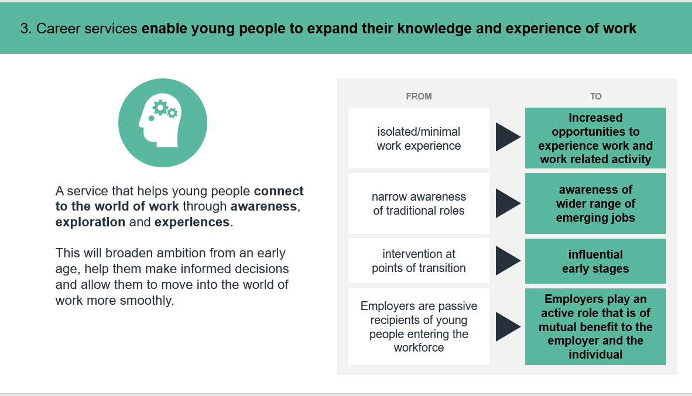
Service Design & Innovation: Update

Slide 5
Service Design & Innovation: Update

Slide 6
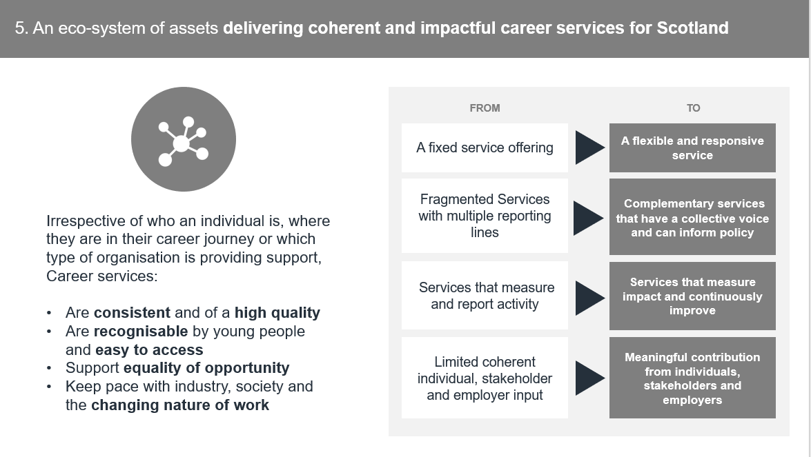
Service Design & Innovation: Update

