Slide 1


SDS / DYW annual operating plan and target operating model
Guidance
March 2024

Slide 2
Contents
  This guidance covers:
  Context and rationale
  TOM case studies
  SDS and SG DYW Strategic Partnership Agreement – shared commitments and actions
  Developing an Annual Operating Plan/ target operating model (TOM)
  Supporting documents checklist
  Appendices
  Links to relevant documents

Slide 3

Rationale
The development of an Annual Operating Plan/target operating model (TOM) reflects the expectation that partners working with young people do so in an integrated way and with an unrelenting focus on meeting their needs and improving their outcomes
Our approach to aligning planning and activity described in this guidance goes beyond just developing mutual awareness of respective partners roles and actions, although this is important, and is more about the opportunity to ensure that planned activity is complementary and developed and delivered collaboratively, where appropriate
Our approach allows and encourages the co-design, co-delivery and review of learner experiences which draws on the collective expertise of SDS, DYW, schools and other partners

Slide 4
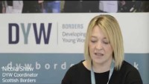
Annual Operating Plan/TOM case studies
Notes:
https://www.youtube.com/watch?v=lJUv0ZyEFKE&t=5s

Slide 5
SDS, SG and DYW Strategic Partnership Agreement
Partnership Agreement focused on:
  Aligning delivery of shared entitlements for our young people (CES)
  Improving outcomes for young people through enhanced collaboration
  Maximising our collective resources in doing so through clarity on roles and responsibilities
  Ensuring an ‘no wrong door’ approach for our young people
  Enhanced strategic and operational engagement
  Embedding the School Employer Partnership Framework as our shared approach
  Sharing of intelligence that informs our work and monitors our progress (LMI/Data Hub)
  Engaging in a shared professional learning programme including sharing of effective practice for continuous improvement
  Review and, where appropriate, align our digital assets to improve the Employer and Customer journey (Marketplace/My World of Work/YPG.scot/E-DYW)
  Working together and revising operational activity on an annual basis to review and drive performance
We will do this through:
Notes:
These are extracts from SDS / SG / DYW Strategic Partnership Agreement that captures shared commitments and how these will be taken forward.
Data sharing
At the moment, there are no changes to existing data sharing agreements. Data sharing should continue ‘as is’ and in-line with existing arrangements. This situation will be kept under review and any changes notified to all relevant partners.

Slide 6
Annual Operating Plan and Target Operating Model (TOM)
SDS: CIAG service offer and school partnership agreement (SPA)
Defines SDS role and activity
DYW: offers at national, regional, local authority and school level
School: career related elements of PSE and other school led events
Other partners: any partner regularly working in school e.g. MCR pathways
School employer partnerships (SEP) Framework defines learners’ entitlements by age/stage
Planning informed by evidence base:
- LMI
- SLDR
- Data Hub
SDS, DYW, school and other relevant partners map planned activity onto the SEP Framework
Employer engagement planning draws on SEP Framework and Employer Engagement Toolkit.
Partners identify gaps or opportunities for realignment or joint working and agree respective roles and responsibilities
Plans describe roles and responsibilities for discrete actions and respective contributions of partners to shared activity
All this leads to the development of a shared annual operating plan
Notes:
Purpose
Aligning delivery, enhancing collaboration and clarifying respective roles and responsibilities
Approach
The School Employer Partnership (SEP) framework is used to ‘map’ contributions from SDS, DYW, school and other school employability partners (e.g. MCR pathways, CLD/youth workers, Prince’s Trust, Career Ready etc) against the learner outcomes described by age and stage in the SEP framework.
Preparation
Local LMI should be used to inform planning and influence provision e.g. employer engagement appropriately reflects LMI, SLDR and pupil preferences (e.g. via data hub).
Roles and responsibilities
Mapping will clarify roles and contributions of partners, identify areas of coincident interest at a particular age or stage where the timing or sequencing of actions needs to be managed or offers the potential for collaborative approaches and joint working. It will also highlight gaps in provision and support discussion on how / whether these can be filled.
Support
Planning for employer engagement should be informed by the SEP Framework and the employer engagement strategic toolkit (How to get the best employer engagement for the young people in your school – A Strategic Toolkit).
See appendix 1 of this guide for further links to relevant documents

Slide 7
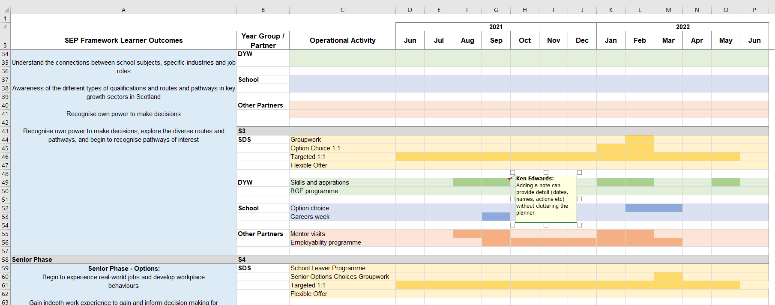
Planner
SEP describes learner outcomes by age/stage
Gaps identified and options discussed by partners
Notes can be added to provide finer detail
SDS, DYW, school and other partner(s) map planned activity by highlighting relevant month(s)
Provision reviewed and adapted collaboratively
Areas of overlap identified
Notes:
Completion
The target operating model (TOM) and annual operating plan should be completed at individual school level by SDS careers adviser or team leader, DYW school coordinator, relevant school staff and other school partner(s) as applicable.
The core SDS school service offer has been pre-populated. National, regional or local authority level DYW activity, where known in advance and applicable to all schools, can also be pre-populated by DYW groups prior to distribution of the guidance and spreadsheet.
Aligning planning and integrating co-development and delivery needs an open, collaborative approach and a degree of flexibility within the limits of service expectations.
Completing the TOM/operating plan is an iterative process and likely to continue through the May-June planning period. There is no ‘correct’ sequencing to tie in with discrete plans such as SDS school partnership agreement or DYW coordinators school agreement. Content may be completed before, in parallel with or after other planning activity. It is likely that aspects of the plan will be added at each of these stages as information becomes available.
Management and review
The annual operating plan is a live document and should be regularly revisited and updated through discussion and agreement between relevant partners. More formal reviews of progress and impact should take place in November and February.
Storage and access
This is for partners to agree about what works best for them in terms of access and updating

Slide 8
Supporting documents checklist
Aligned TOM and annual operating plan
Partners
School partnership agreement, calendar of planned activity
LMI
RSAs, SDS data Matrix SLDR, Monthly PM Snapshot, APM, other local information
DYW
National / Regional priorities, school partnership agreement, national KPIs
SDS
CIAG school service offer and school partnership agreement (SPA)
National
SEP framework and other employer engagement guidance and toolkits
(see Appendix 1)
School
PSE programme, school events calendar and SIP

Slide 9
Appendix 1: Links to relevant documents
School – employer partnership guidance
Employer Partnerships in Education – A framework to support evaluation and improvement
How to get the best employer engagement for the young people in your school – A Strategic Toolkit
School-Employer Partnership (SEP) Framework.
Career Education Standard
Work Placements Standard
SDS school service offer
Regional Skills Assessments (RSA) and the RSA data matrix
Young Persons Guarantee 2023
My world of work – young person guarantee

