Slide 1

Activity!
Quick Quiz
Notes:
Activity
Ask everyone to take a piece of paper to write their responses to multiple choice quiz numbered 1-5. Will see how well people know what's happening in the local labour market.

Slide 2




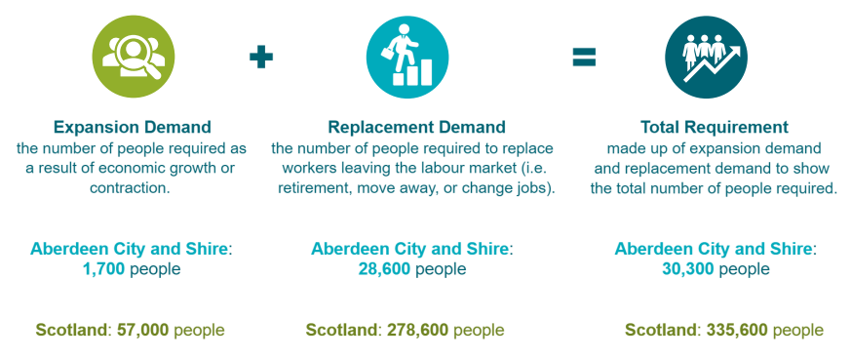
Labour Market Information – Future forecasting
Past and current data trends
Show patterns which help us predict possible labour market changes
Providing us with future skills forecasts
Replacement demand, - when people retire from the labour market or change jobs
Expansion demand – new jobs are created as industry expands.
Aberdeen City and Shire (2023-2026)
Growth forecast in:
Engineering
Health and Social care
Food and Drink
Energy
Tourism
Early Learning and Childcare
Creative Industries
Digital
Life Sciences
Notes:
Acknowledge that understanding potential routes and getting a plan in place is important but it also helps to understand where the future opportunities may lie when making decisions about the future. You’re not expected to be an expert on this but there are lots of resources that can help you see the bigger picture. Skills Development Scotland regularly checks what’s happening in the labour market which helps us understand the direction that the world of work is heading. You can access all of this information on our website but today, we’re going to do a quick quiz to see how much you know about Scotlands growth sectors and the jobs of the future.
Explain what LMI is – data that helps us understand what is happening in the local labour market, growth sectors, where skills are needed now and in the future etc.

Slide 3
Question 1
From 2026 – 2033, which sector is predicted to have the highest replacement demand for people in Aberdeenshire?
A. Tourism
B. Food and Drink
C. Life Sciences

Slide 4
Question 1
From 2026 – 2033, which sector is predicted to have the highest replacement demand for people in Aberdeenshire?
A. Tourism
B. Food and Drink
C. Life Sciences

Slide 5
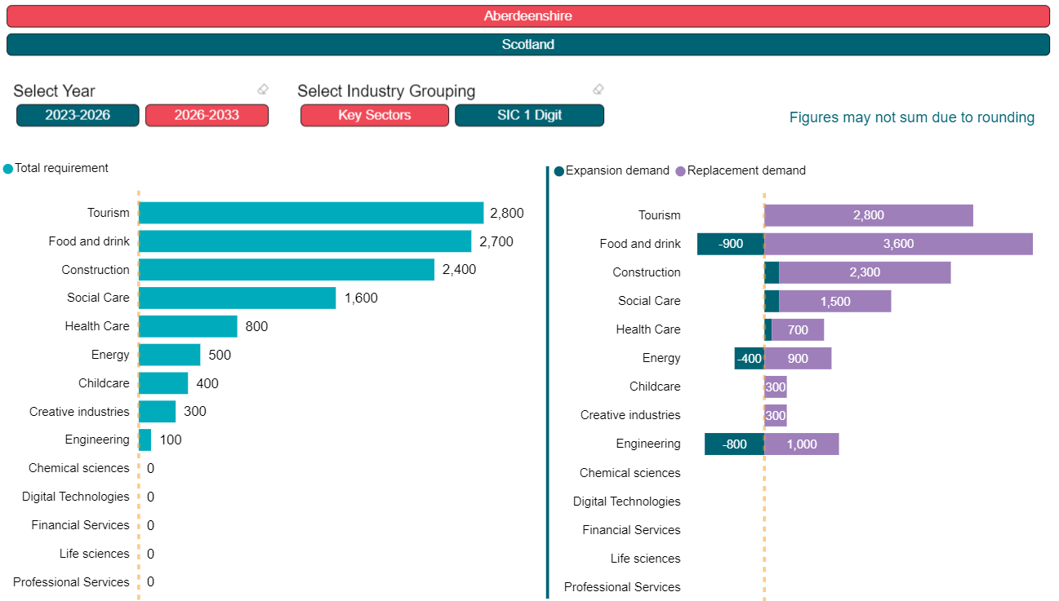
SDS RSA Data Matrix [Accessed 21st Oct 2024]

Slide 6
Question 2
By 2026, which of these three sectors is predicted to employ the most people in Aberdeenshire?
A. Social Care
B. Food and Drink
C. Engineering

Slide 7
Question 2
By 2026, which of these three sectors is predicted to employ the most people in Aberdeenshire?
A. Social Care
B. Food and Drink
C. Engineering

Slide 8
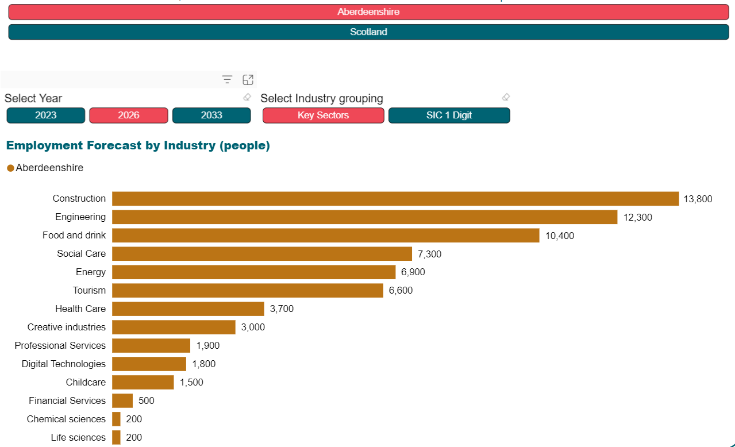
SDS RSA Data Matrix [Accessed 21st Oct 2024]

Slide 9
Question 3
From 2026 – 2033, which occupational category is predicted to have the highest demand for new and replacement roles in Aberdeenshire?
A. Caring Personal Service Occupations
B. Science and Technology Professionals
C. Skilled Construction and Building Trades

Slide 10
Question 3
From 2026 – 2033, which occupational category is predicted to have the highest demand for new and replacement roles in Aberdeenshire?
A. Caring Personal Service Occupations
B. Science and Technology Professionals
C. Skilled Construction and Building Trades

Slide 11
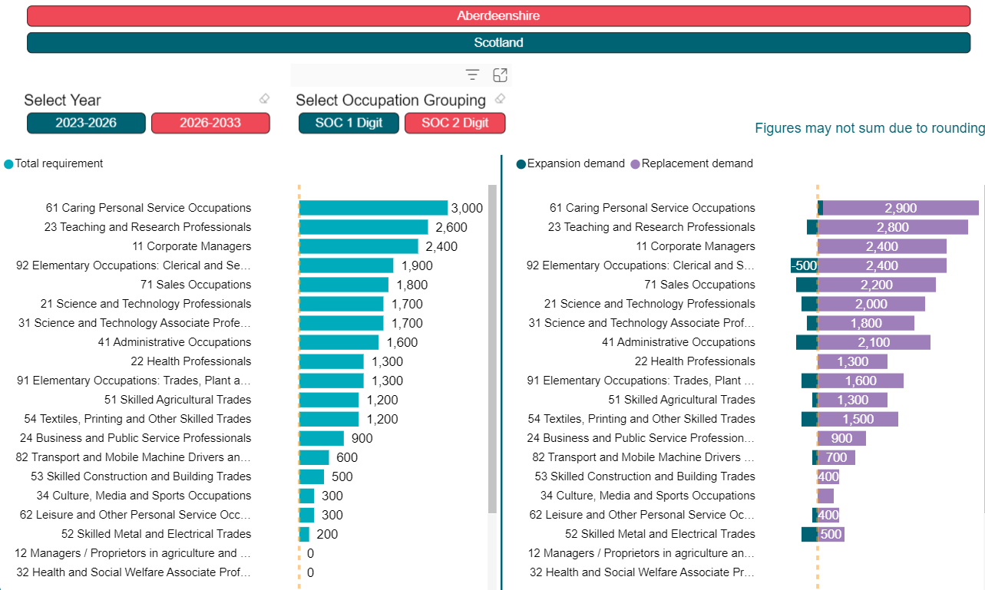
SDS RSA Data Matrix [Accessed 21st Oct 2024]

Slide 12
Question 4
In a 2022 survey, which post school pathway had the highest level of satisfaction amongst school leavers?
A. Graduate Apprenticeship
B. College
C. University

Slide 13
Question 4
In a 2022 survey, which post school pathway had the highest level of satisfaction amongst school leavers?
A. Graduate Apprenticeship
B. College
C. University

Slide 14
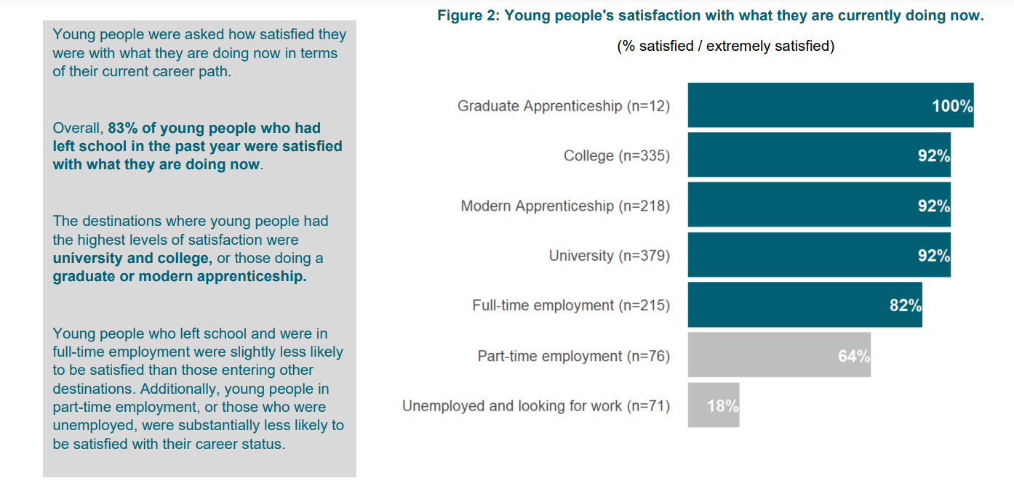
SDS Young People’s Career Ambitions 2022

Slide 15
Question 5
In a 2022 survey, what was ranked most highly by employers as a consideration when choosing someone for a job?
A. Relevant work experience
B. Having particular academic qualifications
C. Meta-skills e.g. problem solving, communication

Slide 16
Question 5
In a 2022 survey, what was ranked most highly by employers as a consideration when choosing someone for a job?
A. Relevant work experience
B. Having particular academic qualifications
C. Meta-skills e.g. problem solving, communication

Slide 17
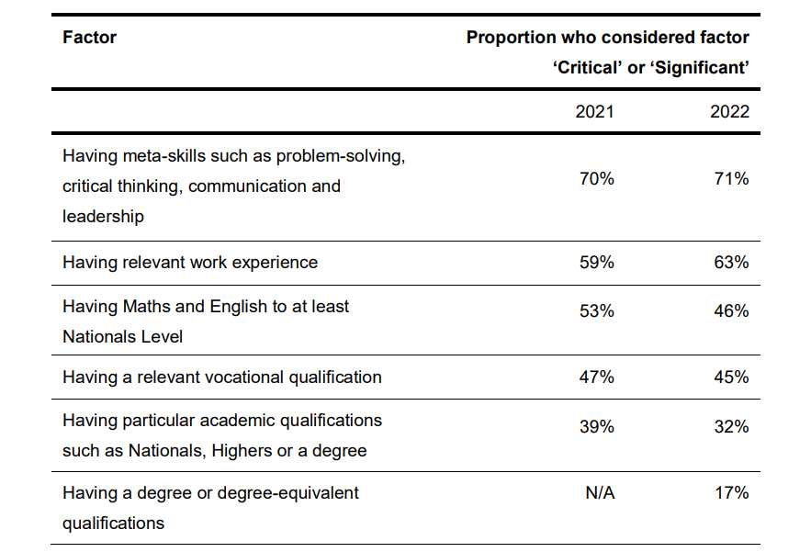
Scottish Government Employer Skills Survey 2022

