Slide 1
Safeguarding in Modern Apprenticeships
Community of Practice
6 March 2025
#ScotAppWeek25 and #MadeForBusiness

Slide 2
Welcome and housekeeping
Fire Alarm
Toilets facilities
Escorted by a member of staff
WIFI
Mobile phones
Photography
Social media #ScotAppWeek25 #MadeForBusiness
Event feedback
Notes:
Reminder – Scottish Apprenticeship week – use the hash tags to tag SDS in any of your socials

Slide 3
Agenda
Item | Timings
SDS - Introduction, Purpose and Objectives | 10.30 – 10.45
NSPCC Education Scotland | 10.45 - 11.45
Comfort Break | 11:45 - 12:00
Provider Showcase – L & G Learning Live Q&A | 1200 – 12.45
Lunch | 12:45 – 13:45
Workshop and feedback | 13.45 – 15.15
Closing Remarks and Next Steps | 15:15 - 15:30

Slide 4
Introduction
Purpose
Bringing together the Modern Apprenticeship learning Provider community to develop and strengthen partnerships between SDS, Education Scotland and NSPCC.
To raise awareness and help to improve the quality of delivery of Safeguarding including PREVENT and the UNCRC within Apprenticeships.
Objectives
By the end of the session, Providers will have:
  A greater awareness and understanding of Safeguarding including PREVENT and UNCRC
  Benefitted from the opportunity to share good practice, tips and discuss any challenges.
  Reflect on the insights gained and considered actions or improvements you may wish to take forward because of this event
                #ScotAppWeek25 and #MadeForBusiness

Slide 5


Safeguarding in Apprenticeship delivery
#ScotAppWeek25 and #MadeForBusiness
Lou Donnelly - Programme Enhancement Team, Skills Development Scotland
Zoe Browne & Caoimhe Walsh – NSPCC
Sarah Halliwell - HMIE, Inspectors of Education, Education Scotland
Andrew McCall & Linzi Robertson - L & G Learning Ltd Scotland

Slide 6

Safeguarding – MA Programme Specification –section 3.2.2
SDS expects
You to have a nominated protection/safeguarding lead for children, young people and vulnerable adults within your organisation.
You to have a robust safeguarding policy in place and to ensure best practice through all of your policies and procedures includes Safeguarding and PREVENT
You to provide effective management for staff through supervision, support training and quality assurance measures so they fully understand and follow your safeguarding policy including PREVENT training confidently and competently.
You to have robust recording procedures for noting concerns or facts about disclosure relating to safeguarding and PREVENT.
Title
Notes:
Reminder -Extract from the MA Programme Rules currently Published - MA Specification document section 3.2.2 – LPs contractual obligations this slide only.

Slide 7
Safeguarding – MA Programme Specification – section 3.2.2
SDS expects
The lead member of your staff to maintain their continuous professional development in safeguarding and PREVENT on a regular basis.
The lead member of your staff to be competent and confident to refer issues of protection/ safeguarding and PREVENT to the relevant statutory organisations in their local authority area e.g. social work and in emergencies Police Scotland
You to make available to all Apprentices the name of the individual they should contact if any safeguarding concern arises, with that individual being either within your organisation or within the Apprentice’s employer’s organisation, all as agreed with the employer and intimated to the Apprentice.
You to make available to all your Apprentices and your Employers information about PREVENT and signpost to the most up to date PREVENT duty training which is available here . Further information and guidance on PREVENT is available here and on the Scottish Government web page
The nominated individual is expected to be competent and knowledgeable will all of your policies and procedures in relation to safeguarding and PREVENT.
Title
Notes:
Reminder -Extract from the MA Programme Rules currently Published - MA Specification document section 3.2.2- LPs contractual obligations this slide only.

Slide 8
Vulnerable Adults and Disclosure Scotland
Safeguarding vulnerable Adults - Adult Support and Protection
( Scotland ) Act 2007 and Adults with incapacity
( Scotland ) Act 2000
Wellbeing – Safeguarding all Apprentices 16 -19, 18-24 and 25+
There is a duty of care to all Apprentices
Disclosure Scotland – A new law is coming into force which changes the PVG Scheme
Title
Notes:
Reminders and signpost.
Definition of Vulnerable adults – legal definition
In Scotland, there are two acts that provide a framework for safeguarding vulnerable adults:
Adult Support and Protection (Scotland) Act 2007 is designed to protect those adults who are unable to safeguard their own interests and are at risk of harm because they are affected by: Disability, Mental disorder, Illness, Physical or mental infirmity
Adults with Incapacity (Scotland) Act 2000 provides a framework for safeguarding the welfare and managing the finances of adults who lack capacity. The Act provides for three types of protection when an adult lacks capacity; welfare guardianship, financial guardianship and power of attorney.
Duty of care in the context of Apprenticeship delivery - At any point in someone's life they can experience vulnerable episodes and that its important that the duty of care and wellbeing applies to all your Apprentices from 16 to 60 and for you as LPs being able to offer support to all your apprentices.
Disclosure Scotland – A new law is coming into force which changes the PVG scheme
From the 1 April 2025, a new law comes into force. Those individuals who are to carry out a regulated role with children, protected adults or both, must ensure they are a member of the Protecting Vulnerable Groups (PVG) scheme for that type of work, to ensure that they follow legal requirements. It is also a legal requirement for organisations to ensure that they receive confirmation of an individual’s membership of the PVG scheme ahead of them carrying out a regulated role.
Signpost LPs to access most update to date and accurate information about the PVG scheme and new law.
Please sign up for the free webinars about the changes – Disclosure Scotland eventbrite
Social Media- sign up to Disclosure Scotland Facebook page – regular updates

Slide 9

Wellbeing and Disclosure Scotland
Equality guides and resources - Skills Development Scotland
www.nhsinform.scot/mind-to-mind
www.childline.org.uk – 0800 1111
Samaritans free by phoning 116 123 or emailing jo@samaritans.org
NHS 24 Mental Health Hub - 111
Breathing Space 0800 83 85 87
https://www.disclosure.gov.scot/changes
https://www.disclosure.gov.scot/new-disclosure-levels
Facebook - https://www.facebook.com/DisclosureScotland/
Title
Notes:
Having information accessible for individuals, having posters displayed in your premises, having confidential and safe places to have the conversations. Some of you may already have trained staff in place – mental health champions and its important that this information and resources are accessible to all your apprentices and staff.
SDS resources are available on the equality and diversity pages on our corporate site – Guidance for learning providers, apprentices and employers
Mental wellbeing support for apprentices
Supporting apprentices around suicide and self-harm
Able Futures Employer Toolkit Mental Health at Work
List of Equality Organisations
Mental health and wellbeing support for apprentices
Looking after mental health at work
Examples of some agencies that are available to support older age group of Apprentices and Child line
Disclosure Scotland links and Facebook page – reminder –signposting and sign up for regular updates on PVG

Slide 10
National Society for the Prevention of Cruelty to Children (NSPCC Scotland)
Zoe Browne and Caoimhe Walsh

Slide 11
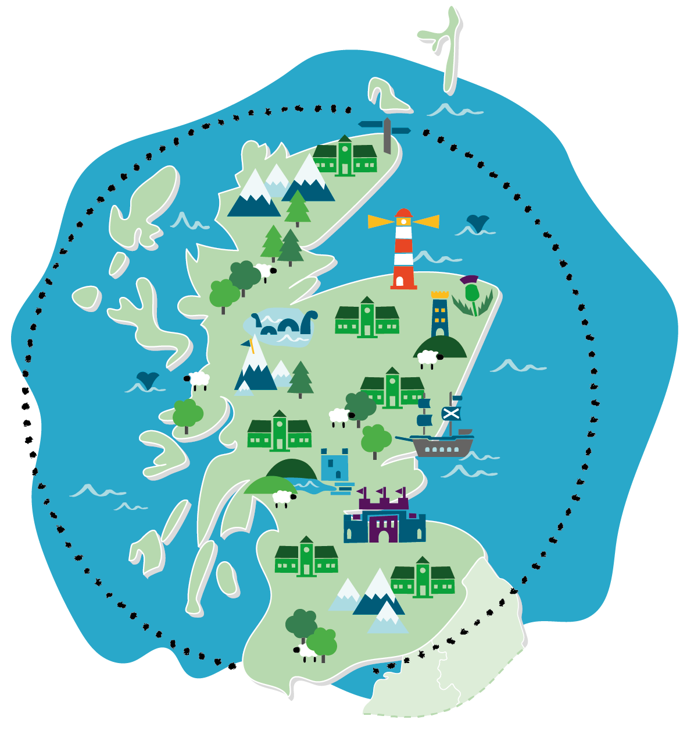

Supporting Your Modern Apprentices
Zoe Brown & Caoimhe Walsh
Zoe.Brown@nspcc.org.uk
Caoimhe.Walsh@nspcc.org.uk

Slide 12


Content
Definitions;
Child, Wellbeing, safeguarding and Child protection, UNCRC
Raise awareness of child rights and unique needs of adolescents
What Concerns Young people?
Supporting Young people in a work environment
NSPCC Resources including; NSPCC Learning, NSPCC helpline, Childline
Not a child protection training session. No detailed discussion of child abuse

Slide 13



Key Definitions
What is a child?
Anyone who has not yet reached their 18th birthday
All 16/17 year olds irrespective of where they live
Wellbeing – Children's wellbeing in Scotland is represented by the wellbeing indicators in GIRFEC
Safeguarding – actions you take to promote welfare (of children) and protect from harm.
Child Protection – protection of children and what is done to prevent children suffering, or likely to suffer, significant harm
United Nations Convention of the Rights of the Child (UNCRC)
Notes:
Any person who has not yet reached their 18th birthday is a child. When a baby is born their voice, their rights and what they can expect from adults are the same as the rights that an 17yrold in your office, business or community. Those rights do not get adapted, changed or taken away in any way at 16. Those rights exist in all circumstances and settings.
In Scotland, at 16 children for example have legal capacity and can make a will, get married or leave school. They can also earn the national minimum wage for their age group and vote in a Scottish parliament or local election
Safeguarding;
Actions to promote the wellbeing of children & young people. Every single person in the community has a responsibility to safeguard children and young people.
Child protection
part of safeguarding and involves what is done to prevent children suffering, or likely to suffer significant harm
In Scotland these are interlinked, as is wellbeing in the GIRFEC approach
UNCRC & EDI
In July 2024, it was incorporated into Scots Law, that any agencies must make efforts to uphold their rights, UNCRC view anyone under the age of 18 as a child.
There are 54 conventions on the rights of the child, from 43-54 they explain how the convention works. ​
These rights are universal, which means they apply to every single child. ​
The rights cant be separated from each other. They shouldn’t be placed in order either – they’re all essential to human dignity.​
​
For example, for many children, the right to the best health possible (article 24) may depend on the right to refuge (article 22) or to be free from discrimination (article 2)

Slide 14

The Adolescent Brain
Adolescent brain development beings at age 9 or 10 and lasts until mid-20s
Ability to suppress impulsive behaviour to take unhealthy risks is limited
Young people are motivated by admiration of adults – activities that engage with parents, teachers, coaches, supervisors, all help develop healthy interests and brain connections
Adultification
Notes:
Retrieved from AFWI: https://www.albertafamilywellness.org/what-we-know/adolescence/

Slide 15
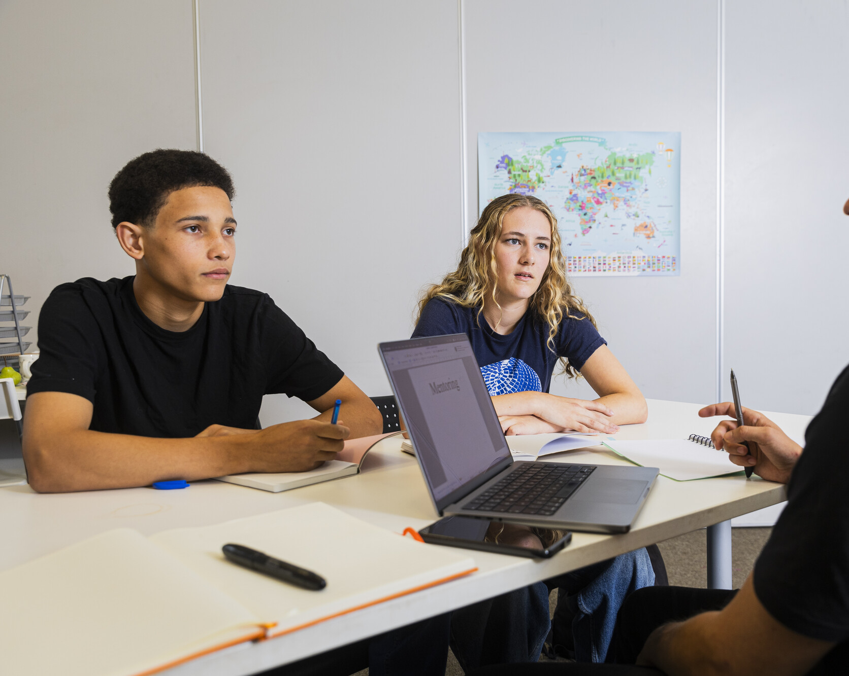
Supporting young people in your workplace
Accessibility; Is information easy to find and accessible to those with additional needs.
Induction process; staff awareness of policies, leads, training
Promotion; Identification of Child Protection lead and contact information
Culture; supportive and Inclusive work environment, respectful of protected characteristics
Responsibilities; as indicated by Skills development Scotland

Slide 16
Commitments
Skills Development Scotland Programme Rules for Modern apprenticeships
        Nominated safeguarding lead
        Safeguarding policies and procedures
        Support for staff in understanding safeguarding
        All staff & MA knowing who the safeguarding lead is and their role
Health and safety at work
Meeting requirements of external reviews
Notes:
It is important to view safeguarding as another element of health and safety at work.

Slide 17

Supporting wellbeing
16-18 year olds are the second biggest age group of Childline users
2023/24 over 53000 counselling sessions were with this age group
Main concerns;
  Mental/emotional health 39%
  Feelings associated with suicide 15%
  Family relationships 9%
  Self harm 6%
  Sex, Relationships, puberty 5%
Intimate and explicit Images
  Sexually coerced extortion
  Report Remove
  Any nude image of a child under 18 is illegal content particularly the taking and sharing of an image
  Behind The Screen

Slide 18


NSPCC Learning - Resources
News
Podcast, blogs, why language matters
Key topics
Safer recruitment, online safety
Research and Resources
Child protection self-assessment tool
Training
Services
Child Protection consultancy

Slide 19

NSPCC Learning - Training
Introduction to safeguarding & child protection training
Safeguarding young people and young adults training
Designated Child Protection lead in Scotland
Safer Recruitment Training

Slide 20


Childline gives children
and young people a voice
Childline is a free, confidential service for children and young people, available 24/7.
nspcc.org.uk/childline
Whatever their worry, children can talk to a counsellor over the phone, via email, or using
the 1-2-1 chat.
The Childline website has a range of information and games for young people, and message boards for peer-to-peer support. Childline’s Deaf Zone provides advice and support for those who are d/Deaf or hard of hearing. And the Childline Kids website provides help and support for younger children.
Notes:
Signpost CYP you work with to Childline – support up to the age of 19yrs old
Childline offers a range of support – on issues that some children and young people might not realise. This includes bullying, mental health, eating disorders.
Children can access free, confidential counselling via telephone, email, text or webchat facility
Advice on a range of issues such as keeping safe online, friendships, loneliness, relationships/sex, growing up, school/college

Slide 21

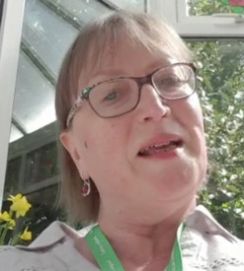
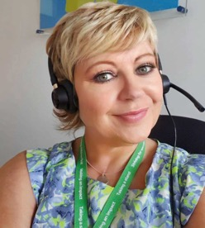
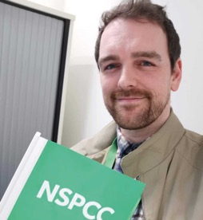
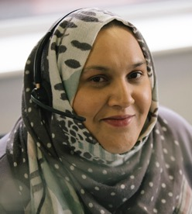
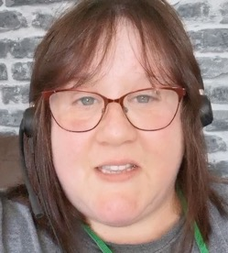

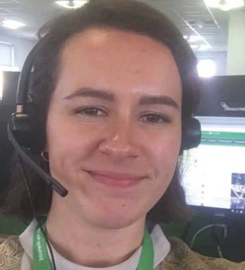
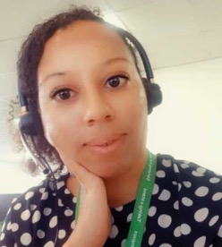
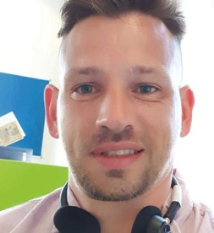

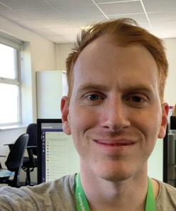
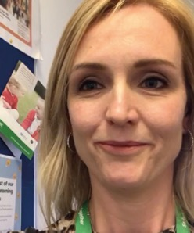
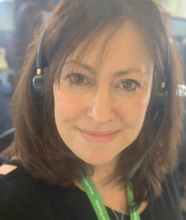
Our Helpline
The NSPCC Helpline is our service for adults
with any concern about a child. From parents,
to professionals, to the wider public, the
Helpline is here for anyone to contact.
It doesn’t have to be an emergency. In fact, every day roughly half of all the calls taken by our friendly team are for guidance and support. This is across
a huge range of issues affecting children.
For any concerns about a child
help@nspcc.org.uk | 0808 800 5000
Notes:
The NSPCC Helpline
This includes a phone line, an email address and an online help form.
.
The helpline is an excellent source of information for guidance and support, on the website there is a section guiding you on how helpline works and the staff at helpline will support you in a stress free way. They know and understand that if you are calling them you really need that safe space to share your concerns. There are also dedicated helplines for things you may be worried about such as gangs and radicalisation

Slide 22

Links and Resources
NSPCC
NSPCC Learning
NSPCC Website
NSPCC Helpline
Listen Up, Speak Up - to organise a workshop click here
      Childline
      Building Connections
      NSPCC Behind the Screen
    External links
Child Protection Resource for Young People
  A guide to child protection in Scotland
CELCIS Knowledge Bank –Protecting Children
  Legislation, policy and information resources for Child protection
UNCRC – Child Rights
  UNICEF website has a summary page for child rights
Notes:
NSPCC Learning -Huge amount of information, lots of paid for resources but also lots of free resources such as podcasts, learning resources news etc
Main NSPCC website – this has various different sections but does outline what abuse is, what the types of abuse can be and how to respond to concerns or abuse and what to do if you are worried about a baby, child or young person, also information on keeping children safe, parenting support such as dealing with a new baby to talking about healthy relationships to bereavement and online safety
Listen up Speak up
Whilst there are specific responsibilities are part of certain professional roles, everyone who works with children’s families, young people and vulnerable adults has a role in making sure individuals safe and well. Individuals, local communities, organisations have a vital role in helping to protect children and vulnerable adults. Prevention and early intervention are essential to help ensure that risk and harm to children and young people is recognised and dealt with quickly and effectively.

Slide 23

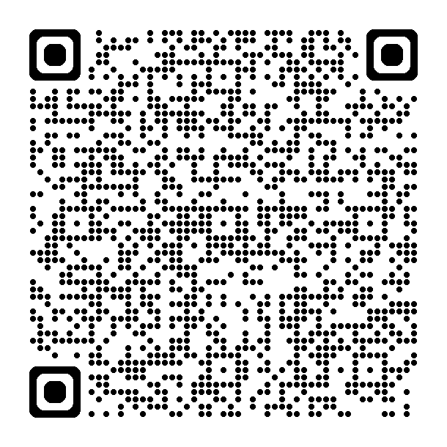
Any questions?
For queries, please email to scotland1@NSPCC.org.uk
©NSPCC 2023. National Society for the Prevention of Cruelty to Children. Registered charity England and Wales 216401,
Scotland SC037717 and Jersey 384. Photography by Tom Hull, Harry George Hall, and Adrian James White. Children and adults
pictured are models and volunteers. Photography includes a real-life NSPCC Childline counsellor, Sarah Murphy. J2023009.

Slide 24
Education Scotland
Sarah Halliwell
HM Inspector of Education

Slide 25

Prevent
Sarah Halliwell
HM Inspector of Education
Notes:
Prevent –This can be covered under existing safeguarding arrangements and duty of care

Slide 26
What is Prevent?
  The UK Counter-Terrorism (CONTEST) Strategy was developed to address threats that Scotland and the rest of the UK face from a range of extremist and terrorist ideologies, groups and individuals.
  Counter-terrorism strategy (CONTEST) 2023 - GOV.UK
  Prevent is one strand of this strategy and sits alongside,
  Pursue Protect and Prepare.
Notes:
Counter-Terrorism and Security Act 2015

Slide 27
Prevent Duty
  The Prevent duty was established by the Counter-Terrorism and Security Act 2015 and places a duty on specified authorities such as education, health, local authorities, police and criminal justice agencies (prisons and probation) to have “due regard to the need to prevent people from becoming terrorists or supporting terrorism.”
  Counter-Terrorism and Security Act 2015 (legislation.gov.uk)
  The updated Prevent guidance came into force on 19 August 2024 following parliamentary approval and this duty of care is now a legal requirement for all education providers.

Slide 28
Prevent Duty and Education
  The Prevent Duty “applies to all education establishments including schools, early learning and childcare settings, the publicly funded skills sector, independent schools and both further and higher education provision across Scotland.”
  Section 165 Prevent Duty Guidance
  Prevent duty guidance: for Scotland (accessible) - GOV.UK (www.gov.uk)

Slide 29
Everyone has civic responsibility and a duty of care
Prevent is about safeguarding individuals from being drawn into terrorism, ensuring those vulnerable to extremist and terrorist narratives are given appropriate advice and support at an early stage. Prevent is no different to any other form of safeguarding from harm.
Prevent Guidance states “Skilled practitioners should use techniques that open up discussion to challenge misinformed views and perceptions.”
Prevent duty training is available on gov.uk. to support practitioners

Slide 30
The role of HMI in Prevent
Section 236 of the Prevent Guidance states, “HMI Inspectors inspect publicly funded further education and skills providers and provision in Scotland under the education inspection framework. This includes colleges and providers of apprenticeships and other skills training.”
Prevent duty guidance: for Scotland (accessible) - GOV.UK (www.gov.uk)

Slide 31
Prevent Referrals
Prevent referrals are often made in the first instance by individuals who encounter those who appear to be susceptible to radicalisation.
Referrals come from a wide range of sources, including:
Local authorities (11% social work and housing association)
Education - schools, colleges, universities (31% of referrals in 23/24)
NHS - health bodies
Prisons
Police (46% of referrals in 23/24)

Slide 32
Prevent Process
All referrals go to Police Scotland’s Prevent Delivery Unit, who undertake an initial assessment of susceptibility before agreeing the appropriate response with partners.
All Prevent referrals are confidential and do not result in a criminal record or any form of sanction.
Where an individual is identified as requiring support via Prevent Case Management (PCM) partners will come together as part of a Prevent Multi-Agency Panel (PMAP) to discuss what support they could provide which would benefit the individual concerned.
PMAPs are chaired by the local authority and made up of representatives from different safeguarding areas such as the police, health and education.

Slide 33
Prevent Support
Support may involve signposting the individual to other professionals, engaging with a Home office Intervention Provider or most commonly identifying the individual’s broader support needs and accessing mainstream support services on their behalf.
Safeguarding the individual is the priority and participation in PMAP is voluntary.
Consent is required to be given by the individual (or their parent/guardian in the case of a child or incapacitated adults)
Where the individual does not consent to engage with PMAP, alternative measures are considered by the multi-agency panel, including whether the individual should enter Police-led Partnership (PLP).

Slide 34
Prevent timeline
REFERAL, ASSESSMENT and CASE MANAGEMENT
PMAP meetings are held as required (within statutory requirements) to review the progress of the individual. If the panel agrees that an individual’s susceptibility has been successfully reduced or managed, then the individual exits the process.
After an individual has exited Prevent, their progress is reviewed at 6 and12 months following closure of the case. If further concerns arise as a result of these reviews, the individual can re-enter the process and receive further support

Slide 35
Prevent in perspective
In 2023/24 there were 114 referrals to Prevent in Scotland. This is an increase of 31% compared to the previous year.
Of these referrals;
100/114 were for males aged between 15 and 20 years
43/114 referrals were for Mixed, Unstable, or Unclear (MUU) ideology
36/114 referrals were for Right-Wing Extremism
Of the 114 Prevent referrals in 2023/24, 56 were deemed suitable for PCM. 56 were assessed and not suitable for PCM (this includes 48 who required no further action and were closed and 8 who were referred to other agencies). 2 referrals remain in the assessment ongoing stage.

Slide 36
Planning for review
The inspection process and evaluation criteria are set out on the Education Scotland website.
About inspection and review | What we do and how we do it | Inspection and review | Education Scotland
Prevent radicalisation and extremism | Resources | Education Scotland

Slide 37
HMI process
The inspection process is risk-based, and the frequency of inspections depends partly on this risk. HMI report on whether they have confidence in the provider’s approaches to safeguarding and the impact of these approaches on the young people’s safety in the various settings.
Professional dialogue is proportionate and relevant to the context of the provider and setting
We want to understand what is working well as well as supporting improvement in arrangements to support safeguarding

Slide 38
Expectations
HMI will expect
That all providers, their subcontractors and all staff are aware of Prevent
That training and information is included with general and regular safeguarding training and briefings
That there is an assigned Prevent lead who should report concerns to the police using this form national-referral-form-august-2024.docx which should be sent to preventreferrals@scotland.police.uk

Slide 39
Summary
Prevent is currently undergoing a review, as there are concerns that the focus is on terrorism philosophy only and not on individuals with an obsession with violence. It is possible this will lead to changes.
Prevent learning review: Southport attack - GOV.UK
QUESTIONS?

Slide 40
L & G Learning ( Scotland) Ltd – Early Learning and Childcare sector
Andrew McCall and Linzi Robertson

Slide 41






SAFEGUARDING APPRENTICES

Slide 42




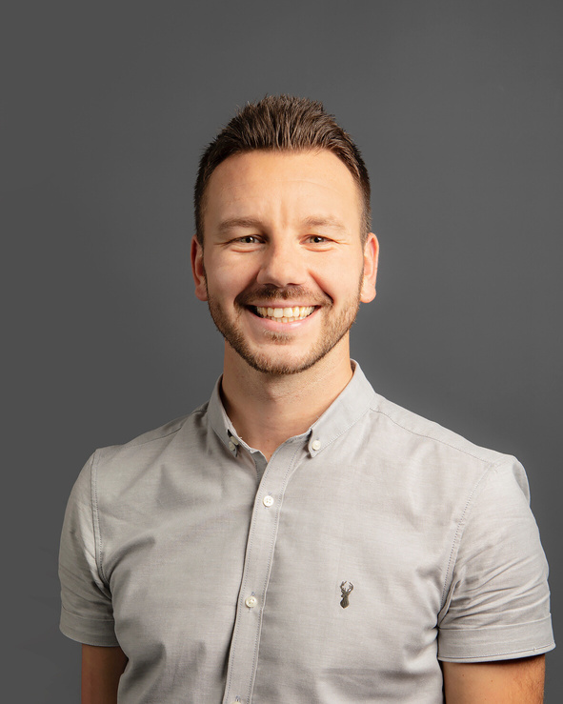
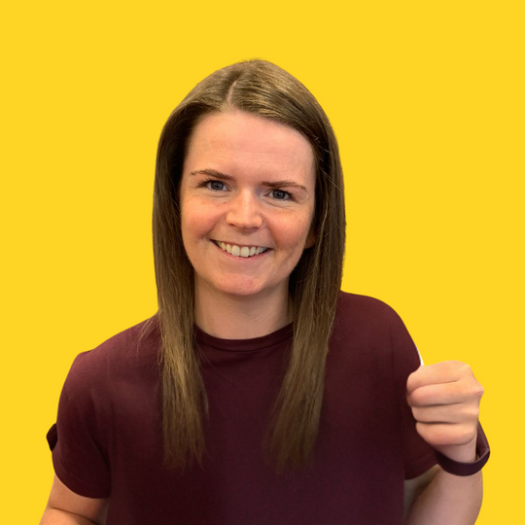

INTRODUCTIONS
L&G Learning
Training provider specialising in Social Services both Healthcare and Children & Young People.
Andrew - Contracts Manager
  Early career in retail & hospitality and leadership roles
  Professional career in Early Education & Childcare
  Joined L&G Learning in 2013
Linzi - Assessor & Internal Verifier
  HNC Healthcare then HNC Early Education & Childcare, SVQ 4 SSCYP & BA Childhood Practice
  Early Years & Nursery experience
  Moved into Nursery Management
  Joined L&G Learning 2020
Andrew
Linzi

Slide 43


1
L&G Learning Policies
2
Safeguarding in practice
AGENDA
3
Supporting our Apprentices
4
Examples
5
Additional support & good practice

Slide 44


SAFEGUARDING POLICY
Overview
  Policy statement and overview
  Definitions
  Responsibilities
  Procedure
  Responding
  Recording & reporting
  Confidentiality
  Partnership Agreements in place
1
Overview of the policy
2
Pros and cons
3
Next steps

Slide 45


SAFEGUARDING IN PRACTICE
Induction
Set standards and expectations, sign paperwork
Staff PVG’s
All L&G staff covered by PVG
Staff Training
Regularly identify training
Regular contact
Fortnightly support sessions
Training days
Time to focus on SVQ and talk openly
PVG’s
Regular Contact
Training
Days
Staff Training
Inductions

Slide 46






SUPPORTING OUR APPRENTICES
Supporting
Partnership
Planning
  Identifying supports: At interview, reviews and support sessions
  Wellbeing Wheel: Adapted from SHANARRI
  One-to-one: Support sessions
  Partnership Agreement: Employers agree additional support to be implemented
  Support Plan: Individual Learning Plans in place to support candidates, where required
  Monthly Meetings: Discuss candidate progress

Slide 47

REAL LIFE EXAMPLES
CANDIDATE ONE
CANDIDATE TWO
CANDIDATE THREE
  Long term mental health struggles
  Signed off by GP
  Keyworker input
  Joined Online support session with external mental health agency
  One-to-one sessions
  Work with employer to support candidate back to work
  Reduced hours agreed
  Care experienced
  Traumatic childhood experience
  Enhanced Funding support
  Individual support plan in place centred around specific needs
  Regular one-to-one sessions
  Wellbeing check-ins
  Assessor and candidate trust and support
  Major car accident, trauma
  Employer contract in place prior to accident
  Time out to recover
  Regular contact with family and candidate
  Support plan in place through Occupational Health
  Individual support plan to achieve SVQ
  Support with return to work
  Staff awareness

Slide 48




ADDITIONAL SUPPORT
Valued
Empowered
Supported
What has worked well?
  STARRA Education - Mental health drop in sessions with Joanne. Group or one-to-one support. Anonymous.
  Key worker allocation - Candidates can be allocated a key worker, separate from their assessor, to regularly check-in out with the Apprenticeship time.
What can we do better?
  Understand where to refer candidates in crisis locally
  What else can we do?

Slide 49

THANK
YOU!

Slide 50
Q & A- Panel
#ScotAppWeek25 and #MadeForBusiness

Slide 51
Workshop Activity
Task 1
4 scenarios on Safeguarding and PREVENT – each table will have 2 scenarios each (1 on PREVENT and 1 on Safeguarding.
Each table will discuss and agree their approach collectively to each scenario based on your experiences, what you have heard today, and the facilitators will capture the discussion points at each table .
Tables 1 – 4 will look at PREVENT scenario 1 and Safeguarding scenario 2
Tables 5 -8 will look at PREVENT scenario 2 and Safeguarding scenario 1
Each table will have 30 mins to complete this task.
Task 2
There are a set of questions at each table and your facilitators will guide you through these questions and take notes.
We would like encourage you all to discuss these questions together and be as open and honest with your responses/ feedback to the questions
Each table will have 30 mins to complete this task.
Feedback
Scenarios feedback
tables 1 -4 feedback on challenges with Safeguarding within your Apprenticeship delivery
tables 5 -8 feedback on good practice, what has been successful in your approach to Safeguarding
Title

Slide 52
Plenary & Close
#ScotAppWeek25 and #MadeForBusiness

