Slide 1

Effective Practice in Hospitality MA Frameworks
Education Scotland review findings
May 2019

Slide 2
Tourism Overview
Lawrence Durden

Slide 3
Tourism sector in Scotland
Tourism employs 207,000 people (one in twelve jobs in the economy)
Tourism employment has grown by 12% since 2011
Around 14,000 tourism businesses
In 2016 almost £4.8 Billion was spent by overnight visitors to Scotland.
Over 2.7 Million overseas visitors came to Scotland in 2016.
Scotland voted ‘The most beautiful and welcoming country in the world’ by Rough Guide readers in 2017.

Slide 4
GVA & Employment Forecasts 2019-2029
Total GVA of the sector will rise to £5.5 billion by 2029, this marks an increase of £794.6m (17%) from 2019.
Productivity per job is also set to rise by 10% in the 10 years to 2029.
  2019: £22,840
  2029: £25,073
The sector will see the need for 125,300 jobs to be filled by 2029:
  13,300 (11%) will be created through expansion demand as a result of economic growth.
  112,000 (89%) will be through replacement demand, replacing existing the workforce.
Total employment in the sector will increase from 206,500 in 2019 to 219,800 by 2029 – an increase of 6%.
Title

Slide 5
Total Employment by Qualification Level
There is a forecasted increase in the people employed in the sector that will hold SCQF level 5 and above.
Whereas by 2029 there is expected to be a decrease in people employed in the sector that will hold SCQF1-4 or no qualifications.
Title

Slide 6
Sector & Occupation Level Forecasts
There is an expected increase in the following occupational groups:
  Professional occupations (12%)
  Associate professional & technical occupations (16%)
  Administrative & secretarial occupations (12%)
  Skilled trades occupations (5%)
  Caring, leisure & other service occupations (12%)
  Process, plant & machine operatives (5%)
  Elementary occupations (8%)
Only Managers, directors and senior officials, and Sales & customer services expect a decrease in the number of people in these occupation groups in the sector, 4% and 8% respectively.
Title

Slide 7
Challenges
Brexit
Business Rates
National Living Wage
Low productivity
Tourism Tax

Slide 8
Identifying the Sectoral and LA Hotspots
Sectors *
Local Authorities #
Most likely to be negatively impacted by No Deal
Food & Drink
Machinery & Equipment
Chemical & Pharma
Agriculture, Forestry & Fishing
Information & Communication
Professional Services
Wholesale & Retail
Aberdeenshire
Scottish Borders
West Lothian
Title
City of Edinburgh
Aberdeen City
Highland
Perth & Kinross
Falkirk
Shetland Islands
Orkney Islands
Angus
Renfrewshire
Eilean Siar
South Lanarkshire
Dumfries & Galloway
Midlothian
Argyll & Bute
North Lanarkshire
Moray
North Ayrshire
Accommodation & Food Services
Transport and Storage
Financial & Insurance
Construction
Fife
South Ayrshire
East Lothian
Stirling
East Renfrewshire
East Ayrshire
Inverclyde
W Dunbartonshire
E Dunbartonshire
Glasgow City
Dundee City
Clackmannanshire
Education
* Sector Exposure to EU exports and Sector Reliance on EU workers
# Proportion of LA workforce in sectors most exposed to Brexit and Local Authority Reliance on EU workers
Notes:
Red = most likely to be severely sectors/LAs to be negatively impacted by No Deal Brexit
Amber = likely to be negatively impacted by No Deal Brexit however to a lesser extent than Red
Yellow = likely to be negatively impacted by No Deal Brexit, however anticipated to be to a lesser extent than Red/Amber

Slide 9
Key Challenges and Priority Themes
Improving management, leadership and enterprise skills across the sector.
Supporting the development of professional and digital skills for all in the sector.
Ensuring staff at all levels understand and are able to respond to visitor needs and expectations
Raising the attractiveness of the sector.

Slide 10
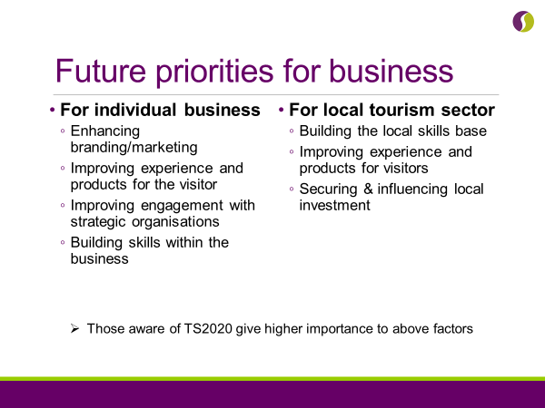

Slide 11
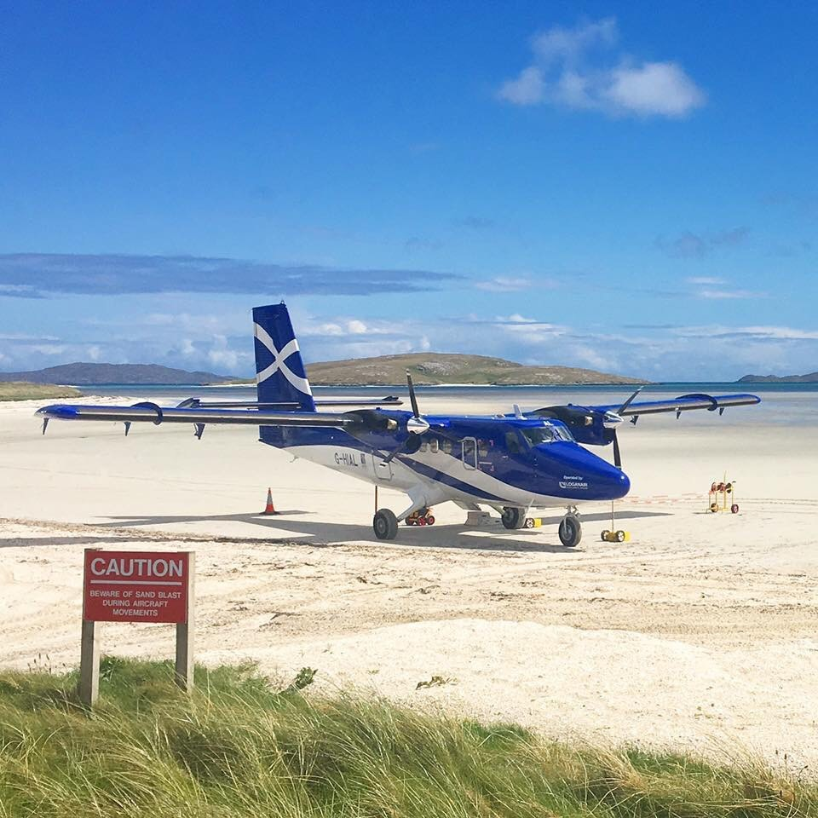

Slide 12

Modern Apprenticeship Review
Hospitality providers meeting
21 May 2019
Notes:
This is a front cover page and can only be used once. Use the corresponding green internal and back pages if you are using this page. You may add a title and a subtitle if needed only. Do not add anything else or move elements around.

Slide 13
Review of Modern Apprenticeships
Previously no independent, external review or scrutiny of the quality of learner experiences for MA programmes in Scotland.
All industry sectors in scope.
Off-the-job and now on-the-job training for MAs.
Engineering as the pathfinder, completed Hairdressing, Automotive, ICT and Hospitality.
Review of Learndirect MA programme 16 March 2018 and PeoplePlus 12 May 201
Notes:
Currently undertaking the review of Social services, children and young people.

Slide 14
Scope of the review
All training providers are in scope, whether independent training providers (ITP), colleges or employers.
Commenced with the evaluation of the work of ITPs and colleges in the first instance.
Other colleges’ work as training providers in relation to MA programmes will also be scrutinised separately under this proposal.

Slide 15
Process of review
Framework - External quality arrangements for the review of Modern Apprenticeship Off-the-job training.
Three high level principles of Outcomes and Impact, Delivery of Training and Leadership and Quality Culture.
Sample of providers; 1/2 days in centre or employer; feedback to provider.
Model – Discussions with assessors; managers; employers; and, apprentices. Observations.

Slide 16
Process of review
The sample of providers
Babcock Training; Hospitality Training; Di Maggio Restaurant Group; Perth College; GO@L Training; Edinburgh College; Lanarkshire Catering School; The Principal Blythswood Square Hotel; Macdonald Hotel and Resorts; MGT Training; Montpeliers (Edinburgh) Limited; On Track Training; Training Matters.

Slide 17
Grades
Excellent Outstanding and sector leading
Very Good Major strengths
Good Important strengths with some areas for improvement
Satisfactory Strengths just outweigh weaknesses
Weak Important weaknesses
Unsatisfactory Major weaknesses

Slide 19
Responsibilities regarding delivery of peripatetic assessor/provider where delivery is all “on-the-job”
To ensure that the MA “route” meets the need of the individual apprentice and the employer
To provide a robust induction to what is expected of the apprentice in terms of assessment processes; to planning their assessment activities; to understand their individual needs and ensure that an individual learning plan is put in place to meet these needs; to portfolio building and reflecting on their own performance etc
To coach the apprentice through informal/formal tutorial sessions for portfolio and/or formal “tests”
To use assessment for learning- provide constructive feedback and tuition to support progression to “competency” (f2f and/or remote)
To confirm and sign off competencies against the framework standards
To engage appropriate personnel in the workplace to ensure that the apprentice is receiving appropriate support from their employer towards meeting competencies (e.g. formal/informal learning sessions; mentoring support; diversity of tasks to allow them to meet the competencies; time for development and reflection)
To undertake (at least) quarterly reviews to ensure that the apprentice is progressing appropriately, planning next steps, giving constructive feedback upon general progress and to ensure that appropriate employer rep is engaged in this process too

Slide 20
High level questions
Outcome and Impact
  How well are apprentices progressing and achieving relevant high quality outcomes? Very good
  How well do we meet the needs of our apprentices and stakeholders? Very good
  Delivery of training
  How good is our delivery of training? Very good
  How good is our management of training delivery? Very good

Slide 21
High level questions
Leadership and quality culture
How good is our strategic leadership? Very good
Capacity for Improvement
Judgment based on evidence of all key areas, in particular Outcomes and Impact and Leadership and quality culture.

Slide 22
Areas of positive practice
Apprentice achievement rates.
Equality statistics.
Core skills.
ITPs are nominated and successful in awards.
Health and safety
Notes:
ACHIEVEMENT RATES - In most providers, apprentice achievement rates are on, or above, the national achievement rate for the sector of 73.8%. In a few cases, Independent Training Providers (ITP) have delivered achievement rates which are significantly higher than the national average.
EQUALITY PIs - The proportion of MA starts self-identifying with an impairment, health condition or disability, and for those MA starts from ethnic minorities, is higher than the SDS national benchmark.
CORE SKILLS - They are making good progress towards achieving their core skill components within programmes. In the best centres, core skills are embedded fully and signposted well within awards.
AWARDS - More than a few providers encourage apprentices to enter nationally recognised competitions, which helps to celebrate apprentice achievement. For example, an apprentice from Training Matters was recognised as SDS’s Scotland’s Apprentice of the Year 2017. Babcock Training was voted the winner of the Scottish Training Federation’s 2018 Provider of Quality Training award, and GO@L Training was shortlisted for the SDS 2018 MA award for Small to Medium Sized Enterprises.
All colleges and ITPs place a strong emphasis on health and safety practices and legislation.

Slide 23
Areas of positive practice
Induction programmes.
Assessors visit apprentices regularly.
Employers views.
Delivery of training.
Training plans
Notes:
All colleges and ITPs offer a comprehensive induction programme for apprentices. These programmes are effective in ensuring that candidates understand clearly what is involved in their programme and what types of activities they will be undertaking. For example, DiMaggio’s Restaurant Group have a Declaration of Intent, signed by candidates, which sets out the responsibilities of candidates, employers and assessors and provides a firm idea of what is involved in the programme for apprentices.
ASSESSORS VISIT APPRENTICES - All assessors plan their engagements flexibly to meet the needs of apprentices, including working around rotas and timings in their work places, to ensure candidate evidence can be gathered effectively. Assessors visit apprentices regularly, which maintains relationships with apprentices and employers, and provides a focus on apprentice progress. Apprentices and employers prepare well for these discussions during progress reviews with assessors.
EMPLOYERS - Almost all employers consider that the programme is adding value to their business and meeting their needs well. They feel that apprentices are more committed to their role, than those entering employment through traditional qualification routes. Those providers which work throughout Scotland, and in particular in remote rural locations, support apprentices well and ensure regular progress visits take place.
DELIVERY OF TRAINING - Overall, providers deliver programmes well, which are designed in conjunction with employers and support apprentices to improve their skills and enhance their qualifications. They provide suitable career progression and help ensure employers develop a skilled workforce which meets their needs well.
TRAINING PLANS - Overall, training plans for apprentices are developed in conjunction with employers and apprentices. Optional units are agreed jointly with employers and apprentices. This aligns well apprentices’ learning experiences and the development of skills, with the business need within their employers.

Slide 24
Areas of positive practice
Quality of online resources
Questioning and challenge
Assessors knowledge and experience.
Joint evaluation.
Notes:
QUALITY OF RESOURCES - Most assessors adopt a flexible approach to gathering evidence from candidates. Many apprentices are encouraged to use mobile devices to provide relevant evidence, which aids the completion of their portfolios and develops their ICT skills. The availability of high quality dedicated online resources within ePortfolios is valued highly by apprentices. For example, at MGT, the use of ePortfolios assists the delivery of the qualifications and the communication of candidates progress. Assessors can review evidence before a review meeting and make best use of the time spent with the candidates.
QUESTIONING AND CHALLENGE - Almost all assessors in colleges and ITPs use a good range of effective questioning techniques to gauge knowledge and understanding and ensure apprentices are making good progress. They know their apprentices, and their work contexts well, and observation of apprentices activities are carried out in appropriate contexts to support the gathering of evidence.
Most apprentices are suitably challenged by assessors and are often encouraged to stretch themselves to gain further knowledge and skills.
ASSESSORS - In general, assessors are highly qualified and use their extensive experience of the industry effectively, to support apprentices as they progress through their qualifications. For example, in ITPs, assessors regularly identify and access modern work practices and career and lifelong professional learning sessions to ensure their skills and knowledge are current and industry standard.
Almost all assessors develop positive relationships with candidates and employers. Assessors are very approachable and flexible, and build the confidence of apprentices through positive engagement and encouragement.
JOINT EVALUATION - In most programmes, employers and apprentices actively contribute to the evaluation of the delivery of programmes. They comment positively on the communication between them and the providers.

Slide 25
Areas of positive practice
Employer and strategic links.
Leadership of staff.
Team working.
ITP training activities.
Self evaluation.
Notes:
Overall, providers have strong employer and strategic links which ensures programmes are industry relevant. In doing so, their programmes align well to the needs of the sector. Almost all providers communicate effectively to staff their vision in relation to the importance of the Hospitality industry to the Scottish economy and the values and aims of delivering high quality training to apprentices.
In most providers, key business performance information is communicated well to all staff, particularly contract performance against targets. This knowledge helps the staff to plan their activities with employers and apprentices more effectively.
Team working across staff in almost all of the providers is strong. All staff are highly motivated and engaged in their work, and are committed to delivering high-quality training experiences for apprentices, which meet employer needs well.
ON THE JOB EXPERIENCES - In all on-the-job training activities, assessors are supported well by managers to provide high-quality training experiences and effective support for apprentices.
SELF EVALUATION - In almost all providers, there is a strong commitment to self-evaluation leading to improving outcomes for apprentices. They react promptly as a result of feedback received from apprentices and employers. Most providers actively encourage staff to share examples of best practice. Approaches to internal verification are developed well and there are regular staff meetings, which staff value highly.

Slide 26
Areas for development
Providers below the SDS national achievement rate hospitality programmes.
Gender imbalance in programmes.
Sufficient challenge.
Core skills.
Restricted communication with employers.
Notes:
PROVIDERS - A few providers are performing significantly below the SDS national achievement rate of 73.8% for hospitality programmes, and one provider has been unable to fulfil their SDS contractual obligations for apprentice starts.
GENDER - More than a few providers are not sufficiently proactive in addressing gender imbalance in programmes, and do not benchmark their recruitment statistics against national targets.
CHALLENGE - In a few providers, apprentices did not receive sufficient challenge to extend their knowledge and skills. For a few apprentices, this lack of challenge within extension activities and progression opportunities, demotivates them.
CORE SKILLS - Not all apprentices understand the relevance of core skills within their programme - In more than a few centres, opportunities to reinforce core skills development are not contextualised, and apprentices therefore fail to see the relevance of core skills within their overall MA programme.
EMPLOYER LINKS - In a few providers, employers have limited communication with college staff and find it frustrating not to discuss the design of the programme, to better reflect the needs of their business and the progress of apprentices. In a few providers, apprentices and employers had no formal opportunities to feedback directly on their programme and were rarely involved in progress review discussions. A few employers would appreciate more effective communication from their provider. This restricts opportunities for employers to influence programmes which lead to improvement in training. For example, in a few providers, there are no systematic arrangements in place to gather feedback from employers about their experiences or levels of satisfaction, to inform improvements.

Slide 27
Areas for development
Resources.
Self evaluation.
Links to government strategies.
Feedback from employers.
Notes:
RESOURCES - A few providers did not provide appropriate learning resources for the apprentices. For example, a kitchen in one provider did not reflect current industry standards, and in another provider, the ICT facilities were poor.
SELF EVALUATION - In a few providers, there are insufficient formal opportunities for staff to reflect meaningfully on the experiences of apprentices, or plan for improvement more generally.
GOVERNMENT STRATEGIES - For a few providers, there is insufficient engagement with partners such as the local DYW group, or wider trade associations, to deliver actions from the Scottish Government’s Youth Employment Strategy. In a few providers, strategies for engaging fully with schools to develop a pipeline for pupils to undertake apprenticeships are underdeveloped.
FEEDBACK - In a few providers, the use of formal arrangements for gathering employer and apprentice views are not always used systematically to identify and inform improvement themes. For a few providers, communication links between the Business Development Unit and the programme area, were insufficient, and employer feedback was not sought or utilised effectively to make improvements in the programme.

Slide 28
Recommendations - Providers
Promote the practices from those centres with excellent grades.
Strategies that respond appropriately to national priorities.
Achievement rates.
Core skills.
Communication with employers.
Under-represented groups apply and are recruited to programmes.
Influencing programmes.
Notes:
Work with Her Majesty’s Inspectors (HMI) and SDS staff to promote the practices from those centres with excellent grades, across all of the providers in the sector;
Further develop strategies that respond appropriately to national priorities, such as DYW;
Continue to improve the achievement rates for hospitality apprentices to at least the national average in the sector.
Take action to contextualise and highlight the relevance of core skills within programmes and ensure apprentices recognise fully how they are developing their core skills;
Improve formal communication with employers to ensure they fully understand the structure of the programme, the role they have in supporting apprentices within the programme, and the progress of their apprentices;
Continue to develop strategies to ensure applicants from under-represented groups apply and are recruited to programmes; and
Establish formal mechanisms for apprentices and employers to influence improvements in the programmes.

Slide 29
Education Scotland
Denholm House
Almondvale Business Park
Almondvale Way
Livingston EH54 6GA
T +44 (0)141 282 5000
E enquiries@educationscotland.gov.uk
www.educationscotland.gov.uk

Slide 30


Angela Newton
Group Head of Learning, Development & Quality

Slide 31
Agenda
Importance of Apprenticeships at Apex
Working in Partnership
Apprenticeship Feedback & Success

Slide 32

Importance of Apprenticeships
Promoting Hospitality as a rewarding, sustainable Career Path
Development of our People
Recognition & Achievement of an SVQ
Retention of our People
Flexible & Accessible

Slide 33
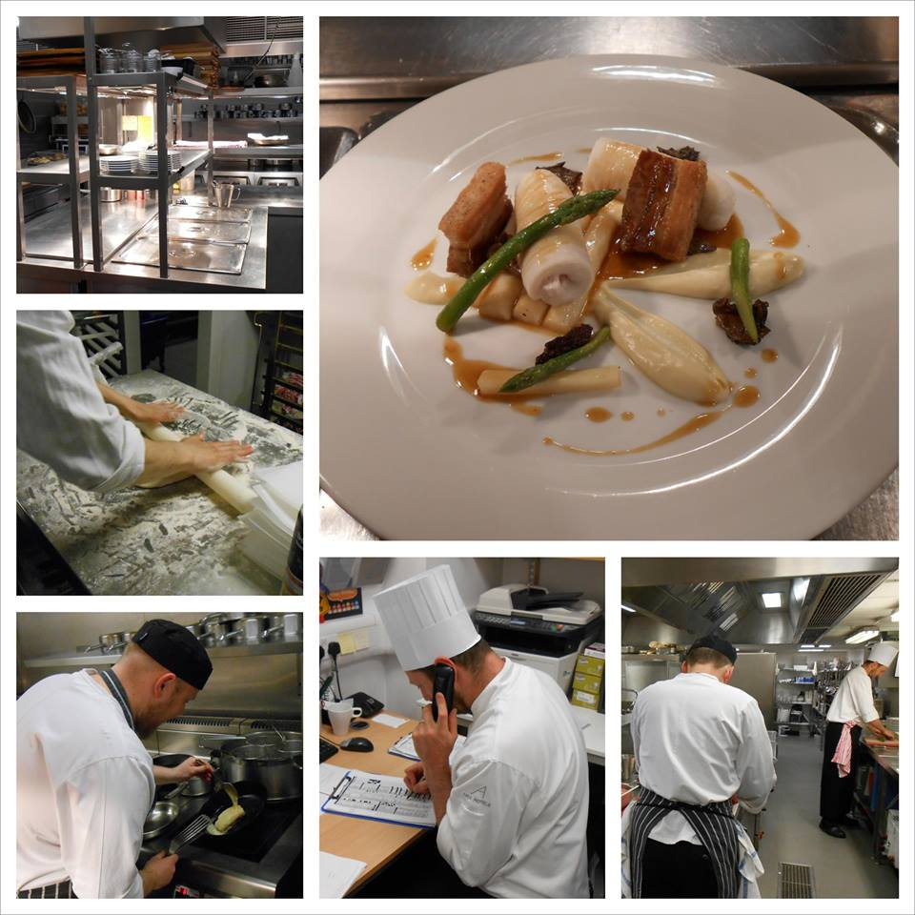
Working in Partnership
DYW & Springboard
14 Career Fairs this year within high schools, colleges & universities
Pre apprenticeship programme for S5 &S6 course choices
Key Partner of the Apprenticeship in Hospitality Scotland (AIH)
Executive Head Chef Education & Training works alongside teaching staff in High Schools

Slide 34
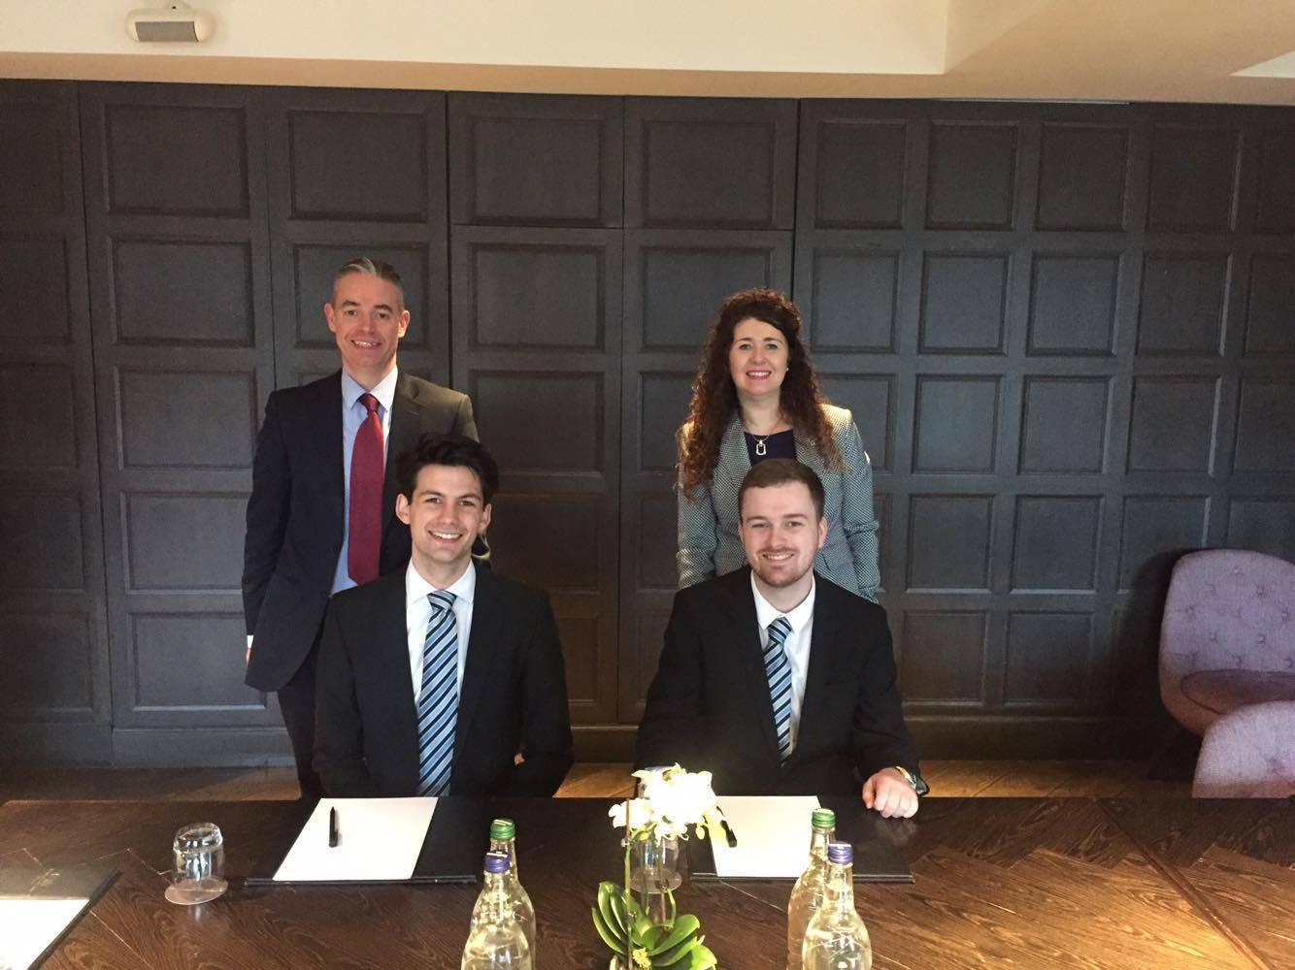
Apprenticeship Feedback & Success
In 2018 Joe our AIH Apprentice won HIT Scotland “Regional Rising Star”
MA’s & AIH continue to be positive Ambassadors promoting Apprenticeships
Up-skilling through an MA has led to promotion
L&D Team & Management Support / Mentors
15 participants on AIH – 8 who have graduated
25 staff achieved their MA with a further 47 in progress.

Slide 35
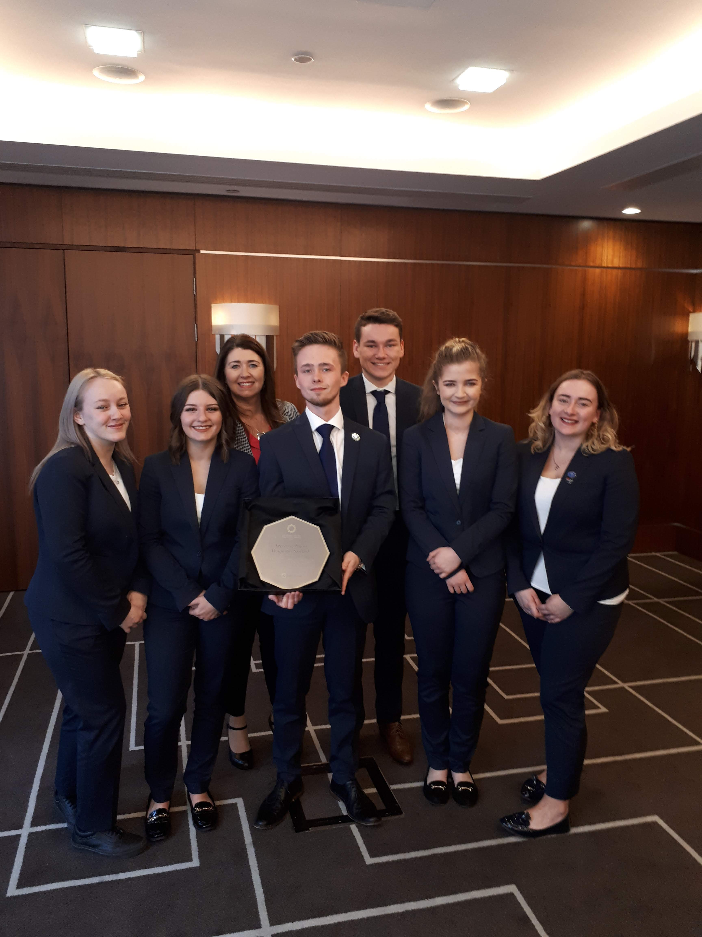
Apprenticeship Feedback & Success
Quotes
“I feel that I have become more productive and have a better understanding of my current role and potential career.”
“When I first started I did not have any experience in hospitality & to where I am now my skills & talent have become a lot stronger. I can do things I never thought I would be able to & that makes me proud of how far I have come along.”
“It helped me with building up more confidence and have a better understanding on how to do my work i.e. helping the guests and have the appropriate way to speak to customers.”

Slide 36
Thank You

Slide 37

Margo Findlay
Working with our employers
21st May 2019

Slide 38
Our agenda
About Training Matters
Why and how AHS started
Our Partnership
The apprenticeship programme
Partner agreement
The Ambassadors
The future

Slide 39











Notes:
Start off by saying how we will work together today. There are 2 points (at least within the presentation ) to discuss and question with the focus on clarifying what you want

Slide 40

How and why?
As so often with all good ideas…….a discussion…
4 original partners and TM
vision to create something better
partners

Slide 41
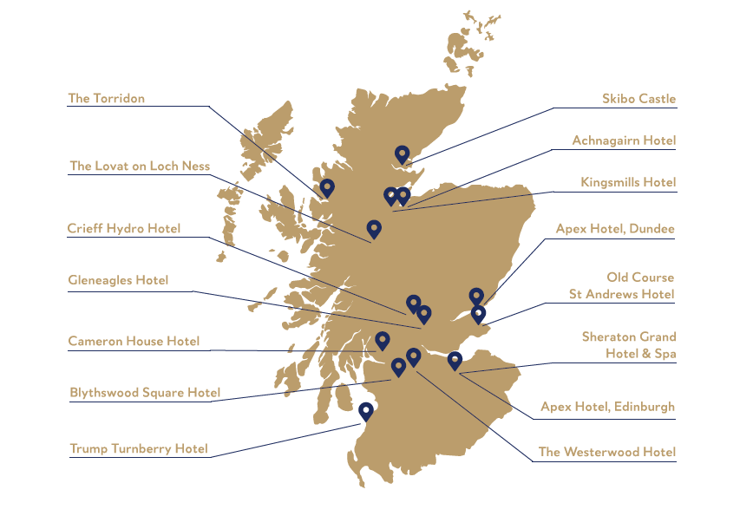
Our Partners

Slide 42
Our Partnership
Started in 2014 as a partnership between 4 hotels and one training partner and now 16 hotel employers
Developed to offer an alternative to academic routes
Industry-led, unique programme offering the opportunity to earn while you learn
A nationwide programme with online learning for all candidates

Slide 43

The programme
Employers involved actively in the development and enhancement of the programme
2 years -4 departments-specialist 3rd year
Workshops, industry leading guest speakers and masterclasses.
Communication platforms /on line learning
Support from department managers, work based assessors, coach and fellow apprentices

Slide 44
The partners
Partners decide on
Format
Design
Delivery
Wage and conditions
Work based assessors
Culture ,behaviours and rules

Slide 45

Board meetings
Partner meetings
Handover events
Recruitment and retention
Communication tools
All of this drives quality and consensus to excellence

Slide 46
Partner agreement content
Partner contribution
Time commitment
Rules and relationships
Travel and expenses
Partners meetings,handovers and learning journeys/masterclasses

Slide 47
Our ambassadors
Enthusiastic
Social media savvy
Their growth, development and professionalism
Partnership of the future
Spreading the word

Slide 48

The team

Slide 49
The Future
Adaptability
Flexibility
Open to Change
Partnership
Meta Skills
Be the best!

Slide 50


Questions ?

Slide 51

Welcome
Anneliese Archibald
Xtra-Mile.com
Managing Director/
Assessor

Slide 52
Xtra-Mile.com
      Approved to offer Modern Apprenticeships in hospitality
      Approached by SDS to work with ethnic restaurants
      Finally made contact with Sikh Sanjog and Punjabi Junction

Slide 53
Sikh Sanjog
      Sanjog means ‘link’ so the organisation was set up as the link for the Sikh community
      Went on to set up Punjabi Junction - a café where women could develop their skills
      Employer knew about apprenticeships but had not realised they existed in the hospitality industry

Slide 54
First Steps
      To meet the women who had shown interest
      To go through the programme spending time to reassure and explain
      Being honest and up front about potential issues including language barriers and being able to achieve the knowledge & understanding

Slide 55
Hospitality Services
        Of the 6 women who had shown interest 4 signed up
        Early on I was identified as the assessor
        Already competent in their jobs
        Knowledge questions completed as a team
        Flexible approach to the units chosen

Slide 56
Outcome
    After 9 months of assessing all 4 achieved their MA in Hospitality Services
    Certificates presented at Sikh Sanjog AGM and during MA week by Kezia Dugdale MSP
    Took part in cookery class during MA week run by the 2 new candidates who signed up

Slide 57
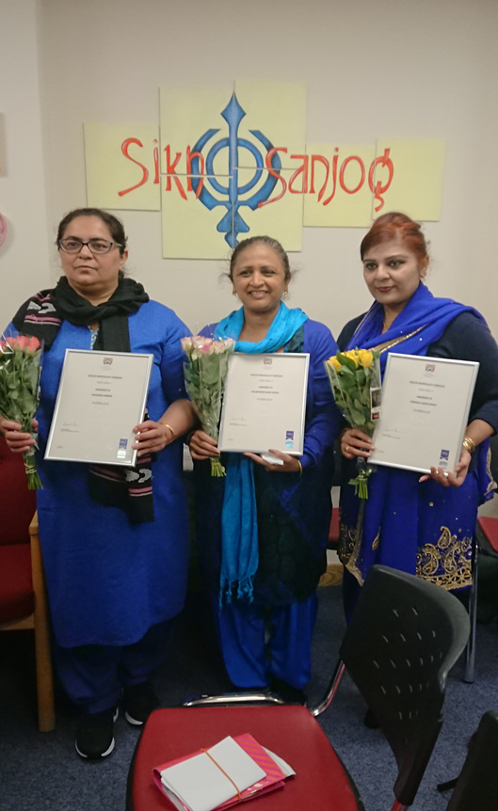
Certificate Presentation

Slide 58
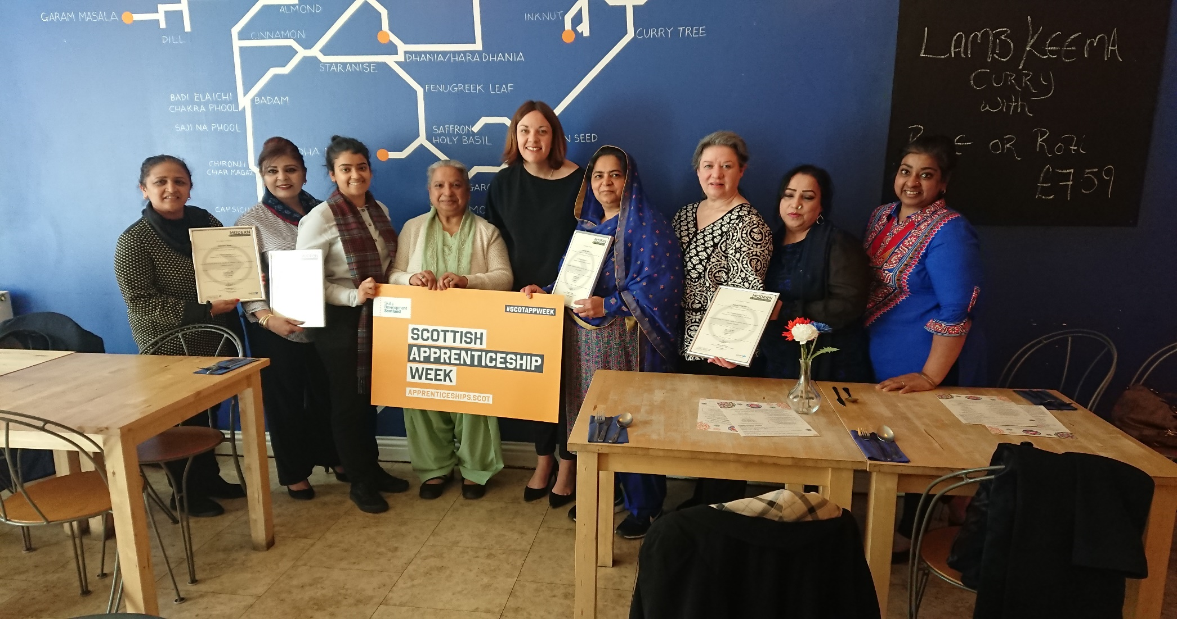
MA Week 2019

Slide 59
Challenges
          Very different culture
          Language barriers
          Part time and shift work
          Assessors skills
          Funding
          Environment

Slide 60
Positives
          Fantastic relationship
          Made to feel part of the team
          Presentation of the certificates
          Changed the minds of those not engaged
          Cookery class
          My skills developed

Slide 61
Positives
        Positive experience for each person
        Developed confidence in their ability
        Learning from the KQ
        Now willing for external support to identify other work opportunities
        SVQ certificate and MA certificate
        Continuation with their development
        Taking responsibility for their own future

Slide 62
The Future
        Work with more similar groups
        Identify a part time person who could work with us from the community
        Train them to achieve their L&D9DI

